Slide 1
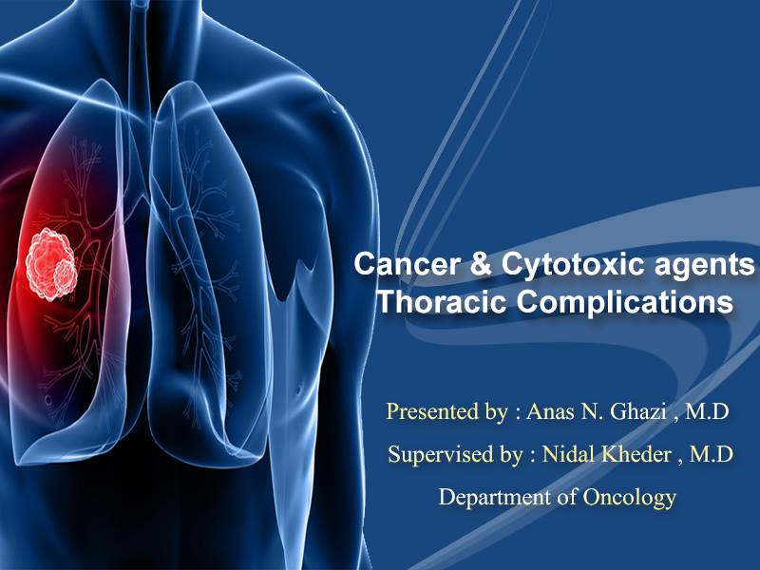

Slide 2


Slide 3
Topics :
1- Pulmonary metastases
2- malignant pleural effusions
3- Superior vena cava obstruction
4- Chemotherapy lung
5- Radiation-induced lung disease (RILD)
6- pericardial effusion ( +metastases )
7- Pulmonary embolism ( VTE )
8- Cardiomyopathy

Slide 4
Lung cancer
:Signs of Unresectable NSCLC
1- Distant metastases including to the opposite lung ( Exceptions : Solitary adrenal or hepatic -------→ Evaluation )
2- Persistent pleural effusion with positive malignant cells ( Exception: Transudative without malignant cells )
3- SVC obstruction
4- Involvement of the following : RL nerve , supraclavicular or neck LNs , contralateral mediastinal LNs ,Tracheal wall , Main-stem bronchus < 2 cm from the carina

Slide 5
Resectable but not operable
Age and mental illness
Cardiac status ( Uncontrolled HF , uncontrolled arrhythmia , recent MI within the past 6 months)
Pulmonary status ( including routine PFTs )

Slide 6
Post-op management
- ICU admission or high dependency unit with adequate monitoring of oxygen saturation , CVP , ECG , BP and RR
- Adequate analgesia ( now , thoracic epidural analgesia is routine )
alternatives are : IV opiates ( PCA )
post op ventilation is no longer required ( Nebulizer is adequate + Bronchodilator + chest physiotherapy )

Slide 7
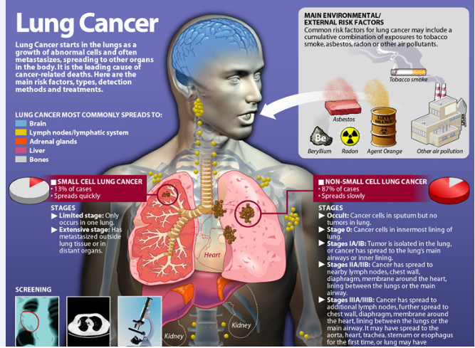

Slide 8
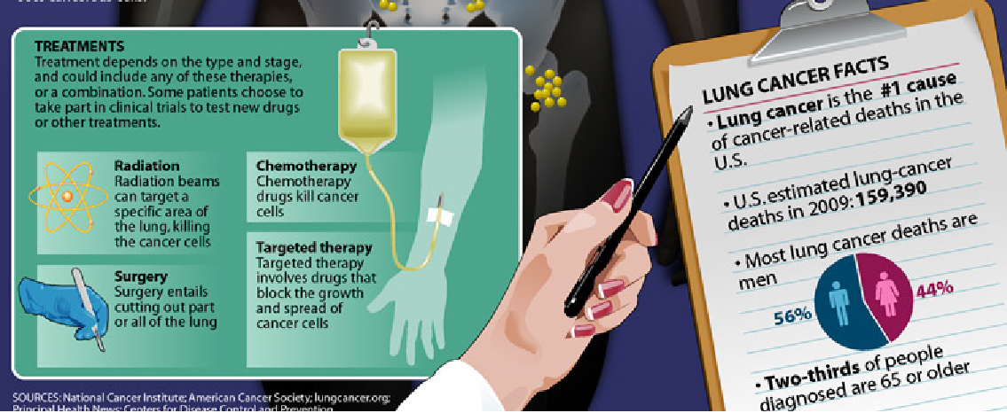

Slide 9

Value-based cancer care
- The cost of cancer care has been growing rapidly, though it accounts for a relatively small portion of the overall US health care expenditure , it is expected to increase from 125$ billion in 2010 to 158$ billion in 2020

Slide 10
Value-based cancer care
- The cost of cancer drugs accounts only 5-20 % of the total costs of cancer care ( although some newer drugs cost as much as 100,000 $ per month

Slide 11
Superior Vena cava obstruction
Etiology:
1- Malignant causes ( 70%) : NSCLC accounts for 50% of cases and SCLC for 25% . SVC obstruction develops in about 3% of patients with lung cancer .
Other malignancies : NHL ( Intermediate- and high-grade) , thymoma , mediastinal germ cell tumors , mesothelioma , solid tumors with mediastinal LN metastases ( e.g. Breast cancer )

Slide 12
Etiology: ( cont.)
2- Benign causes ( 30% )
- Mediastinal fibrosis , Infections particularly Histoplasma capsulatum .
Other infections : T.B , actinomycosis, aspergillosis , balstomycosis
- After RT to the mediastinum
3-Thrombosis of the SVC : related to the presence of CVC ( long-term CVC ) , Polycythemia vera and Behçet syndrome.

Slide 13
Diagnosis:
Symptoms: Shortness of breath (50%) , neck and facial swelling (40%) , swelling of trunk and upper extremities (30%) in a patient with mediastinal mass
Other symptoms: a sense of chocking , fullness in the head , headache , back pain ( if associated with spinal cord compression )
Signs: Thoracic and neck veins distension, edema of the face , plethora of the face , Horner’s syndrome and paralysis of the vocal folds in 3% , dilated retinal veins on fundoscopic examination

Slide 14
SVC obstruction:
Imaging studies
- CXR : mediastinal mass ( in the right superior mediastinum in 75% of cases ) + hilar lymphadenopathy + pleural effusion in 25%
- Contrast-enhanced CT scan: which shows:
( area of obstruction , degree of obstruction , presence of collateral veins , absence of contrast in the central venous structure )
- Superior venogram : Contrast-enhanced CT scan with multidetector technology can be of value in planning stenting procedure. ( rarely used )
- If symptoms associated with back pain , Horner’s syndrome , ask for MRI of the thoracic and upper thoracic vertebrae

Slide 15
Histopathlogical diagnosis
- Tissue diagnosis is mandatory before any intervention to identify the malignancy and to start the appropriate chemotherapeutic regimen :
- After RT , tissue diagnosis is difficult because of radiotherapy-induced necrosis
- Steroid therapy can alter the diagnosis if the underlying disorder is lymphoma
( sputum cytology , Bronchoscopy , LN biopsy , Transthoracic FNA , VATS , Mediastinoscopy , BM biopsy )

Slide 16
Histopathlogical diagnosis ( cont.)
- Sputum Cytology : is +ve in 67% of cases of lung cancer cases
- Bronchoscopy : is +ve in 60% of NSCLC cases , and should be done by experienced physician ( to avoid serious complications )
- LN biopsy if palpable ( +ve in 85% ) , and if non-palpable ( +ve in 30%)
- VATS is preferred for biopsy and hemorrhage control
- Mediastinocopy
- BM biopsy should be done if the diagnosis is lymphoma or in patients with NSCLC associated with cytopenia or leucoerythroblastic picture of peripheral blood film

Slide 17
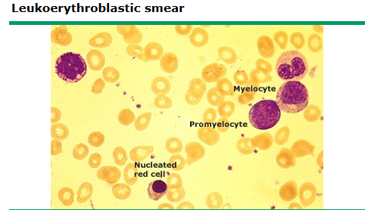
(Leucoerythroblastic film)

Slide 18
BM biopsy (Leucoerythroblastic film)
- Contains nucleated RBCs , tear drops , myelocytes , other primitive granulocytes
- Seen in BM invasion by tumors , fibrosis , granuloma formation , anorexia , hemolysis
- It is an indication for BM biopsy

Slide 19
Treatment of SVC syndrome
- This is not a life-threatening condition
- Accurate tissue diagnosis is essential before starting the treatment.
- Emergency treatment is indicated only if associated with cerebral dysfunction, decreased cardiac output or the presence of airway obstruction
- Evidence-based guidelines for management of SVC obstruction are lacking.

Slide 20
Treatment interventions:
1- Endovascular stent: for symptomatic SVC obstruction +short term anticoagulation ( warfarin 1 mg daily to maintain INR<1.6 + Clopidogrel 75 mg daily + ASA for 3 months after
stent placement .
2- RT is indicated in symptomatic SVC obstruction associated with NSCLC or SCLC and associated with relief of symptoms within 2 weeks in 70% of patients.
3- Chemotherapy for SCLC , NSCLC , Lymphoma , GCT , breast cancer . Many of the patients can achieve long-term remission
4- Supportive care for cerebral dysfunction , airway obstruction

Slide 21
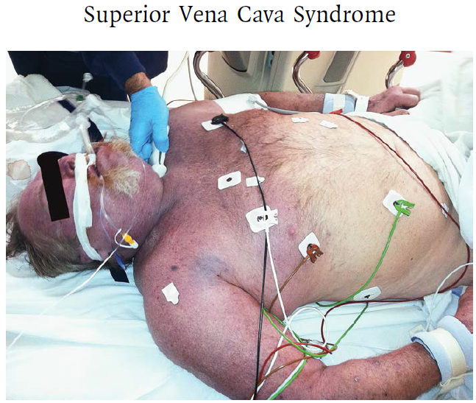

Slide 22
Anthracycline-induced cardiomyopathy
- Anthracyclines.
- Mechanism.
- Types of Cardiac toxicity.
- Risk Factors
- Evaluation and Management.

Slide 23
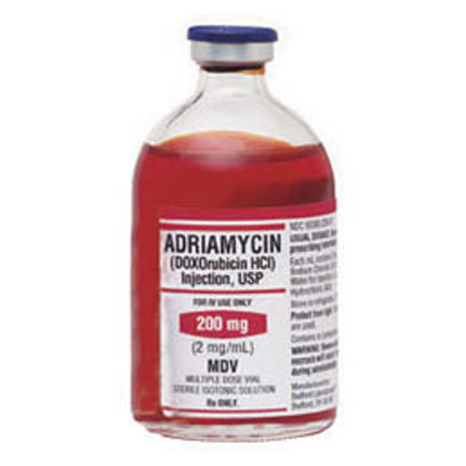
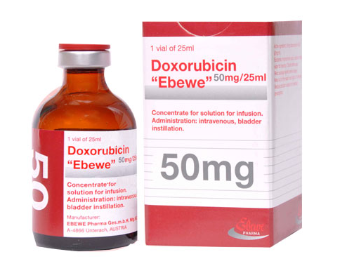
Anthracyclines

Slide 24
Anthracycline-induced cardiomyopathy
- A major dose-limiting toxicity of Anthracyclines is cardiomyopathy.
- Anthracyclines are : Doxorubicin , Liposomal doxorubicin , Idarubicin , daunorubicin and Epirubicin
- Nonanthracycline chemotherapy induced cardiomyopathy : 5-FU , Trastuzumab , Bevacizumab , Alemtuzumab , Rituximab , Mitoxantrone ( anthraquinone ) , TKIs , Alkylating agents , Taxanes

Slide 25
Mechanism of Anthracycline-induced cardiomyopathy
- Is poorly understood.
- Is thought to be caused by generation of oxygen free radicals an increase in oxidative stress, which cause lipid peroxidation of membranes, leading to vacuolation, irreversible damage, and myocyte replacement by fibrous tissue
- more recent data implicate the topoisomerase-II (Top2) enzyme. In cancer cells, doxorubicin’s cellular target is the enzyme Top2 .Doxorubicin binds both Top2 and DNA to form the ternary Top2-doxorubicin-DNA cleavage complex, which triggers cell death.

Slide 26
Types of Topoisomerase:
- There are two Top2 enzymes, Top2-alpha and Top2-beta. Top2-alpha is a known marker of cellular proliferation and overexpressed in tumors but not in quiescent tissues; it is thought to represent the molecular basis of doxorubicin antitumor activity
- Adult mammalian cardiomyocytes express Top2-beta, but not alpha, However doxorubicin also interacts with Top2-beta, and the Top2-beta-doxorubicin-DNA complex can induce DNA double strand breaks, leading to cell death
This hypothesis is supported by murine studies cardiomyocyte-specific deletion of the gene Top2b (which encodes the Top2-beta enzyme) protects cardiomyocytes from doxorubicin-induced DNA double strand breaks

Slide 27
Risk factors
1- The strongest predictor is the cumulative dose
2-age at the time of drug exposure ( Age > 60 years carries high risk)
3- pre-existing heart disease (including coronary artery disease, hypertension, peripheral vascular disease, diabetes)
4- concomitant administration of other cardiotoxic chemotherapeutic agents particularly Paclitaxel and Trastuzumab
5- concurrent or prior chest irradiation (e.g. Left-sided breast cancer)

Slide 28
Cumulative dose:
-The overall incidence of congestive HF related to doxorubicin is 3-4%
- The incidence is 1-2 % for total dose of doxorubicin 300mg/m² , 3-5% for total dose of 400mg/m²
5%-8% when the total dose is 450mg/m²
6-20% when the total dose is 500mg/m²
25% for total doses >550mg/m²

Slide 29
Evaluation of Cardiac injury:
-Symptoms , physical findings and ECG abnormalities occur too late
- ECG : Reduction of the QRS voltage by 30%
- Endomyocardial biopsy is the specific method to diagnose Anthracycline-induced cardiac toxicity , but it is invasive , associated with complications and need an experts.
- Echocardiography and Multigated radionuclide angiography (MUGA) are non-invasive methods. They should be obtained at baseline ( High-risk patients ) .
Suggested protocol to repeat the echocardiogram : at 300mg/m² , then at 450mg/m² then at each 100mg/m² thereafter .
MUGA is preferred for patients with poor echocardiographic window ( e.g. Morbid obesity )

Slide 30
Types of Cardiac toxicity :
Acute Cardiotoxicity:
-It is uncommon and is unrelated to the total dose
-Manifestations include : Arrhythmia, atrial fibrillation , heart block , nonspecific ST-T wave changes , and the echocardiogram is normal . Usually within 1-2 days
Chronic cardiomyopathy:
Is the result of permanent damage to the cardiomyocytes , it is irreversible. It is related to the total dose and method of administration . Heart failure can develops 2 months of the last dose up to 6 months and even years

Slide 31
Prevention
- The cumulative lifetime doses should be <550mg/m² for doxorubicin and <800-900 mg/m² for epirubicin
- Active surveillance during therapy : by serial echocardiography . The Anthracyclines should be discontinued if the patient develops clinical signs of CHF or if the LVEF decreases :
to 45%
to >10% to below the lower limit of the normal
by > 20% from any level
- Infusion rate : continuous infusion is associated with lower risk of cardiac toxicity
In a meta-analysis of four randomized trials comparing infusional versus bolus schedules of epirubicin or doxorubicin, bolus administration significantly increased the risk of clinical cardiotoxicity

Slide 32
Prevention ( cont.)
Liposomal doxorubicin : approved for many malignancies including ovarian carcinoma , breast cancer , myeloma and Kaposi sarcoma
- Beta-blockers and ACEIs
Animal studies have suggested that concurrent administration of the beta blocker carvidelol may protect against the cardiotoxicity of Anthracyclines
Angiotensin converting enzyme (ACE) inhibitors and Angiotensin II receptor blockers (ARBs) have been shown to improve outcomes and slow disease progression in patients with left ventricular systolic dysfunction

Slide 33
Prevention ( cont.)
Dexrazoxane ( Zinecard)
- It is an EDTA-like chelator that may prevent anthracycline damage by binding to iron that is released from intracellular storage secondary to lipid peroxidation
-the use of dexrazoxane is generally deferred until after cumulative doses of 300 mg/m ² are reached.

Slide 34
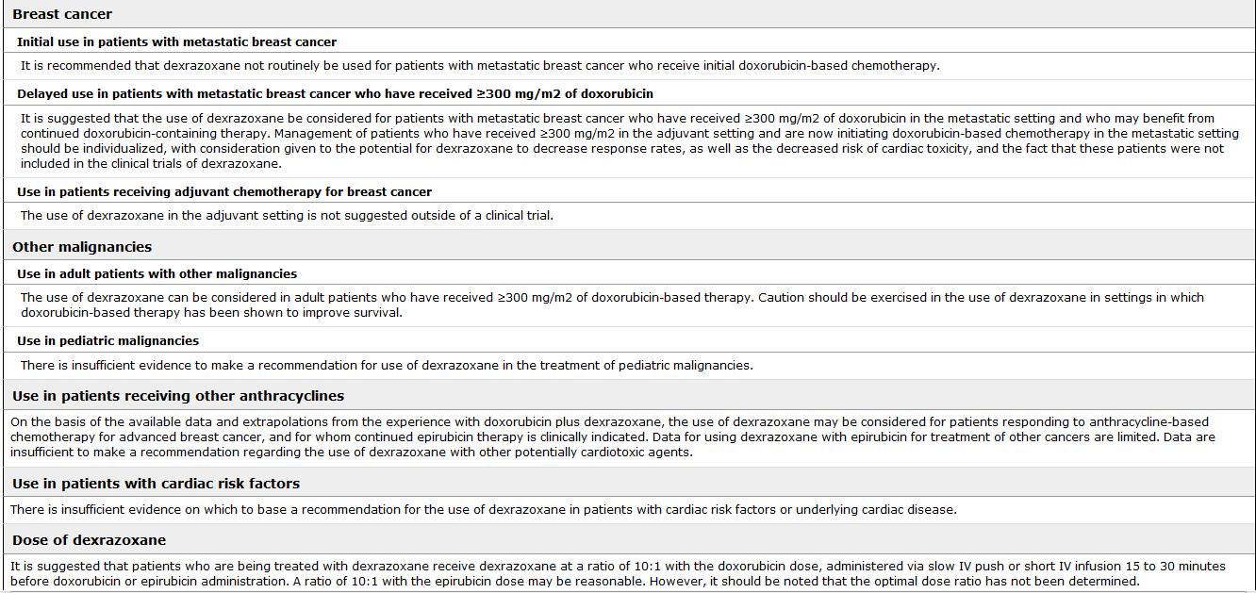

Slide 35
Non-anthracycline-induced cardiac toxicity
- 5-FU : ischemic cardiac toxicity ( Coronary artery vasospasm , which is reversible when the drug is stopped . Capcitabine is also associated with ischemic cardiac events in3-9% of patients
Other medications associated with ischemia : Paclitaxel and vinblastine
- Trastuzumab : decreased LVEF and less commonly HF
- Bevacizumab : angina , MI , Hypertension , stroke , HF and arterial thromboembolic events
- Imatinib and Lapatinib : Decreased LVEF in 2-3%
- Nioltinib and dasatinib : Prolongation of QT interval
- Sorafenib and sunitinib : decreased LVEF in 20% of patients and clinical CHF in 10%
- Vendatenib : Prolonged QT interval and Torsade de pointes

Slide 36
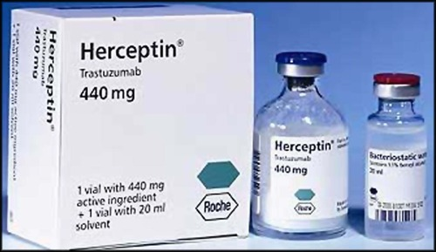
Trastuzumab

Slide 37
Non-anthracycline-induced cardiac toxicity
- Cyclophosphamide : can potentiate doxorubicin-induced cardiomyopathy and when given in high doses can cause myocardial necrosis and hemorrhagic myocarditis
- Other agents : Paclitaxel ( asymptomatic bradycardia and conductive defects , HF .
- Mitoxantrone : decreased LVEF in 3-6% and HF in 1-3%

Slide 38
Radiation-induce lung disease (RILD)
- Patients who undergo RT to the thorax or neck for malignancy are at risk for acute ( or subacute ) pneumonitis or fibrosis especially when the patients receive radiosensitizing agents ( Gemcitabine , bleomycin ) .
- The frequency of radiation-induced pneumonitis is increased by concomitant endocrine therapy for patients with breast cancer.
- Radiation-recall pneumonitis : occurs when certain antineoplastic agents are given to a patient who received prior RT ( Gemcitabine , VP-16 , doxorubicin , Paclitaxel , gefetinib )
- Acute radiation pneumonitis : 3-10weeks after completion of RT with acute alveolar infiltrates ( Corticosteroids +/- immunosuppressive agents , don’t use antibiotics )

Slide 39
Questions
And Answers

Slide 40
Which of the following is not a proposed mechanism for cardiotoxicity from Anthracyclines :
a) Enhanced catalysis of oxidation-reduction reactions
b) Increased susceptibility to P-glycoprotein
c) Generation of reactive oxygen species
d) Peroxidation of myocardial lipids

Slide 41
Regarding early detection of cardiac dysfunction , which is not used :
a) ECG
b) Measurement of the LVEF by the echocardiography
c) Serum cardiac troponin T levels
d) Serum brain natriuretic peptides levels ( BNP )

Slide 42
Pulmonary metastases:
- The lungs are the most frequent site of distant metastases.
- Discrete metastatic lung nodules : Malignant melanoma , soft tissue sarcoma , bone sarcoma , trophoblastic
tumors , RCC , CRC and thyroid cancers .
- Tumors of the breasts , pancreas , stomach and liver: Direct lymphatic spread ----→ mediastinal LNs , interstitial infiltration

Slide 43
Pleural effusion
- A sign of advanced disease ( mean survival 3 months from the time of diagnosis )
- Pleural fluid should be assayed for protein, LDH , pH , glucose , cell count and cytology + Culture
- Light’s Criteria for the exudative pleural effusion:
a) Pleural fluid/serum ratio for protein >0.5
b) Pleural fluid protein >2.9 gm/dL
c) Pleural fluid/serum LDH ratio >0.6
d) Pleural fluid LDH > 0.45
e) Pleural fluid cholesterol >45 mg/dL

Slide 44
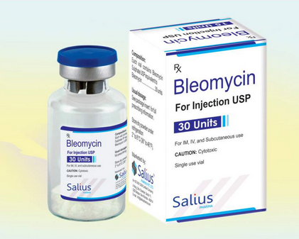
Bleomycin

Slide 45
Chemotherapy lung
- Direct cytotoxic effects
- Risk factors that promote chemotherapy-induced lung damage :
________________________________
1- Advanced age
2- History of smoking
3- prior chronic lung disease ( IPF )
4- renal dysfunction
5- High doses of inspired Oxygen ( Anesthesia )

Slide 46
Chemotherapy Lung
Onset | Dose dependant | Drug
Months | >400 mg | Bleomycin
Usually 4 years | >500 mg | Busulfan
3 months-3 years | Possible | Cyclophosphamide
2-21 days ( ARDS) | Yes | HD Ara-C
----------- | No | Etoposide (VP-16)
Few weeks | No | Fludarabine
 | No | Gemcitabine
2 months -17 years | >1500 mg/m² | Carmustine
Days-weeks | No | Paclitaxel, Docetaxel
2-6 weeks | Possible | Mitomycin C
2 weeks – 1 year | No | MTX

Slide 47


