Slide 1
Modern Strategies For Basal Insulin
Dr . Mouna Dakar

Slide 2
Role of Basal Insulin

Slide 3
Clinical Recommendations for Use of Basal Insulin: 2017 AACE/ACE

Slide 5
Basal Insulin Treatment in T2D

Slide 8
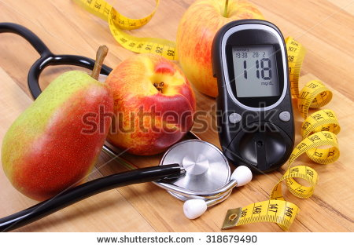

Slide 9
Basal Insulins

Slide 11
Weight Gain With Insulin Glargine and Insulin Detemir in T2DM

Slide 20
A New, FDA-approved Novel Long-acting Insulin Formulation

Slide 21
Glargine U-300

Slide 23
U300 Formulation of Insulin Glargine

Slide 24
Insulin Glargine U-300

Slide 25
Glargine U300 vs U100 Pharmacodynamics

Slide 26
EDITION Program: Glargine U300 vs U100

Slide 28
EDITION I-III (Meta-analysis) Nocturnal Hypoglycemia (Rates)

Slide 30
EDITION 4: Weight Change With U300 vs U100 in T1DM

Slide 31
Glargine U300

Slide 32
Concentrated Insulin Glargine U300

Slide 33
EDITION I-III (Meta-analysis) Basal Insulin Doses

Slide 34
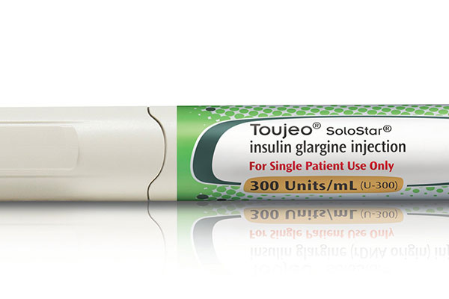

Slide 35
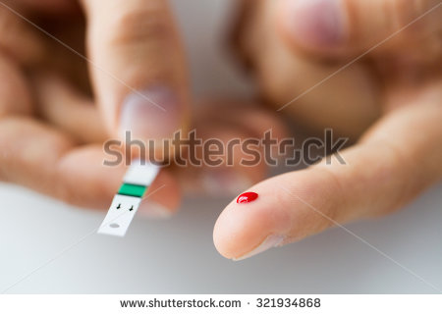

Slide 36
PEGylated Lispro (Peglispro)

Slide 39
Peglispro Single-dose Pharmacodynamics in Healthy Patients

Slide 40
Insulin PEGlispro* A Novel, Polyethylene Glycolylated Insulin

Slide 41
Peglispro* vs Glargine: Effects on HbA_{1c} in Pooled Analysis of Data From IMAGINE Trials 1-5

Slide 42
IMAGINE-3 and -5: HbA1c

Slide 43
IMAGINE-3 and -5: Body Weight

Slide 44
Peglispro* vs Glargine: Hypoglycemia Rates in Pooled Analysis Data From IMAGINE Trials 1-5

Slide 45
IMAGINE-3 and -5: Alanine Aminotransferase

Slide 46
IMAGINE-3 and -5: Triglycerides

Slide 47
IMAGINE-3 and -5: Liver Fat Content

Slide 48
Peglispro (BIL)*

Slide 50
Insulin Degludec

Slide 51
Insulin Degludec

Slide 52
Insulin Degludec

Slide 53
Insulin Degludec: Duration of Action (0.6 U/kg dose) Smoothed BG-profiles of a 42h Clamp Study

Slide 54
Action Profile of Newer Basal Insulins

Slide 55
Effect of Insulin Degludec on Glycemic Control

Slide 56
Lower Risk of Nocturnal Hypoglycemia With Insulin Degludec vs Insulin Glargine

Slide 57
BEGIN Once Long: Degludec vs Glargine Body Weight Outcomes in T2DM at 52 Weeks

Slide 58
SWITCH 1 Study Glargine U100 vs Degludec in T1D

Slide 59
SWITCH 2 Study Glargine U100 vs Degludec in T2D

Slide 60
Degludec U200 BEGIN Trials

Slide 62
Degludec Variable Dosing† vs Glargine U100 or Degludec Dosed Regularly*

Slide 67
Ultra-Long-Acting Insulin Degludec U100 and U200

Slide 68
Tresiba® – A new basal insulin for adult patients with type 1 and type 2 diabetes

Slide 69
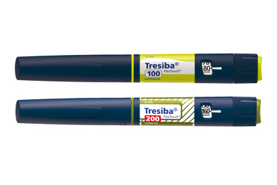

Slide 70
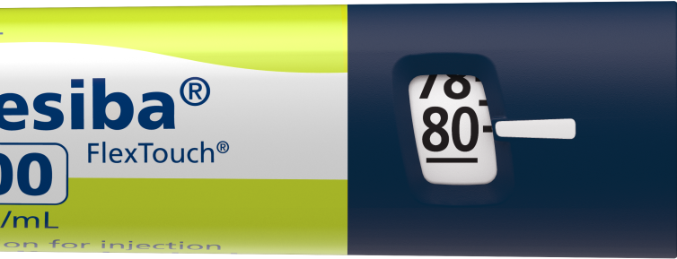
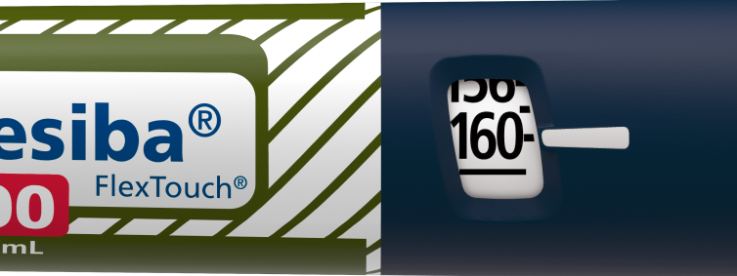
Insulin degludec is available in two strengths, what you see is what you get
U100 pen
Up to 80U in 1U increments
U200 pen
Up to 160U in 2U increments
The insulin degludec U200 pen:
Ability to deliver up to 160U in one injection
No dose conversion if transferring from U100 (what you see is what you get)
Provides a 50% lower injection volume for patients requiring higher insulin doses
Tresiba® SmPC, Novo Nordisk, January 2013

Slide 73
The Role of Basal Insulin

Slide 74
Basal Insulin Plus GLP-1 RA—Free Combination

Slide 75
Basal Insulin/GLP-1 RA—Fixed-Ratio Combination

Slide 76
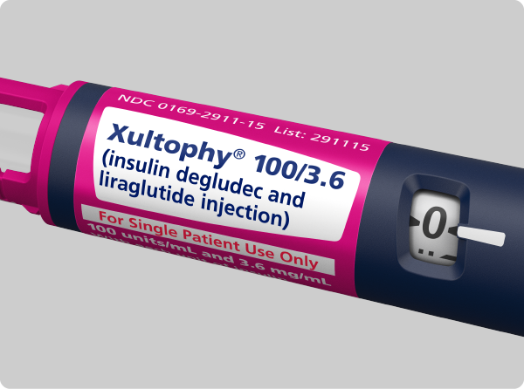

Slide 78
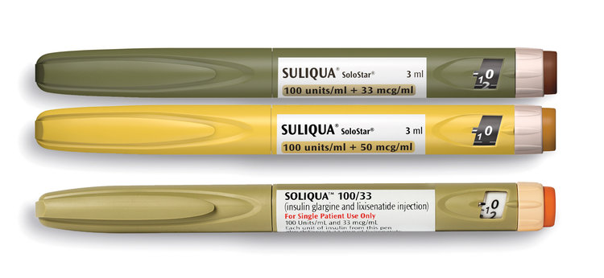

Slide 79
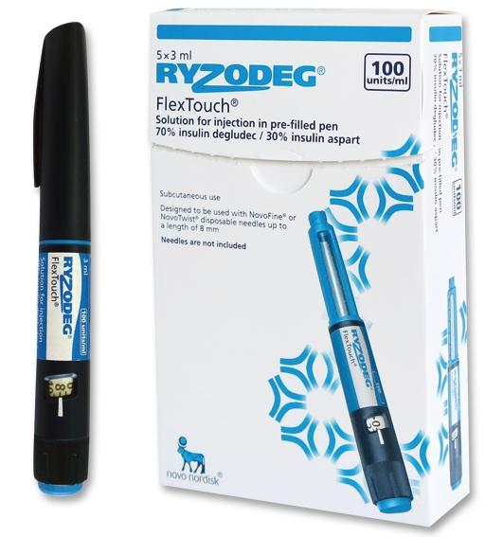

Slide 80
DPP- 4 Inhibitors as Add-ons to Basal Insulin

Slide 82
Basal Insulin in Combination With a GLP-1 RA or SGLT2i

Slide 84
Patient Case: Shawn

Slide 85
A Practical Insulin Titration Scheme

Slide 86
Reducing Risk of Hypoglycemia

Slide 87
Patient Case (cont)

Slide 91
Thank You
Notes:
4/2/2018 11:27 PM
DRAFT MannKind Corporation
91
DRAFT MannKind Corporation
91
In summary, expectedly some patients experienced an increase in antibody levels during AFREZZA treatment, which dropped after AFREZZA was discontinued. However, we did not find any association between antibody levels and clinical outcomes, such as
HbA1c
Hypoglycemia
Insulin dose
Serious and non-serious AEs
Changes in pulmonary function
Discontinuations
DRAFTMannKind Corporation
91

