Slide 2
Introduction
A 59-year-old male presents to the physician with a chief complaint of bloody urine of 2 months duration. He admits an intermittent right flank pain , the last one was of more than 1 year. Urine analysis shows 10-12 red blood cells in the urine. He denies taking any anticoagulants. Which of the following is the best initial step in his management ?
A) Cystoscopy
b) Observation with next follow-up within 1 month
c) Urinary tract US.
d) Urine culture and sensitivity
e) PSA f) Coagulation studies ( PT and aPTT )

Slide 3
Introduction
A 59-year-old male presents to the physician with a chief complaint of bloody urine of 2 months duration. He admits an intermittent right flank pain , the last one was of more than 1 year. Urine analysis shows 10-12 red blood cells in the urine. He denies taking any anticoagulants. Which of the following is the best initial step in his management ?
A) Cystoscopy
b) Observation with next follow-up within 1 month
c) Urinary tract US.
d) Urine culture and sensitivity
e) PSA f) Coagulation studies ( PT and aPTT )

Slide 4
Epidemiology
-Urinary bladder cancers constitute 4.5% of all cancers in the US. - 2.5 times more frequent in men than in women.
-Most frequent in the industrial northeastern cities.
-The average age of onset is the 6th-7th decade. - The incidence doubles in men in >75 years of age

Slide 5
Risk Factors
1- Smoking :is the most important risk factor for bladder cancer. Smokers are at least 3 times as likely to get bladder cancer as nonsmokers. Smoking causes about half of all bladder cancers in both men and women.
( 20% cases of bladder cancer ) :2- Workplace exposures
Chemicals called aromatic amines, such as benzidine and beta-naphthylamine, which are sometimes used in the dye industry, can cause bladder cancer. Workers in other industries that use certain organic chemicals also may have a higher risk of bladder cancer. Industries carrying higher risks include makers of rubber, leather, textiles, and paint products as well as printing companies. Other workers with an increased risk of developing bladder cancer include painters, machinists, printers, hairdressers and truck drivers

Slide 6
Risk Factors ( cont.)
3- Certain medicines or herbal supplements
Pioglitazone (Actos) for more than one year may be linked with an increased risk of bladder cancer.( according to US FDA ) Dietary supplements containing aristolochic acid (mainly in herbs from the Aristolochia family) have been linked with an increased risk of urothelial cancers, including bladder cancer. 4- Arsenic in drinking water 5- Age , Gender and race 6- Chronic bladder irritation and infections ( Schistosoma haematobium ) : Squamous cell carcinoma 7- Birth defects : Persistent urachus ( Adenocarcinoma ) and exstrophy
increases the risk by fourfold:8- Pelvic irradiation
9- Drugs : Cyclophosphamide

Slide 7
Patent Urachus

Slide 8
Bladder Exstrophy

Slide 9
Risk Factors ( cont.)
10-Genetic factors : gene abnormalities that result in perturbations in cell cycle regulatory process
- Chromosome deletions or duplications
- Proto-oncogene expression
- Tumor suppressor gene mutation
- Abnormalities of the specific cell cycle regulatory proteins
- In invasive-bladder cancers : deletion of part or all of the chromosome 9 and alterations in the gene coding for FGFR3

Slide 10
Risk Factors ( cont.)
- Proto-oncogene associated with bladder cancer :
RAS and p21 proteins.
- Genetic abnormalities associated with CIS are Rb gene , p53 and phosphate and tensin homolog (PTEN). - Abnormalities associated with MIBC : p53 genes , Rb gene ( Tumor suppressor genes ) EGF , Ki-67 , Cyclin D-1 , Metalloproteinase ( MMP ) and Tissue inhibition of metalloproteinase ( TIMP )

Slide 11
Pathology
- Transitional cell carcinoma ( 90% )
- Squamous cell carcinoma 8% - Rare types : Adenocarcinoma , sarcoma , Lymphoma , carcinoid tumors

Slide 12
Diagnosis ( Symptoms , signs and investigations )
- Hematuria is the presenting feature in 90% of patients.
- Bladder irritability in 25% of patients ( hesitancy , urgency ,dysuria, frequency and post voiding pelvic discomfort.
- Flank pain , pelvic pain
- Edema of lower limbs or genitalia because of lymphatic obstruction.
- Bimanual examination is mandatory each time the patient is put under GA or having cystoscopy ( to obtain information about local extension of the disease).

Slide 13
Guidelines for evaluation of Hematuria*
- Clinicians should refer all adult patients with gross hematuria, even if it is self-limited, for further urologic evaluation
- Clinicians should confirm heme-positive results of dipstick testing with microscopic urinalysis that demonstrates 3 or more erythrocytes per high-powered field before initiating further evaluation in all asymptomatic adults
- Clinicians should consider urology referral for cystoscopy and imaging in adults with microscopically confirmed hematuria in the absence of some
demonstrable benign cause
- Clinicians should pursue evaluation of hematuria even if the patient is receiving antiplatelet or anticoagulant therapy. __________________________________________________________________ *Clinical guideline on hematuria released by ACP , annals of internal medicine, 2015

Slide 14
Natural history
Bladder cancer is grouped into 3 main categories :
a)Non-muscularis propria invasive bladder cancer ( NMIBC ) b) Muscularis propria invasive bladder cancer ( MIBC ) c) Metastatic bladder cancer

Slide 15
Cystoscopy
- Is the cornerstone procedure for diagnosing bladder cancer . - Biopsy is performed at abnormal areas and randomly ( to look for CIS ) + Bimanual examination - Cystoscopy is indicated for patients with the following features: ==================================== a) Any gross or microscopic hematuria and a normal upper urinary tract imaging b) Unexplained or chronic lower urinary tract symptoms
c) Urine cytology that is suspicious for cancer
d) A history of bladder cancer

Slide 16
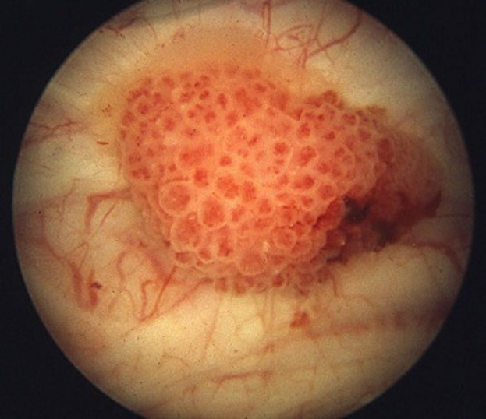

Slide 17
TURBT

Slide 19
Stage categories

Slide 20
CT urography
- The work-up for suspected bladder cancer includes urine cytology , cystoscopy and upper tract study - The preferred upper tract study is CT urography - CT scanning of the abdomen and pelvis that includes three phases : a non-contrast phase , an early postcontrast phase and pyelographic phase a) Non-contrast phase : Abnormal calcifications ( e.g. stones ) b) Early postcontrast phase : serve to discern renal lesions and to differentiate between lymph nodes and normal structures c) Pyelographic phase : to identify abnormal filling defects within the collecting system

Slide 21
Indications for CTU
1- Any patient with hematuria.
2- A part of bladder cancer work-up ( For staging ).
3- A history of bladder cancer
4- A positive urine cytology. _____________________________________________

Slide 22
Urine Cytology
- Detects 70% of bladder cancer that are subsequently diagnosed by cystoscopy.
- Should not be the primary method of diagnosis for patients suspected to have bladder cancer - It is useful for the following purposes : ==========================
a) Following patients with bladder cancer
b) Screening symptom-free individuals who are exposed to environmental carcinogens.
c) Evaluating patient with chronic irritative bladder symptoms before cystoscopy

Slide 23
CIS of the urinary bladder
- Flat intraepithelial tumor.
- A high-grade malignancy.
- Up to 80% of patients with CIS develop invasive bladder cancer within 10 years after diagnosis
- A lethal disease for most of patients

Slide 24
Prognostic factors
- Tumor stage
- Tumor grade - Presence of CIS
- SCC and Adenocarcinoma: Poor prognosis
- Invasion : Invasive cancer is associated with 50% MR in the 1st 18 months after diagnosis.
- Delaying cystectomy more than 12 weeks following the diagnosis of MIBC : poor survival

Slide 25
EORTC risk stratification in NMIBC
- To detect recurrence and progression in Ta and T1 patients.
- The EORTC scoring system is based on the six most significant clinical and pathological factors :
Number of tumors
Tumor size
Prior recurrence rate
T category
Presence of concurrent CIS
Tumor Grade ( WHO 1973 )

Slide 26
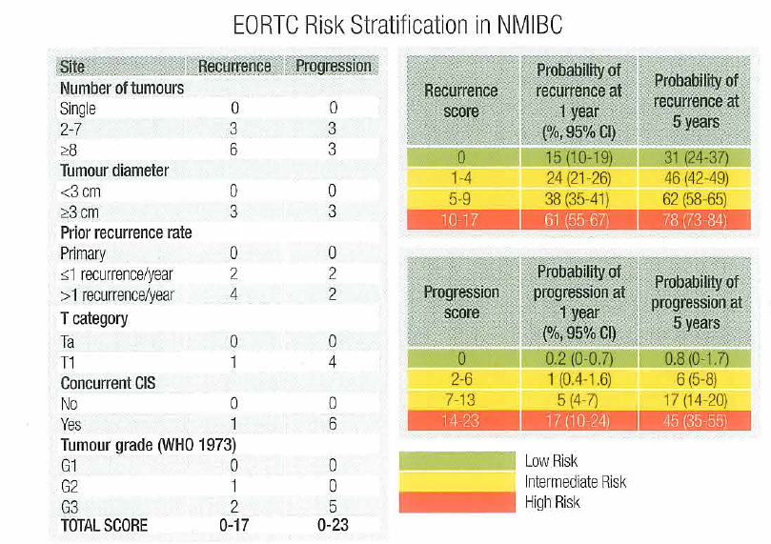

Slide 27
Low-risk patients
Should be treated with a single postoperative chemoinstillation within 24 hours after TURBT and have follow up cystoscopies. Chemotherapeutic agents: Thiotepa , Mitomycin C , Valrubicin and Doxorubicin

Slide 28
Intermediate-risk patients
- Should be offered intravesical adjuvant chemoinstillation with either Mitomycin C or BCG for a maximum of 12 months

Slide 29
High-risk patients
- Intravesical BCG immunotherapy
- In those with extensive T1 , GIII with associated CIS or BCG non-responders : Radical Cystectomy
Absolute contraindication to BCG instillation : 1- during the first 2 weeks after TUR
2- gross hematuria
3- after traumatic catheterization
4- Symptomatic UTIs systemic infection with BCG instillation affects 5% of patients and may lead to significant morbidity.

Slide 31
Management of MIBC
Radical Cystectomy
In men : removal of the bladder , prostate and seminal vesicles
In women : removal of the bladder , distal ureters , uterus , adnexa and cuff of the vagina ( en bloc ) + urinary diversion

Slide 32
Indications of radical cystectomy
1- T2-4a , Nx-No , Mo
2- CIS not responsive to intravesical therapy
3-High grade tumors not responsive to intravesical therapy ( BCG non-responders ) 4- High risk NMIBC ( other than CIS )
Indications for urethrectomy
1- +ve urethral margin
2- Bladder neck tumor
3- extensive stage T IVa tumor

Slide 33
PLND

Slide 34
Complications of RC
MR 1-3%
Blood loss
Rectal injury, ureterocutaneous fistula , small bowel fistula ( high mortality rate )
Infection
VTE
Impotence ( avoided by sparing the corporal nerves )

Slide 35
Complications of urinary diversion
UTI
Stenosis and fibrosis : obstructive nephropathy
Urinary calculi : Calcium stones are the most common
Acid base imbalance : Hyperchloremic metabolic acidosis is the most common

Slide 37
Neoadjuvant Chemotherapy
Neoadjuvant Cisplatin-based therapy is recommended in patients with T2-4a , N0 , M0 bladder cancer ( It improves the 5-year survival by 5-8% )
Regimens
DDMVAC for 3-4 cycles ( + G-CSF )
Cisplatin and Gemcitabine for 4 cycles
CMV for 3 cycles

Slide 39
Metastatic bladder cancer
Approximately 50% of patients with MIBC relapse after radical treatment : a) Distant metastases ( 70% )
B) Local recurrence ( 30% )
The most common site of metastases are LNs , lungs , liver , bone and the peritoneum.
In cases of progressive symptomatic metastatic bladder cancer , oncologic palliative therapy should be considered

Slide 40
Metastatic bladder cancer
GC and M-VAC are equal in efficacy , but there is less toxicity from GC therapy
Survival outcome depends on patient-related factors and comorbidities. The absence of visceral metastases improves the outcome .
Palliative one dose RT or fractionated RT are equally effective for pain relief or for decreasing pathological fractures.

Slide 41
Metastatic bladder cancer
Cisplatin combination therapy is the 1st line ( superior to monotherapy in terms of response and survival ) Fit patients : GFR more than 60 mL/min and PS 0-1 , Unfit patients : GFR less than 60 mL/min and PS 2 More than 50% of patients with metastatic bladder cancer are unfit for Cisplatin ..
Cisplatin Day 1 and Day 8
Or Cisplatin D1 and D2 or carboplatin ..

Slide 42
Second-line
Vinfluinine is the only approved 2nd line treatment .

Slide 43
Vinflunine
Side effects : GI side effects , BM suppression ( grade 3 or 4 neutropenia in 50% of patients ) Dose 320 mg/m² ( 20 minute infusion ) every 21 days

Slide 44
What’s next ??
Immunotherapy through PD-1/PD-L1 checkpoint inhibition may prove a novel treatment for mUBC
Nivolumab : fully human monoclonal IgG4 antibody
pembrolizumab is a humanized monoclonal IgG4 antibody --------------------------------------------------------------------------

Slide 45
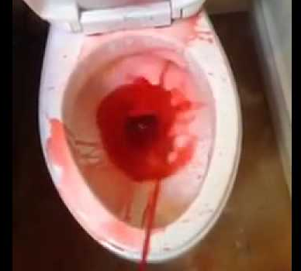
Take home message
Hematuria

