Slide 1


Slide 2
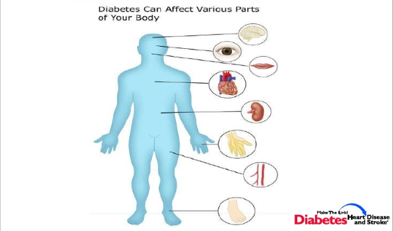
Complications

Slide 3


Slide 6
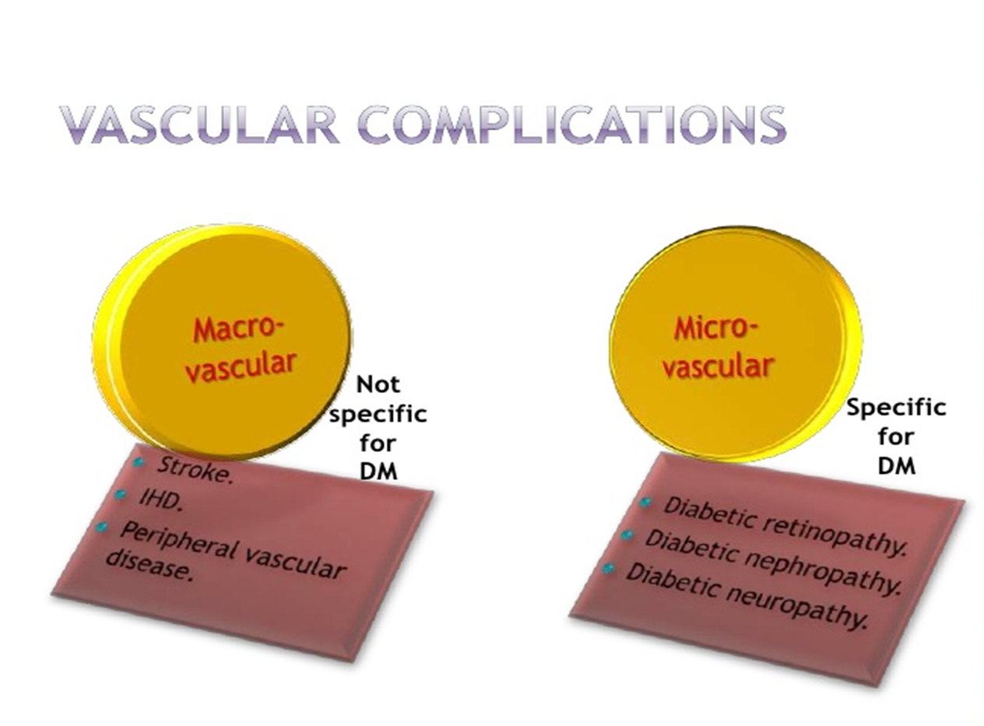

Slide 11
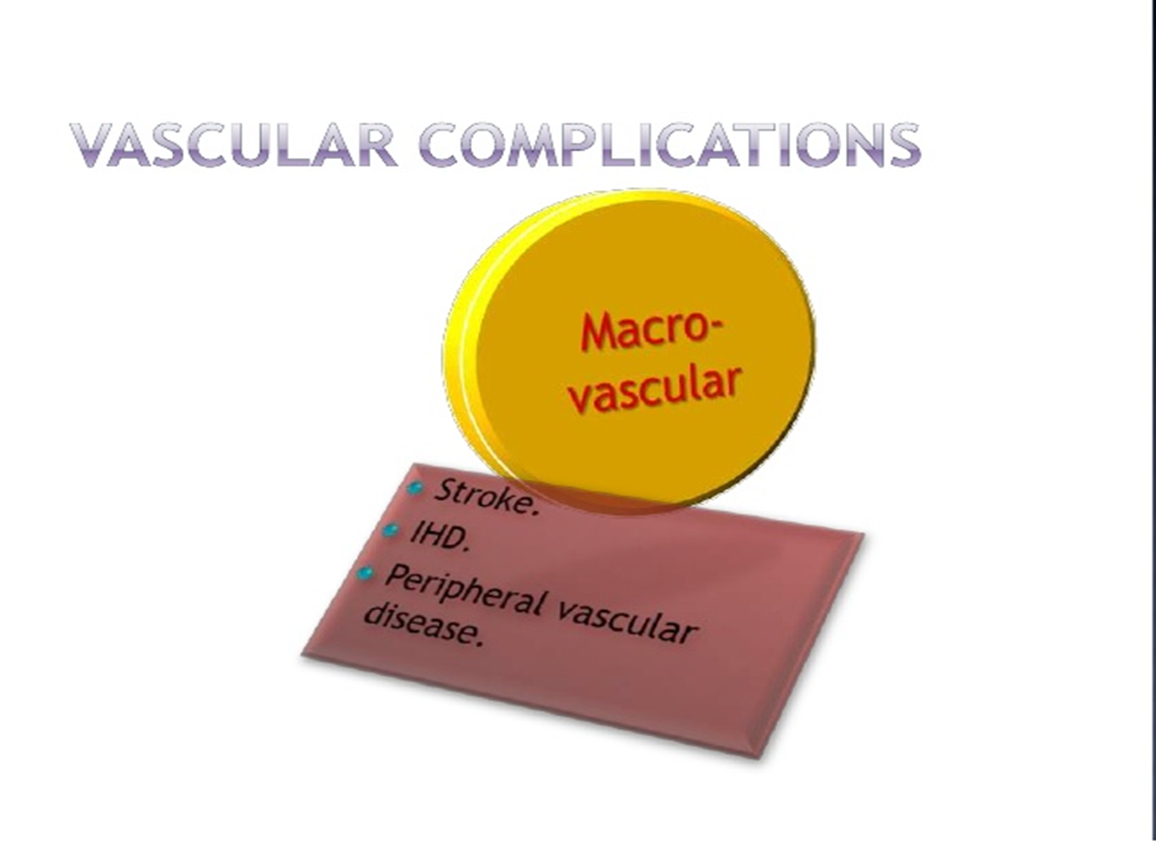

Slide 12
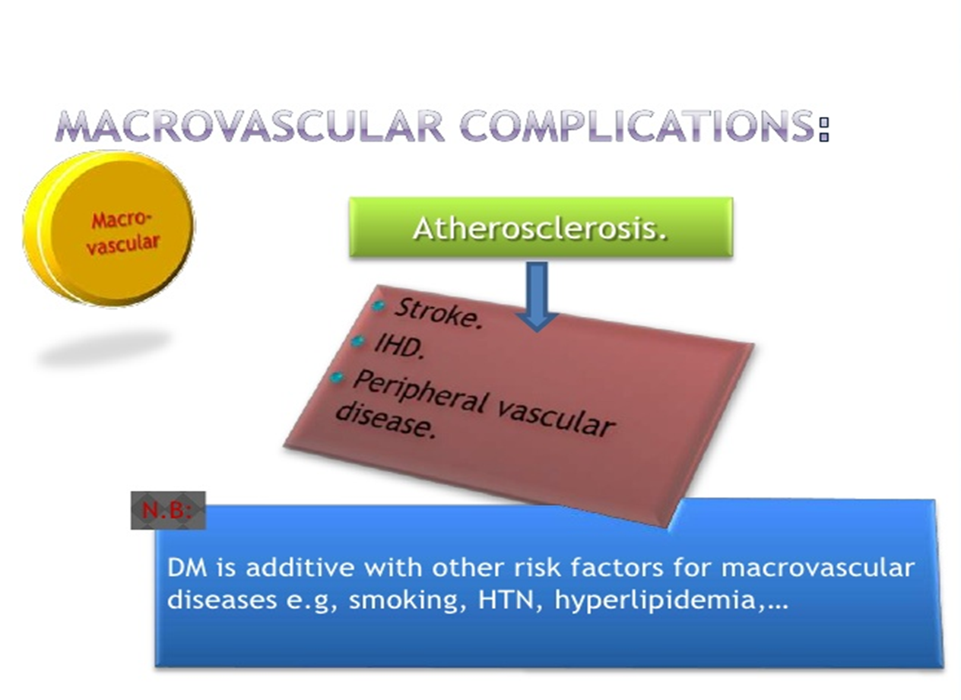

Slide 16
heart failure
Myocardial infarction is 3- 5 times more common in DM.
leading cause of death in patients with type 2 diabetes.
Silent MI as result of autonomic neuropathy.

Slide 17

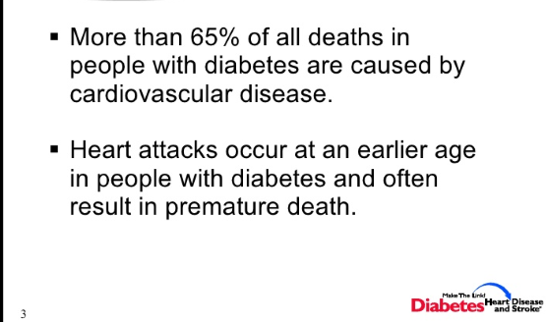

Slide 18
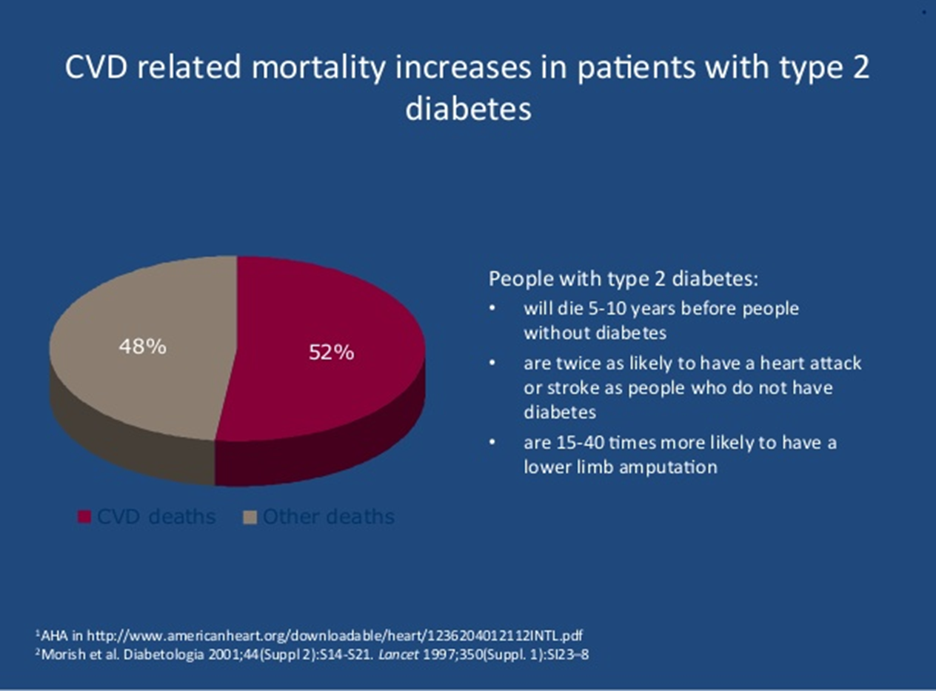

Slide 19


Slide 21
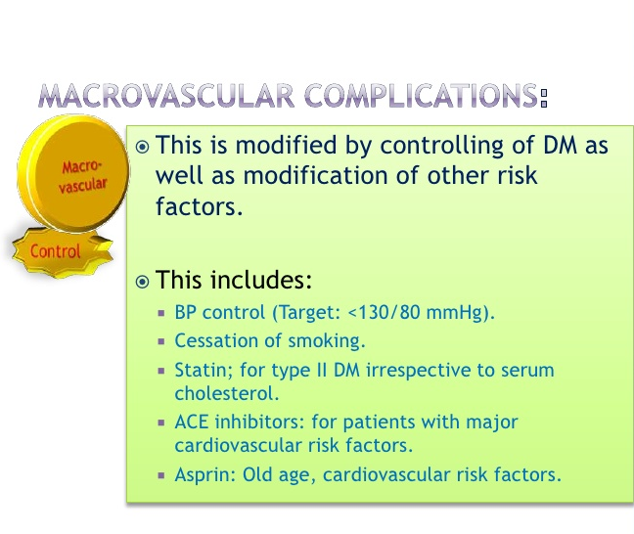

Slide 22
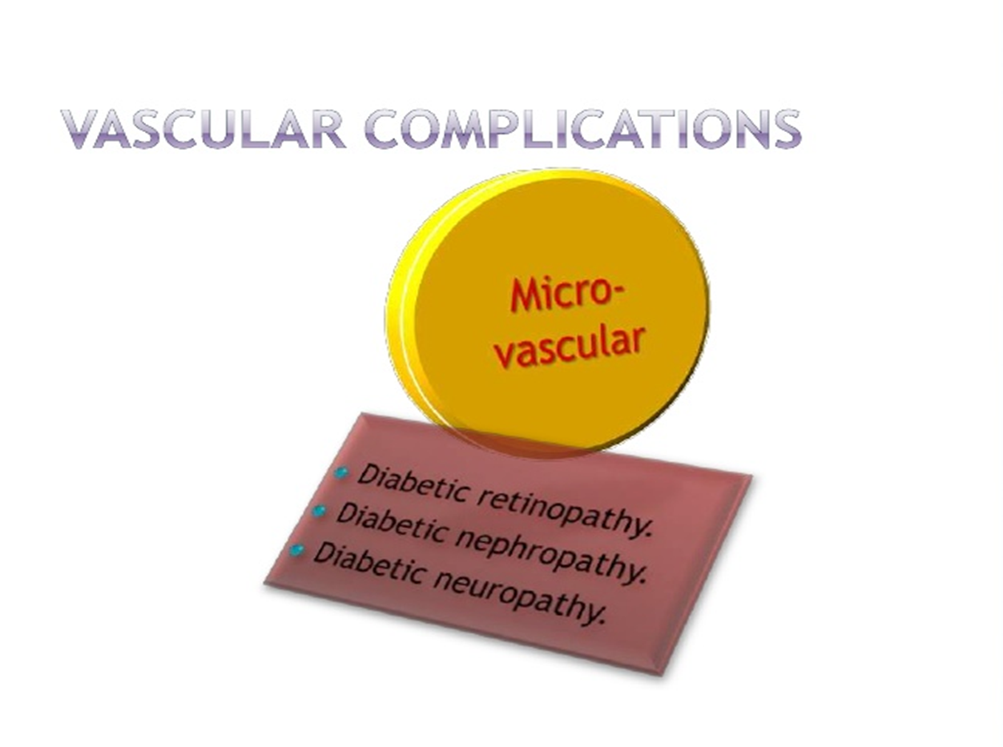

Slide 23
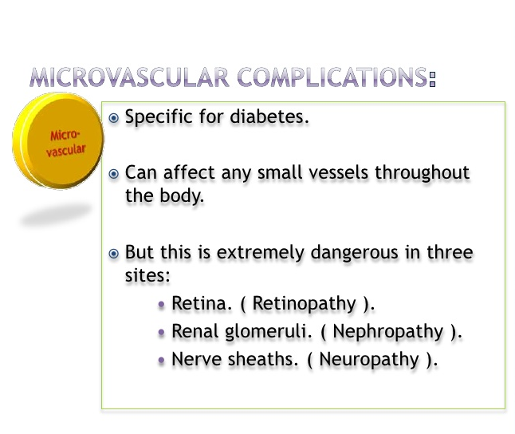

Slide 24
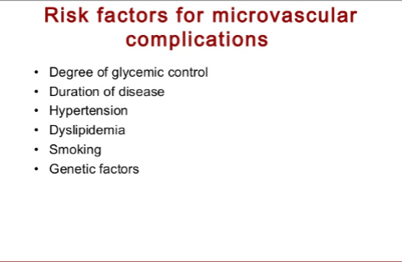

Slide 25


Slide 26
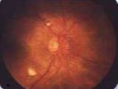
Diabetic Retinopathy
Complication of Diabetes for both
Type 1
Type 2
Blood Glucose level increases for a long , changes occur in tiny blood vessels that supply blood to retina
Person notices :
Blotch
Blurriness
Dark spots

Slide 27
What causes Diabetic Retinopathy ?
Hyperglycemia (Diabetes )
High Blood Suger
Changes Blood Vessels of Retina
Blood Vessels (Retina ) swell and leak fluid
Fluid leaks into ‘Macula
Blurred Vision

Slide 28
Stages
Mild non – proliferative
Moderate non – proliferative
Severe non – proliferative
Proliferative

Slide 30


Symptoms :
Patients complain of spots or floaters in end out of focus
Patients may complain of blockage of vision
Others may notice difficulty seeing at night
Risk Factors :
Diabetes
Pregnancy
High Blood Pressure
High Cholesterol

Slide 31
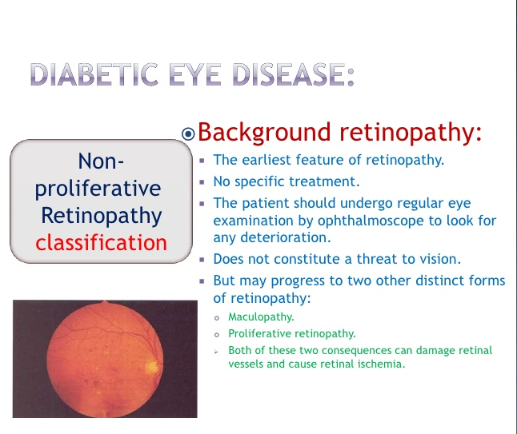

Slide 32
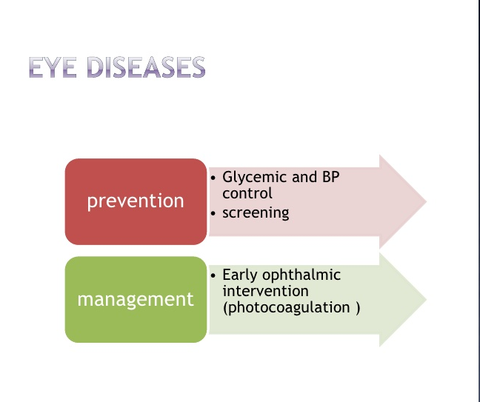

Slide 33
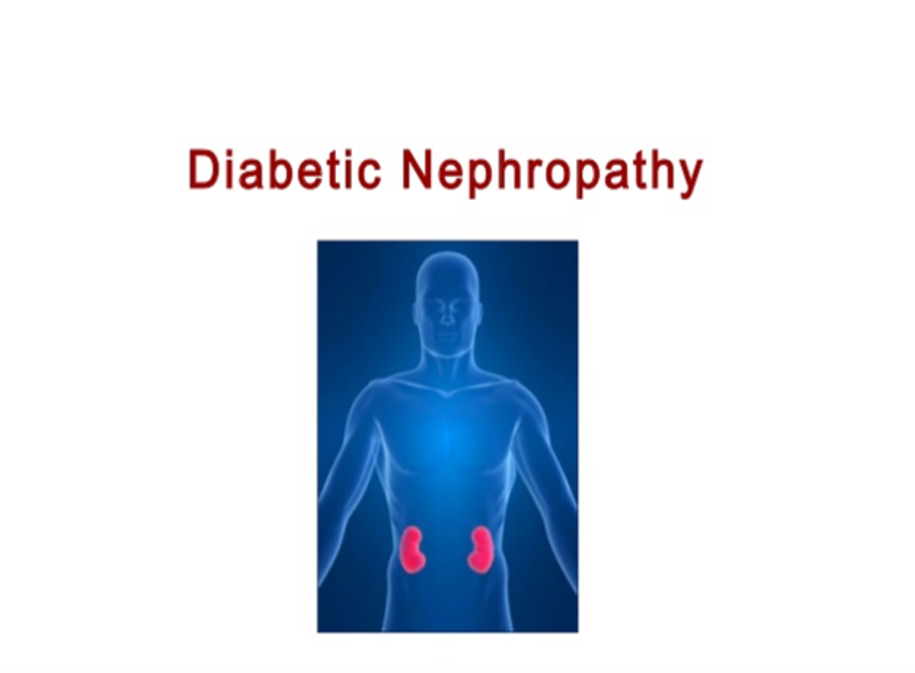

Slide 36


Slide 43


Slide 44
Introduction

Slide 45
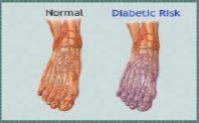
Diabetic Neuropathy
Affect nerves throughout the body (most commonly affects nerves in feet and legs )
Types of Diabetic Neuropathy
..Peripheral neuropathy
..Autonomic neuropathy
..Focal neuropathy
..Proximal Neuropathy

Slide 46
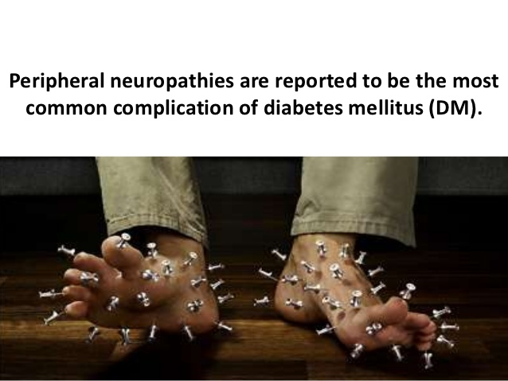

Slide 47
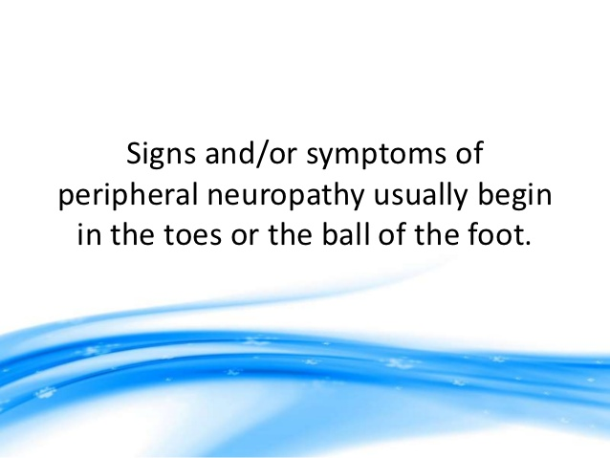

Slide 48


Slide 49


Slide 50


Slide 51
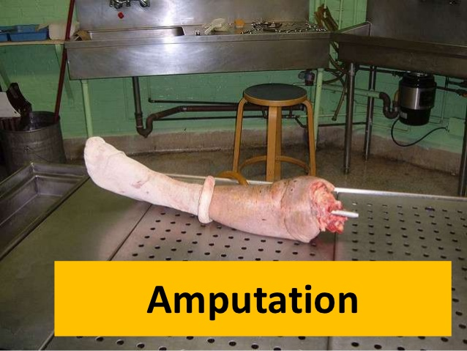

Slide 52
What Causes Neuropathy ?
…Lifestyle factors - -smoking --alcohol consumption
…Metabolic factors (duration of diabetes )
…Nerve and blood vessel factors ( damage to blood vessel )
…Nerve injury such as Carpal tunnel syndrome

Slide 53
Introduction

Slide 54
Major Causes of Diabetic Neuropathy

Slide 55
Major Causes of Diabetic Neuropathy

Slide 56
Effective Symptoms of Diabetic Neuropathy

Slide 57
Effective Symptoms of Diabetic Neuropathy

Slide 58


Slide 59


Slide 60
Complications of Diabetic Neuropathy

Slide 61
Complications of Diabetic Neuropathy

Slide 62
Key messages
Diabetic microvascular complication are preventable
Screen 1- Microalbumin to detect nephropathy
2-Neurological exam for neuropathy
3-Retins evaluation for retinopathy
Treat 1-ACEI/ARB for nephropathy
2-Foot care education for neuropathy
3-Good metabolic control for all
microvascular complications

Slide 64


