Slide 1
Pain in Cancer Survivors
د قصي الحسين

Slide 2
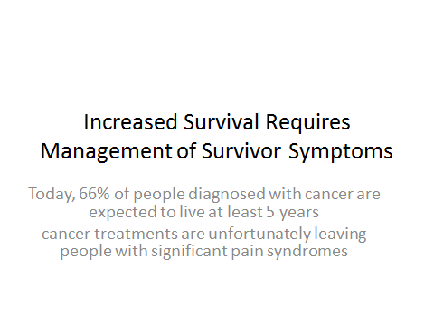

Slide 3
Chronic Pain Associated With Cancer
43% of a diverse population of cancer survivors experience pain since their diagnoses
20% suffere chronic cancer-related pain

Slide 4
Treatment-Related Pain Syndromes
Chemotherapy-induced peripheral neuropathy (CIPN);
Radiation-induced pain;
Hormone therapy-induced arthralgia;
Graft vs host disease (GVHD)-related pain; and
Surgery-related pain.

Slide 5
Chemotherapy-Induced Peripheral Neuropathy
neurotoxic effect of some chemotherapeutic agents
paclitaxel, vincristine, cisplatin, oxaliplatin, thalidomide, and bortezomib
dose-dependent
severity depend on previous chemotherapy, use of multiple neurotoxic agents, or chemotherapy combined with surgery and/or radiation therapy

Slide 6
Chemotherapy-Induced Peripheral Neuropathy
chronic, intensely painful paresthesias, burning, and/or painful numbness of the hands and feet ("glove and stocking" distribution)

Slide 7
Treatment of CIPN
tricyclic antidepressants (amitriptyline, nortriptyline)
anticonvulsants (gabapentin, pregabalin)
serotonin-norepinephrine reuptake inhibitors (duloxetine, venlafaxine)
opioids may be the best option for selected patients
maintenance of physical activity

Slide 8
Radiation-Induced Pain
plexopathy, which is damage to and impaired function of a network of nerves
most common is the brachial plexus
microvascular injury, causing fibrosis, or direct damage by irradiation of peripheral axons and myelin sheaths
Larger doses, more courses, larger fields, combined with chemotherapy all place patients at higher risk for radiation-induced injury

Slide 9
Radiation-Induced Pain
symptoms of plexopathies are often delayed in onset, from months to years
numbness and paresthesias of the hands and fingers, followed by weakness and pain

Slide 10
Treatment of radiation-induced plexopathy
Medications similar to those used for CIPN

Slide 11
Hormone-Induced Arthralgia
aromatase inhibitor, incorporated either as up-front therapy or as adjuvant therapy after tamoxifen. data show that aromatase inhibitors reduce the risk for breast cancer recurrence and prolong survival
painful arthralgias and myalgias
Risk factors for pain include obesity and previous hormone replacement therapy or chemotherapy
one study, 20% of women who had joint pain stopped taking their aromatase inhibitors

Slide 12
Treatment of hormone-induced pain
No single therapy has yet been shown to be effective
acupuncture, exercise, acetaminophen, nonsteroidal anti-inflammatory drugs, opioids, glucosamine/chondroitin, omega-3 fish oil, and probiotics
lifestyle modification including weight reduction, regular exercise

Slide 13
Graft vs Host Disease-Related Pain
complication of hematopoietic stem cell transplantation
skin changes that look and feel like scleroderma

Slide 14
Treatment of GVHD-induced pain
topical corticosteroids
topical tacrolimus
intravenous opioid analgesics

Slide 15
Surgery-Related Pain
rates of chronic pain after cancer surgery are as high as 50%,
predisposing factors
Pre-existing pain;
Repeat surgery;
Radiation;
Chemotherapy;
Psychological vulnerability; and
Depression and anxiety.
most well-described ,postmastectomy pain, postamputation pain, postthoracotomy pain, and pain associated with head and neck surgeries.

Slide 16
Postmastectomy pain
neuropathic in nature and is related to surgical trauma and, in particular, the extent of axillary dissection.
tissue expanders used in the time period between initial surgery and reconstructive procedures
phantom breast pain; intercostobrachial neuralgia and postmastectomy pain syndrome; neuroma and scar pain; other nerve injury

Slide 17
Postthoracotomy pain
occur in up to 60% of patients
intercostal nerve injury
disarticulation of the costochondral and costovertebral junctions

Slide 18
Post amputation pain
phantom limb pain (PLP)
PLP of upper limb amputees is more frequent and longer lasting than that of lower limb amputees.

Slide 19
Improved Symptom Management Influences Treatment Adherence
significant barrier to the management of chronic pain in cancer survivors is a lack of professional knowledge

Slide 20
Chronic pain is not easy for patients, but neither is chronic pain treatment

Slide 21


