Slide 1
Diabetes and the eye
Dr. rania ghosen

Slide 2
Diabetic eye disease comprises a group of eye conditions that affect people with diabetes.
These conditions include:
diabetic retinopathy.
diabetic macular edema(DME)
cataract.
glaucoma.

Slide 3
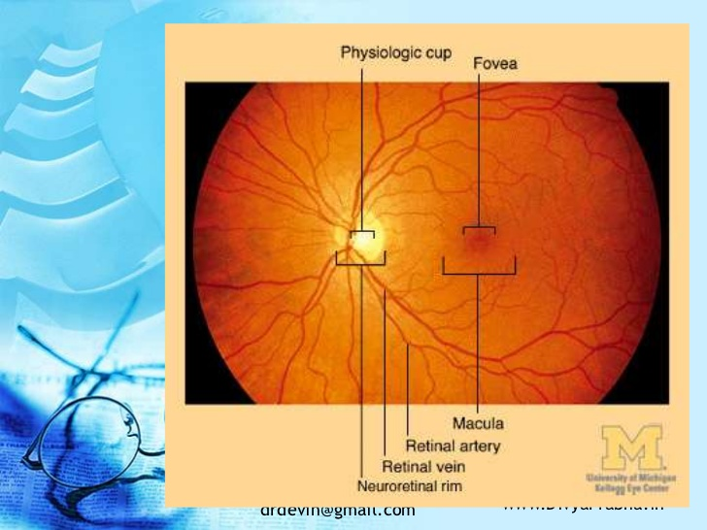

Slide 4
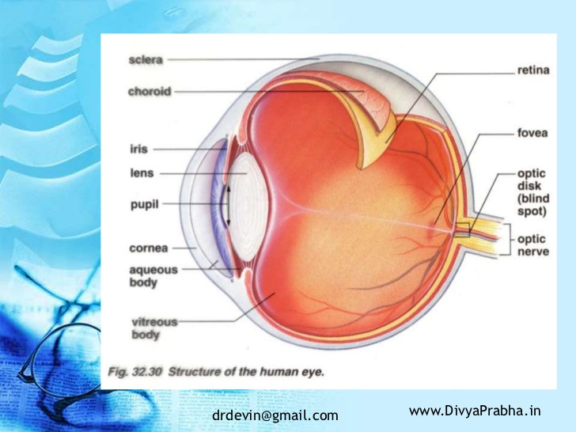

Slide 5
1-Diabetic retinopathy
Diabetic retinopathy remains the most common complication of diabetes mellitus and is a leading cause of visual loss and may cause blindness.
Studies in the past year suggesting that defective repair of injured retinal vessels by endothelial progenitor cells may contribute to the pathogenesis of diabetic retinopathy.
Type 1 diabetes is due primarily to autoimmune-mediated destruction of pancreatic β-cells, which leads to insulin deficiency.
The frequency of Type 1 diabetes is low relative to Type 2 diabetes, which accounts for approximately 90% of diabetes worldwide.
Type 2 diabetes has no known cause although in many cases there is a strong genetic component ,its most prevalent after middle age between 50-70 years and its also a consequence of poor diet and obesity.

Slide 6
Diabetic retinopathy is the most frequently occurring microvascular complication of diabetes in the eye, although not all patients will suffer appreciable vision loss, this condition remains a leading cause of blindness. In Europe and the U.S. alone, the WHO (World Health Organization) has estimated that diabetic retinopathy accounts for approximately 15–17% of total blindness ,worldwide its an even bigger problem
Following 20 years of diabetes, nearly all patients with Type 1 diabetes will have at least some retinopathy.
Moreover, ~80% of insulin-dependent Type 2 diabetic patients and 50% of Type 2 diabetic patients not requiring exogenous insulin will have retinopathy.

Slide 8
Risk factors
Age of diagnosis of diabetes
Duration :
50 % develop DR after 10 yrs
70% after 20 yrs
90% after 30 yrs
Poor control of diabetes
Pregnancy
Hypertension
Hyperlipidemia
Obesity – Anemia - Smoking
More in females than males
Hereditary more on PDR

Slide 9
Pathogeneses
DR is a microangiopathy affecting the retinal precapillary arterioles, the capillaries, and the venules, However larger vessels may become involved.
The retinopathy has features of both microvascular occlusion and leakage.
despite long and extensive research, the pathogeneses is still a matter for much speculation.

Slide 10
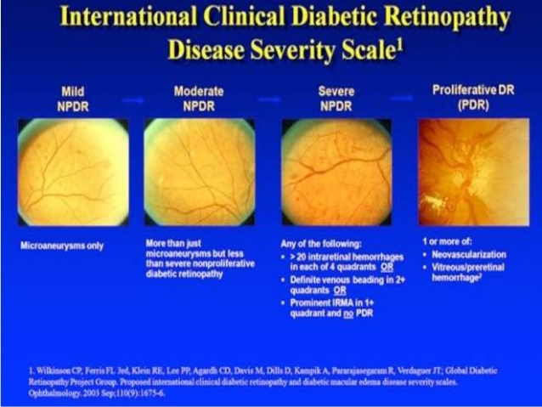
Four stages of Diabetic Retinopathy
Mild Nonproliferative Retinopathy
Moderate Nonproliferative Retinopathy
Sever Nonproliferative Retinopath
Proliferative Retinopathy

Slide 11
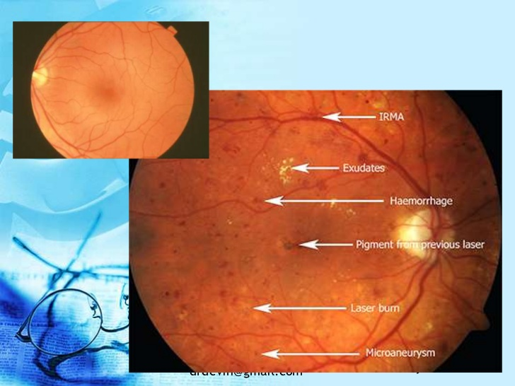
Retina in DR

Slide 12
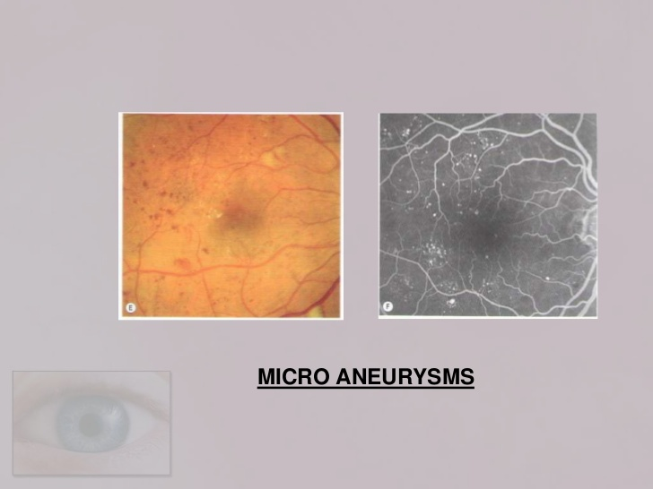
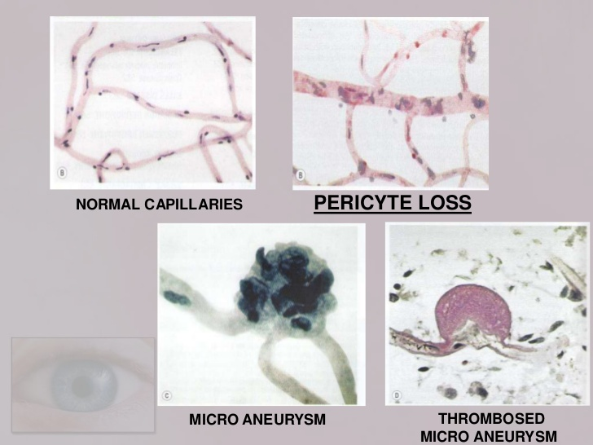
Mild nonprolifirativ DR
Microaneurisms
are the first clinically detectable lesions of DR appearing as a small Round dots usually located temparal to the Macula and when they coated with blood They may be indistinguishable from dot haemorrhages

Slide 13
2 . Moderate nonprolifirative DR
It shows both heamorrhages and hard exudates in addition to the microaneurisms.

Slide 14
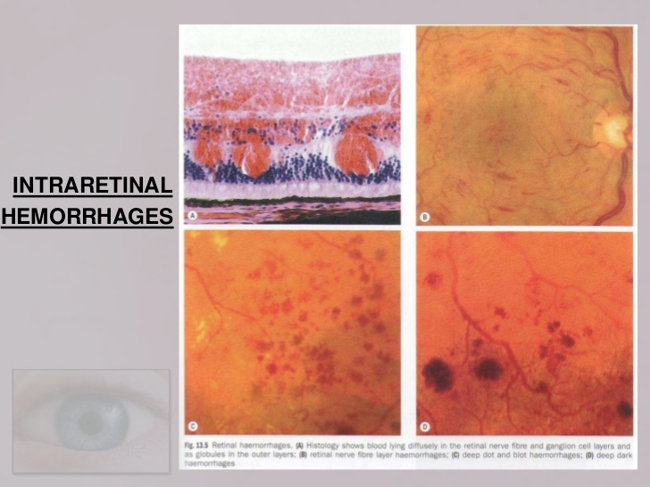
Heamorrhages
Dot and spot H. originate from the venous ends of the capillaries and are located within The compact middle layers
Flame-shaped H. originate from the more superficial arterioles follow the course Of the retinal nerve fiber layer

Slide 15
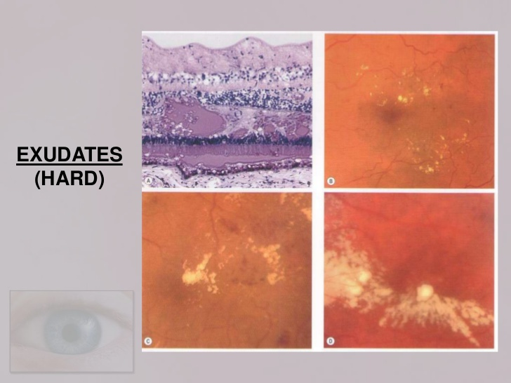
Hard exudates
They have a yellow waxy appearance with relatively distinct margins located in the inner layers of the retina and are frequently Distributed in a circinate pattern peripheral to areas of chronic focal leakage.

Slide 16
3 . Sever nonprolifirative DR

Slide 17
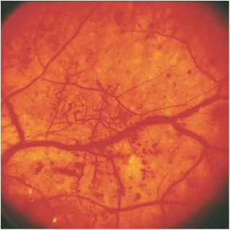
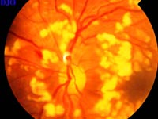
The most important sign in SNDR is :
Cotton-wool spots
venous changes (loops, beading, sausage-like segmentation)
arteriolar narrowing (obliterating)
and intra retinal microvascular abnormalities IRMA
This stage is called pre proliferative DR

Slide 18
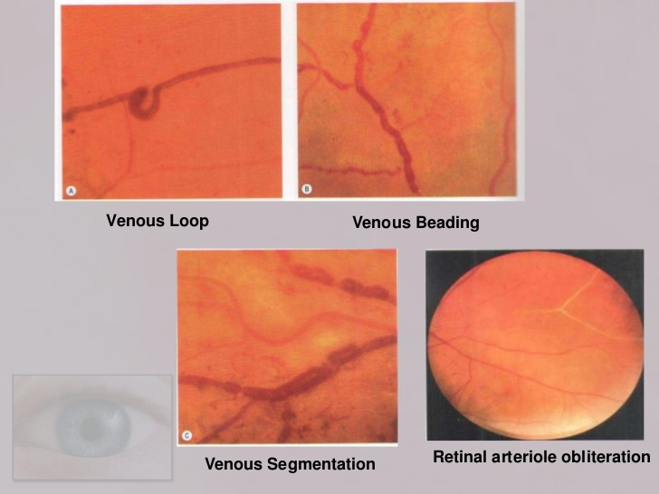
In NPDR there are no symptoms, the signs are not visible to the eye and the patient will have 20/20 vision
The only way to detect NPDR is fundus photoghraphy

Slide 19
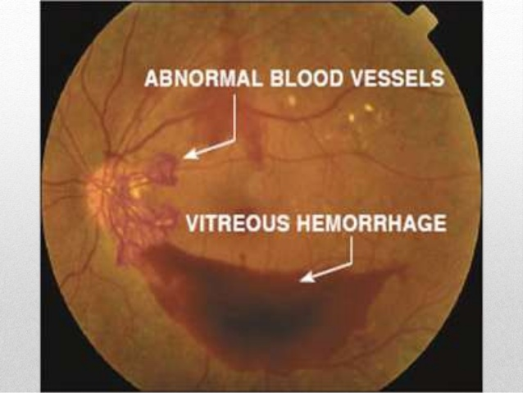
4-Prolifirative DR
It affects about 5% of diabetic population .
Patients with juvenile-onset diabetes are at increased risk of PDR with incidence of about 60% after 30 yrs.

Slide 20
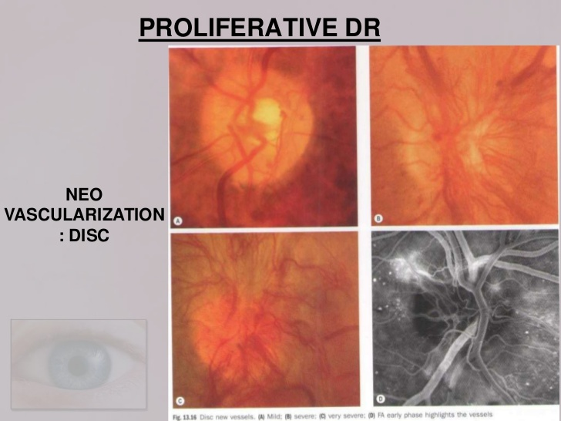
Neo-vascularization is the hallmark of PDR
New vessels may proliferate on the optic disc NVD
and along the course of the major temporal vascular arcades NVE
This new vessels is very fragile.

Slide 21
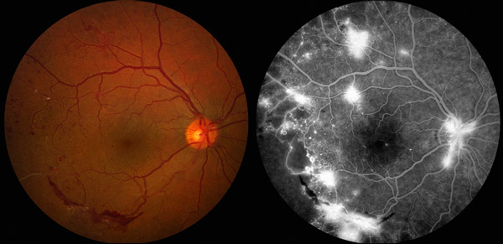

Slide 22
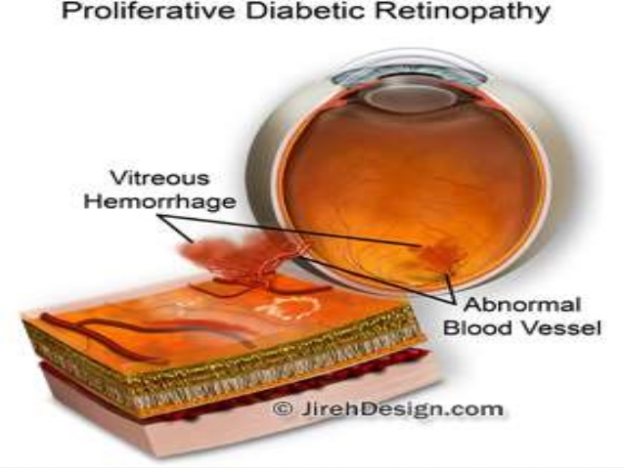
These fragil vessels can cause the most clinically important income of PDR which is vitreous heamorrhage
and until the onset of vitreous hemorrhage PRD is completely
asymptomatic and can only be detected by routine eye examination by dilating pupil and fundus examination.

Slide 23
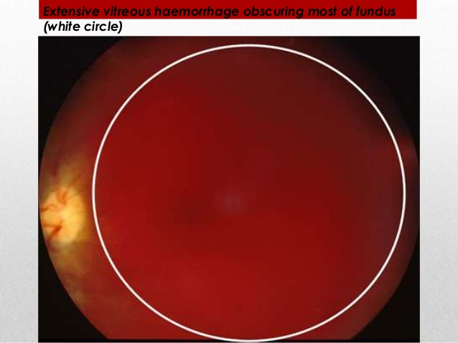
Patients should be warned that occasionally VH may be precipitated by sever physical exertion Or strain , hypoglycaemia , and direct ocular trauma.
However frequently bleeding occurs while the patient is asleep.
Pregnancy may have a worsening effect on PDR .

Slide 24
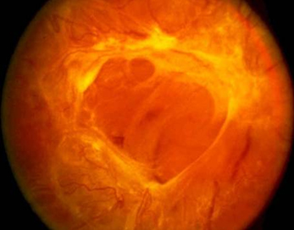
If VH left untreated, scar tissue can grow and pull on the surface of the retina to cause a tractional retinal
detachment. This advanced stage of the disease is potentially blinding.

Slide 25
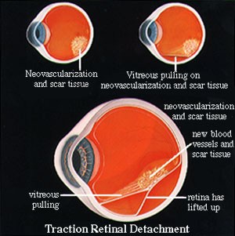

Slide 26
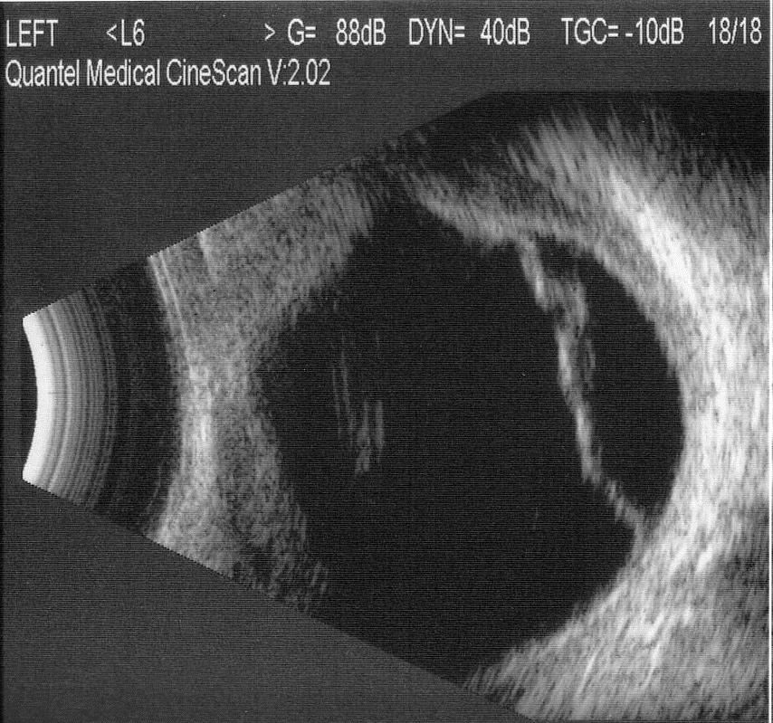
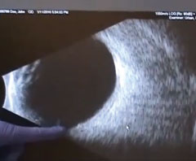
B-scan of the eye
Tractional retinal detachment normal eye

Slide 27
Advanced diabetic eye disease is the last result of uncontrolled PDR and leads to the following serious conditions.

Slide 28
How does Diabetic Retinopathy cause vision loss?
Retinal blood vessels damaged by diabetes can cause vision loss in several ways:
- Fluid can leak into the macula, the part of the retina responsible for sharp detailed central vision.
The fluid causes the macula to become swollen, hence blurring vision.
This condition is called macular oedema.
- Damaged blood vessels can become blocked with loss of blood flow to parts of the retina.
This starves the retina of oxygen and nutrition.
When it occurs in the macula, it causes central visual loss.
This is called ischaemic maculopathy.
- Fragile, abnormal blood vessels can grow in severe cases of retinopathy.
These abnormal blood vessels can bleed into the jelly (vitreous) of the eye causing sudden loss of vision (vitreous haemorrhage).

Slide 29
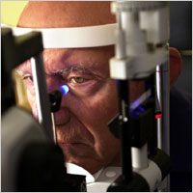
How is diabetic retinopathy diagnosed?
•Patient history to determine vision difficulties, presence of diabetes, and
other general health concerns that may be affecting vision.
•Visual acuity measurements to determine how much central vision has been affected.
•Refraction to determine if a new eyeglass prescription is needed.
•Evaluation of the ocular structures, including the evaluation of the retina through a dilated pupil, and the evaluation of the lens of the eye.
•Measurement of the pressure within the eye.

Slide 30
Supplemental testing may include:
optical coherence tomography(OCT) to document current status of the retina.
Fluorescein angiography to evaluate abnormal blood vessel growth.
B- scan.

Slide 31
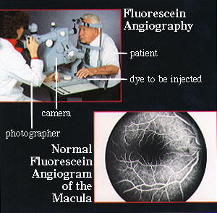

Slide 32
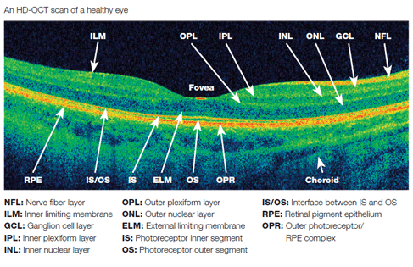
Optical coherence tomography
OCT

Slide 33
2-Diabetic macular edema DME
is the most common cause of visual loss due to DR .
and is more frequent in type 2 and it is due to increased permeability of retinal capillaries.

Slide 34
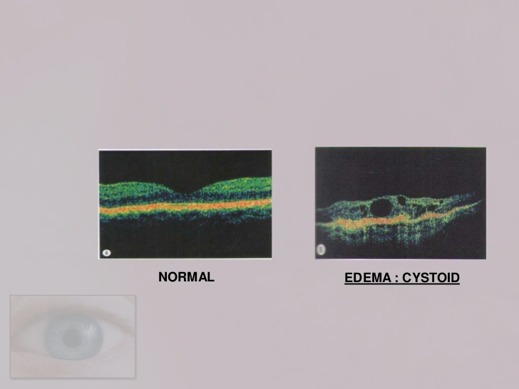
Macular edema can happen at any stage of DR
and cause a sever visual loss .

Slide 35
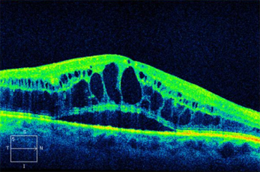

Slide 36
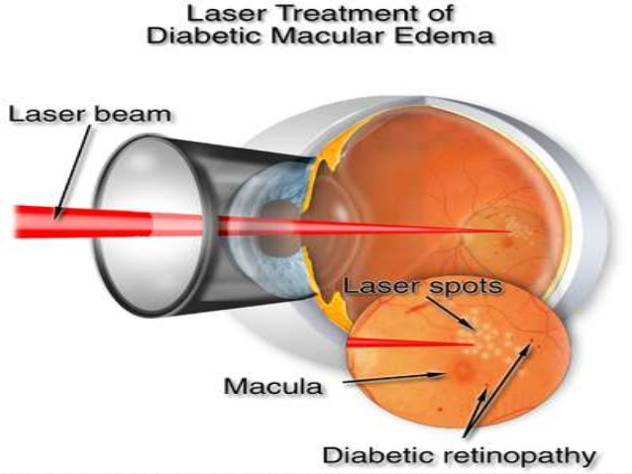
Treatment 0f DR
1- Laser photocoagulation {ARGON}
and it can be focal or grid or panretinal

Slide 37
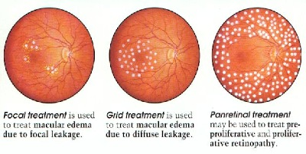

Slide 38
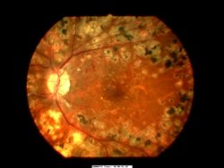

Slide 39
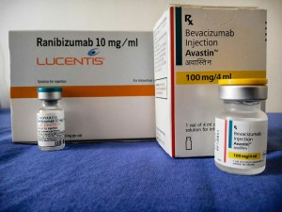
2-Intravitreal anti
vascular endothelial growth factors (VEGF)
People receiving anti-VEGF were approximately four times more likely to gain 15 or more letters of visual acuity at 1 year and its very effective in DME.

Slide 40
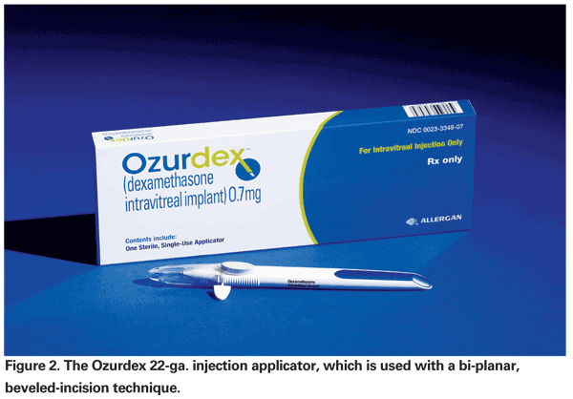
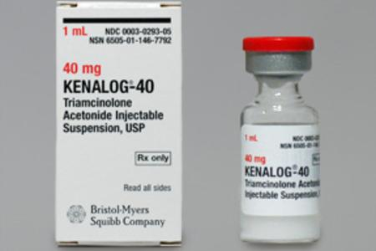
3- intravitreal steroids
visual acuity was better in the triamcinolone acitonide intravitreal injection.
similar to triamcinolone, dexamethasone is capable of reducing vascular permeability and leukocyte accumulation through multiple pathways.

Slide 41
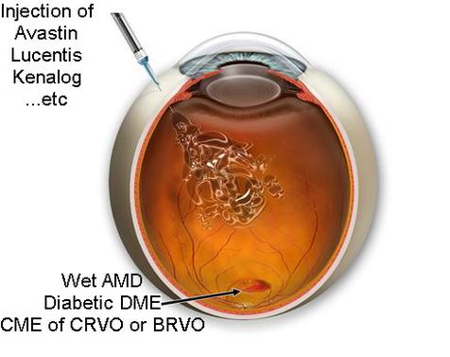
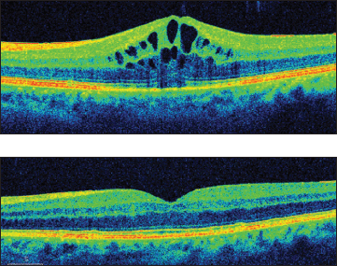
After three month of injection in macular edema

Slide 42
4- vitrectomy
Is a surgery to remove some or all of the vitreous humor from the eye

Slide 43
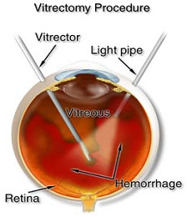
Anterior vitrectomy
is a removing of small portions of the vitreous from the front structure of the eye.
Pars plana vitrectomy
is a general term for a group of operations accomplished in the deeper part of the eye All of which involve removing some or all of the vitreous (the eye’s clear internal jelly).

Slide 44
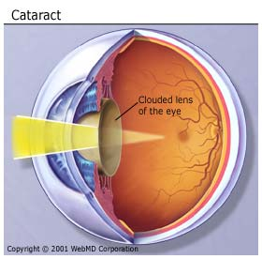
3- cataract
When people with diabetes experience long periods of high blood sugar, fluid can accumulate in the lens inside the eye that controls focusing causing cataract and leading to blurred vision. It can be treated by surgery.

Slide 45
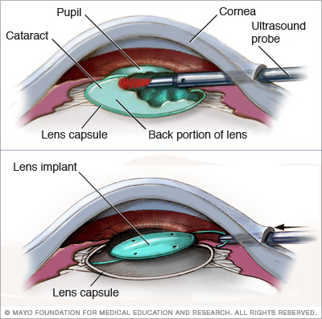
In cataract surgery, the lens inside the eye that has become cloudy is removed and replaced with an artificial lens (called an intraocular lens, or IOL) to restore clear vision. The procedure typically is performed on an outpatient basis and does not require an overnight stay in a hospital or other care facility.

Slide 46
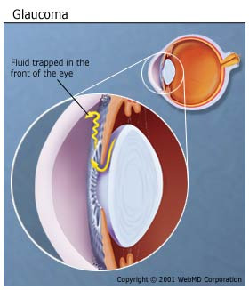
4-glaucoma
Diabetes can also cause glaucoma when fluid inside the eye
does not drain properly so pressure can build up .
Glaucoma in diabetes can be treated with medication.

Slide 47
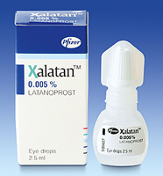
The typical medication for glaucoma in DR is
Prostaglandin Analogs which increase the flow of
fluid (aqueous humour) out of the eye, and reduces the pressure
within the eye (the intraocular pressure IOP).
These eye drops are usually used once a day.
such as latanoprost (xalatan)

Slide 48
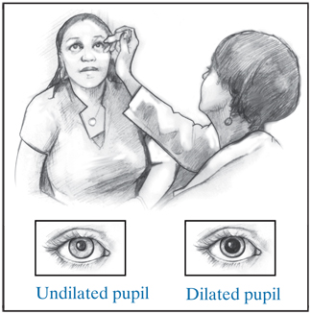
You might not have any problems with your vision until the damage is severe, so you should have the following steps:
an eye exam at least once a year, even if your vision seems fine.
good control of your blood sugar.
Avoid risk factors.
Call your eye doctor right away if you notice any changes in your vision.

Slide 49
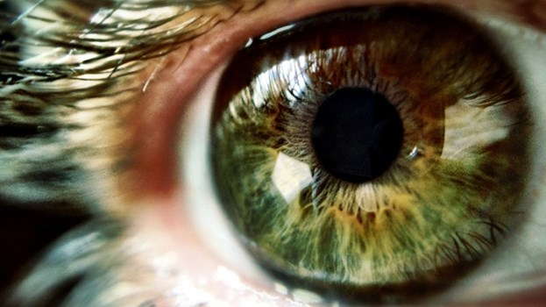
Finally vision is a grace that is being given from GOD.
For this reason keep your eyes healthy as much as you can
so you can see perfectly enough to enjoy life.

Slide 50
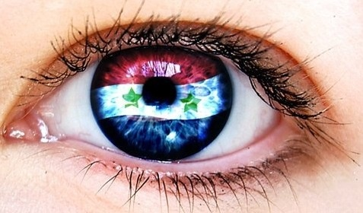
Thank you

