Slide 1
أورام المثانة
Bladder cancer
Dr.Alseoudi Alhadi
د.الهادي السعودي
Albairouni C.H.U

Slide 3
Epidemiology of Bladder Carcinoma
Carcinoma of the bladder is more common in males than females, in industrialized than in developing nations, and in urban than in rural dwellers.
The male to female ratio for transitional cell tumors is approximately 3:1.
About 80% of patients are between the ages of 50 and 80 years.

Slide 4
* Risk Factors for Bladder Cancer:
  1. Cigarette smoking: is clearly the most important influence, increasing the risk threefold to sevenfold, depending on the pack-years and smoking habits. 50% to 80% of all bladder cancers among men are associated with the use of cigarettes, cigars and pipes.
  2. Industrial exposure to naphthylamine as present in aniline dye used in rubber industries. The cancers appear 15 to 40 years after the first exposure.
Notes:
Cigarette smoking - #1 avoidable risk factor

Slide 5
3. Schistosoma haematobium: infections in areas where these are endemic (Egypt, Sudan) are an established risk. The ova are deposited in the bladder wall and incite a brisk chronic inflammatory response that induces progressive mucosal squamous metaplasia and dysplasia and, in some instances, neoplasia. Seventy per cent of the cancers are squamous, the remainder being urothelial cell carcinoma.

Slide 6
4. Long-term use of analgesics.
5. Heavy long-term exposure to cyclophosphamide, an immunosuppressive agent, induces, as noted, hemorrhagic cystitis and increases the risk of bladder cancer.
6. Prior exposure of the bladder to radiation: often performed for other pelvic malignancies, increases the risk of urothelial carcinoma. In this setting, bladder cancer occurs many years after the radiation.

Slide 7
  7. Bladder stones: cause chronic irritation to the mucosa so increase risk for squamous cell metaplasia then cancer.

Slide 8
*Histologic types of bladder carcinoma:
1. Transitional cell carcinoma.
  TCC in situ.
  Papillary (superficial) TCC carcinoma.
  Invasive TCC .
2. Squamous cell carcinoma:
- On top of squamous metaplasia.
3. Adenocarcinoma.

Slide 9
* Clinical Manifestations of Bladder CA
1. Hematuria (80-90%): Generally painless and may be gross or microscopic hematuria.
2. Pain: often reflects tumor location
  Lower abdominal pain – Bladder mass
  Rectal discomfort & perineal pain – Invasion of prostate or pelvis.
  Flank pain - Obstruction of ureters
Notes:
The bladder is a source of gross hematuria (40%), but benign cystitis (22%) is a more common cause than bladder CA (15%). Microscopic hematuria is more commonly of prostate origin (25%); only 2% of bladder CAs produce microscopic hematuria.

Slide 10
3. Other urinary Symptoms:
  Frequency, urgency, nocturia due to irritation of the mucosa or due to decrease bladder capacity.

Slide 11
* Investigations for Bladder Cancer:
Urinary Cytology: to detect any desquamated malignant cells.
Cystoscopy: regardless of cytology results.
TURB (Transurethral resection of bladder tumor) for all visible tumors to determine histology & depth of invasion

Slide 12
4. Imaging:
  Ultrasonography
  CT, or MRI - Can determine the extent of tumor spread (e.g. into perivsesical fat, prostate or vagina, LNs)
  CT chest / abdomen, MRI, radionuclide imaging of skeleton to assess for distant metastasis.
Notes:
Selective retrograde catheterization of the ureters up to the renal pelves to assess for upper tract dz.
The mainstay of dx & staging of bladder CA is cystoscopic eval, incl exam under anesthesia to determine if there is a palpable mass and, if so, whether it is mobile. A non mobile tumor mass indicates dz extending beyond the wall of the bladder & invading into regional organs (eg, prostate, vagina, or muscles along the pelvic sidewall); these tumors are unlikely to be surgically resectable. The bladder is visually inspected to detail the size, number, location, and growth pattern (papillary or flat) of all lesions.
U/S, CT, and/or MRI may help to determine whether a tumor extends to perivesical fat (T3) and to document nodal spread. Distant metastases are assessed by CT of the chest and abdomen, MRI, or radionuclide imaging of the skeleton.

Slide 13
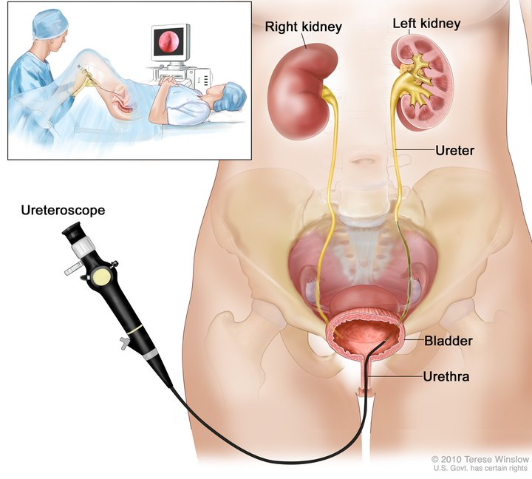

Slide 14
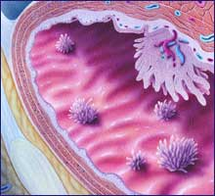
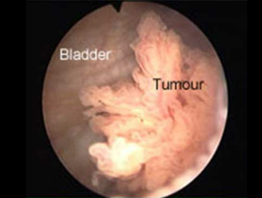
Papillary carcinoma

Slide 15
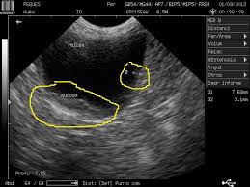

Slide 16
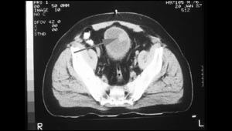

Slide 17
* Complications of urinary bladder carcinoma:
1. Bleeding.
2. Obstruction: specially if the tumor grow near the urethral openings of the bladder lead to obstructive uropathy in the form of hydroureter, hydronephrosis
3. Stone formation: secondary to the obstruction and infection.
4. Fistual formation: fistula is an abnormal channel that connects the urinary bladder with another structure within the abdomen.

Slide 18
6. Spread of the malignant tumor either by :
a. Direct spread to surrounding structures
b. Hematogenous spread to distant organs.
c. Lymphatic spread.

Slide 19
* Grading of transitional cell carcinoma:
Low grade TCC:
- The tumor cells are less pleomorphic, slightly similar to the cell of origin, few mitosis, so have better prognosis.
2. High grade TCC:
- The cells highly pleomorphic, have more mitosis.
- worse prognosis because it have aggressive behavior, more infiltrative

Slide 20
* TNM staging for bladder carcinoma:
T: is tumor size.
N: express lymph node affection by the tumor so:
- N0 no affection to lymph nodes.
- N+ the lymph nodes are infiltrated by the tumor
M: express distant metastasis so:
- M0 no distant metastasis.
- M+ there is distant metastasis.

Slide 21
T: Tumor size.
pT 0: carcinoma in situ.
pT I: the tumor infiltrates the lamina propria.
pT II: the tumor infiltrates the musculosa propria.
pT3: the tumor infiltrates perivesical fat.
pT4: distant spread.

Slide 23
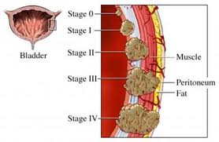

Slide 24
Treatment of Bladder cancer

Slide 25
Treatment – Superfical TCC
TURBT
Check cystoscopy
frequency pending initial differentiation and behaviour
generally commencing 3 monthly, then back to 6 then 12 monthly
flexible cystoscopy
Intravesical chemotherapy
current fashion single dose Mitomycin instilled immediate post op
subsequent 6 dose therapy if frequent recurrence to enforce reduced frequency rec
Upper tract imaging
more so in high grade disease and CIS but consider radiation dose

Slide 26
Treatment – Superficial TCC and Intravesical Chemotherapy
Frequent recurrence – repeat TURBT problematic .
intravesical chemo usually weekly doses for 6 weeks +/- “maintenance” monthly single doses
Current fashion Mitomycin for low grade TCC
Adriamycin probably as effective
Not a cure, but to reduce frequency of recurrence and need for TURBT

Slide 27
Treatment - CIS
Generally high grade and dangerous, high risk of progression to invasive
Can metastasize without clinical invasion
Treatment intravesical BCG – weekly dose 6 weeks, then “booster” doses with a range
of protocols
80% cure, but reasonable long term failure rate – proceed to cystectomy
form of immunotherapy
moderate risk – rare systemic BCG life threatening, not if immunosuppressed
bladder scarring with obstructive uropathy requires cystectomy
Mitomycin C 40% cure

Slide 28
Treatment – “T1G3” TCC
Re resection at 6 weeks of tumour scar to re check for muscle invasion
BCG with close follow up high risk of recurrence, progression
Cystectomy if recurrence or progression

Slide 30
Treatment – Muscle Invasive TCC ≥ T2
Radiotherapy
20% cure alone (depending on staging)
chemoradiotherapy may improve cure rate
not effective if CIS present
check cystoscopy follow up
“salvage” cystectomy for failure – up to 40% cure overall

Slide 31
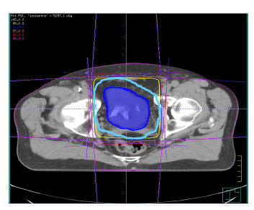

Slide 32
Treatment – Muscle Invasive TCC ≥ T2
Surgery
Partial cystectomy
Little data
Possible use in small solid tumours in dome
Radical cystectomy
Cystoprostatectomy in males
Cystectomy +/- hysterectomy and bilateral salpingo oophorectomy
in females
Usually with regional lymphadenectomy
Major surgery with moderate risks

Slide 33
Treatment – Muscle Invasive TCC ≥ T2
Cure rates radical cystecomy:
T2 60 – 70 %
T3 20 – 30 %
Boosted cure rates recently with
neo adjuvantchemotherapy

Slide 34
Treatment – Muscle Invasive TCC ≥ T2
Bladder reconstruction “neobladder”
Uses “detubularized” bowel segments
Larger procedure, generally done in younger patients
All have a risk of adenocarcinoma in neobladder,
check cystoscopies after 5 years

Slide 35
Treatment – Muscle Invasive TCC ≥ T2
Chemotherapy
MVAC moderate morbidity, requiring good renal function
Cisplatinum / Gemcytabine (or carboplatinum)
less toxic but less effective
Not curative alone
Used with surgery in adjuvant or neo adjuvant setting 5% increase cure in neoadjuvant setting
Chemoradiotherapy
Cisplatinum especially radiosensitizing

Slide 38
Traitement for Metastatic Bladder cancer TCC

Slide 39
Chemotherapy
Palliative radio-chemiotherapy
Palliative radiotherapy

Slide 41
New idea in Bladder Cancer treatment

Slide 42
Urine teste
Checking for Telomerase enzyme in urine

Slide 43
Immune checkpoint inhibitors
PDL1 : Aterolizumab
PD1 : Pembrolizumab
( turned on / off the immune response )

Slide 44
Target Therapy
Lapatinib
Erlotunib
Bevazumab
Sorafinb ….
Usually combined with chemotherapy

Slide 45
Gene Therapy
Using special viruses modified in the lab

Slide 46
Thank you

