Slide 1
Colorectal cancer
Screening and Prevention
Dr malek Alhamidi
24.1.2016

Slide 2
Colorectal cancer: Introduction
Colorectal cancer
  3rd most common in women worldwide
  2nd most common in men worldwide
In 2014 in USA:
93610 new CRC cases
49700 die from CRC

Slide 3
Colorectal cancer: Introduction
Incidence per 100000:
60.5 in 1976
46.4 in 2005
Average annual percentage change of:
- 2.7 % in men
- 2. 1% in women
Mortality from CRC decreased by almost 35% from 1990 to 2007

Slide 4
Colorectal cancer: Introduction
These improvements in incidence of and mortality from CRC are thought to be a result of:
Cancer prevention
Earlier diagnosis through screening
Better treatment modalities

Slide 5
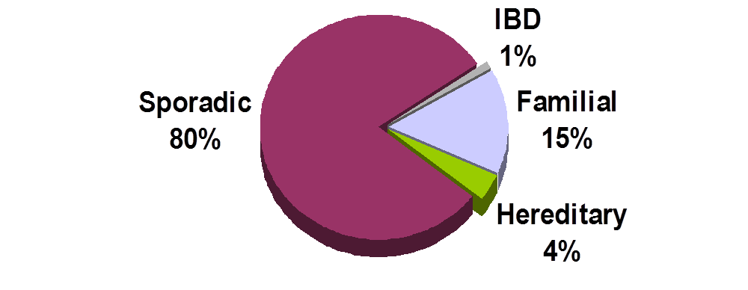
Types of Colon Cancer

Slide 6
CRC: Risk factors
Nearly 90% of colon cancer patients
are over the age of 50.
Other risk factors include:
        family or personal history of colon cancer or polyps
        chronic inflammatory bowel disease
        hereditary colorectal syndromes
        use of cigarettes and other tobacco products
        high-fat/low fiber diet
        physical inactivity

Slide 7
Risk of Colorectal Cancer (CRC)
General population
6%
Personal history of colorectal neoplasia
15%–20%
Inflammatory
bowel disease
15%–40%
HNPCC mutation
70%–80%
FAP
>95%
0
20
40
60
80
100
Lifetime risk (%)

Slide 8
CRC: Signs and symptoms
Early colon cancer usually has no symptoms
Signs and symptoms typically occur only in advanced colon cancer. Symptoms may include:
      Change in bowel habits lasting more
      than a few days
      Bleeding from the rectum
      Blood in the stool
      Cramping or gnawing stomach pains
      Weakness and fatigue
      Jaundice (yellow-green color of the skin & white part of the eye

Slide 9
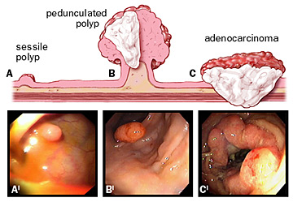
Colon Polyp to Cancer takes about 10-15 years

Slide 10
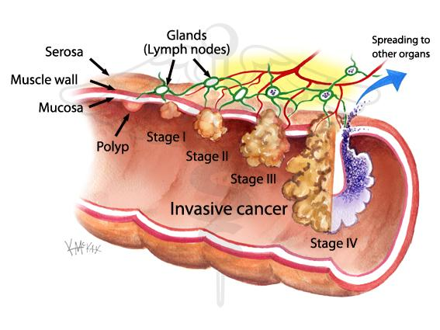
Colorectal cancer screening
Reduction in incidence
Reduction in mortality
Economic benefit in life years saved
Improves QOL

Slide 11
Colon Cancer Tests
Get the test. Get the polyp. Get the cure.
Fecal occult blood testing (FOBT)
Barium enema
Flexible sigmoidoscopy
Colonoscopy
Virtual Colonoscopy
Stool DNA test

Slide 12
Endoscopic tests: Colonoscopy
Dietary preparation and bowel cleansing
Sedation
Complications: bleeding, perforation

Slide 13
Endoscopic tests: Colonoscopy
The most complete screening procedure allowing examination of the entire large bowel and the removal of polyps in one session

Slide 14
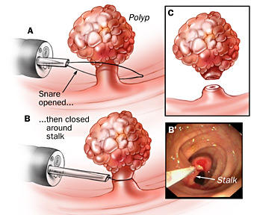
Polypectomy Technique

Slide 15
Endoscopic tests: Sigmoidoscopy
Requires no sedation
Less bowel preparation
Limited the examination to the distal colon
37% of undetected lesions were beyond the reach of the sigmoidoscope
Patients with lesions larger than 1 cm should be referred directly to colonoscopy

Slide 16
Computed Tomographic colonography (Virtual colonoscopy)
Promising technique
Non invasive
No sedation
Sensitivity 90%, specificity 86%
Sensitivity 93%, specificity 97% for lesions more than 1 cm
A positive finding requires colonoscopy
Data are insufficient to determine its clinical impact

Slide 17
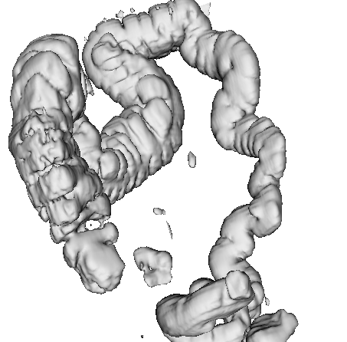
Virtual Colonoscopy
Spiral CT to generate 3D images
Cleaning of bowel, distension with air
Non invasive, no complications
Not endorsed for CRC screening

Slide 19
Limitations of virtual colonoscopy
Variable results
No screening studies
No longitudinal studies
Cost
Does not allow for therapy

Slide 20
Fecal based screening
Fecal Occult Blood Test (FOBT)
Guaiac FOBT
Fecal Immunohistocgemical Test FIT

Slide 21
Guaiac FOBT
Based on pseudoperoxidase activity of heme
Major disadvantages:
May miss tumor that bleed in small amounts or intermittently
High false positive rate (reaction with non human heme in food or bleeding form upper GI tract) (prescribed diet + 3 consecutive specimen)
Randomized control trials: guaiac FOBT reduces mortality from CRC

Slide 22
Fecal Immunohistocgemical Test FIT
FDA approved 2001
Directly detects human globin in hemoglobin
Does not require dietary restrictions
One test is sufficient
Sensitivity 97 %
Specificity 94 %

Slide 23
Stool DNA Test
Detects known DNA alterations during colorectal carcinogenesis in tumor cells sloughed in stool
Multi-target DNA stool assay required to achieve adequate sensitivity and detect the various gene mutations

Slide 24

Stool DNA test
Multi target DNA assay:
SDT-1: 21 separate point mutations: P53, K-ras, APC, plus 2 other markers
SDT-2: Mutations in APC, K-ras, vimentin methylation
Cologuard: first FDA approved (August 2014) for primary screening of CRC
Cologuard: K-ras mutations, aberrant NDRG4 and BMP3 methylation, and ACTB in conjunction with hemoglobin immunoassay

Slide 25

Video Capsule Colonoscopy
In the process of development
  Battery life
No clinical data available
Anticipate to see clinical trials

Slide 26
CRC screening: Average Risk Individuals
No Symptoms
Age ≥ 50
No risk factors

Slide 27
Current Recommendations
Average Risk
Test | Interval (years)
FOBT | Yearly
Sigmoidoscopy | Every 5
FOBT + Sigmoidoscopy | Yearly, every 5
Colonoscopy | Every 10*
Barium enema | Every 5

Slide 28
Approach to Colon Cancer Testing
Asymptomatic
Men and Women
Age < 50 yr
Age ≥ 50 yr
No family Hx
YES family Hx
NO family Hx
No Screening
Average Screening
HNPCC or FAP
2 or more first-degree or
1 first-degree < 60 yrs
1 first-degree
≥ 60 yrs
Genetic Counseling
Colonoscopy every
5 yrs, starting age 40
Average-risk
screening,
starting age 40

Slide 29
Lynch syndrome: Genetic Features
4% of colon cancer cases
Autosomal dominant inheritance
Penetrance ~80%
Germline mutations in 1 of DNA mismatch repair (MMR) genes family (MLH1, MSH2, MSH6, PMS1, PMS2)

Slide 30
Lynch syndrome
70 % chance of developing colon cancer by age 70
40 % risk of developing a second primary colon cancer within 7 years
50% estimated lifetime risk of developing endometrial cancer.

Slide 31
Cancers associated with Lynch syndrome
Colorectal
Ovarian
Small bowel
Upper urinary tract
Hepatobiliary tract
Endometrial
Gastric
Brain
Pancreas
Sebaceous neoplasia of the skin

Slide 32
Clinical Features of Lynch syndrome
Early but variable age at CRC diagnosis (~45 years)
Tumor site in proximal colon predominates
Extracolonic cancers: endometrium, ovary, stomach, urinary tract, small bowel, bile ducts, sebaceous skin tumors

Slide 33
You should suspect Lynch syndrome if a patient has a family history of cancer, especially if there are:
Three or more family members, one of whom is a first-degree relative of the other two, with HNPCC-related cancer
Two successive affected generations
One or more of the HNPCC-related cancers diagnosed before age 50 years
Exclusion of FAP

Slide 34
Amsterdam Criteria
  3 or more relatives with verified CRC in family
    - One case a first-degree relative of the other two
  2 or more generations
  1 CRC by age 50
  FAP excluded
Failure to meet these criteria
does not exclude HNPCC
Vasen HFA et al. Dis Colon Rect 34:424, 1991

Slide 35
Lynch syndrome screening
For colon cancer:
Colonoscopy started at age 25 or 5 years younger than the youngest diagnosis age in the family whichever comes first
To be repeated every 1 to 2 years

Slide 36
Lynch syndrome screening
For endometrial and ovarian cancers:
Patients education to enhance recognition of relevant symptoms
TAH/BSO after completing childbearing
Annual endometrial sampling
Transvaginal ultrasound and serum CA 125: not sufficiently sensitive or specific

Slide 37
Lynch syndrome: chemoprevention
CAPP2 trial
861 patients with Lynch syndrome
Aspirin 600 mg daily or placebo for up to 4 years
After mean follow up of 55.7 months
63 % reduction in the incidence of CRC p= .008
Protection from all Lynch synd cancers p=.001

Slide 38
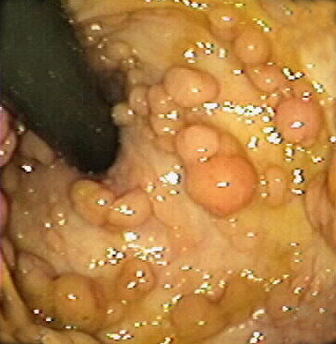
Familial adenomatous polyposis FAP
Autosomal dominant
Germline mutation in APC gene
Estimated penetrance for adenomas >90%
Risk of extracolonic tumors (upper GI, desmoid, osteoma, thyroid, brain, other)
CHRPE may be present
cancer
Notes:
Congenital hypertrophy of the retinal pigment epithelium

Slide 39
Familial adenomatous polyposis FAP
Life time risk for colon cancer 100 % by the age of 50 years
Other cancers associated with FAP:
Duodenal cancer 4 – 12 %
Hepatoblastoma 2%
Thyroid cancer 2%

Slide 40
Multi-Step Carcinogenesis
Loss of
APC
Activation
of K-ras
Loss of
18q
Loss of
TP53
Other
alterations
Normal
epithelium
Hyper-
proliferative
epithelium
Early
adenoma
Inter-
mediate
adenoma
Late
adenoma
Carcinoma
Metastasis
Adapted from Fearon ER. Cell 61:759, 1990
ASCO

Slide 41
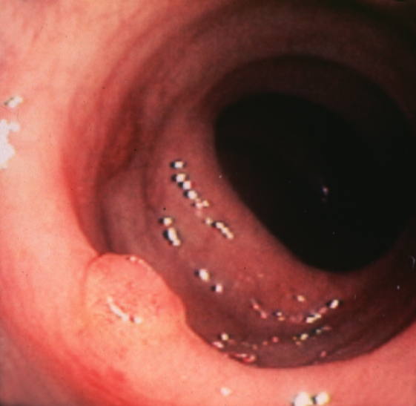
Attenuated FAP
Later onset (CRC ~age 50)
Fewer colonic adenomas
Not associated with CHRPE
UGI lesions
Associated with mutations at 5' and 3' ends of APC gene

Slide 42
Surgical options in FAP and AFAP
Total proctocolectomy with ileal pouch anal anastomosis
Total abdominal colectomy with ileorectal anastomosis
Total proctocolectomy with permanent end ileostomy

Slide 43
Chemoprevention in FAP and AFAP
ASPIRIN SULINDAC CELECOXIB
No FDA approved medication for patients with remaining rectum after surgery
Sulindac is the most potent polyp regression medication
It is not known if the decrease in polyp burden decreases cancer risk

Slide 44
MYH-Associated Polyposis MAP
Autosomal recessive inheritance pattern
1 in every 100 people may carry a single mutation in the MYH gene
Associated with developing less than 20 or 100s of adenomatous polyps similar to FAP or AFAP
Other conditions associated with MAP: polyps in the stomach and the upper GI, thyroid cancer

Slide 45
MAP diagnosis
A possible diagnosis when a person has multiple adenomatous colon polyps but does not have a mutation in the APC gene associated with FAP and AFAP

Slide 46
MAP screening and management:
ASCO recommendations
Colonoscopy every 1 to 2 years, beginning at age 18 to 20
Yearly colonoscopy once a person develops polyps, with the goal of removing all large polyps
Rectocolectomy may be considerd if polyps are too numerous to be moved during a colonoscopy

Slide 47
Peutz-Jeghers syndrome PJS
Rare syndrome
autosomal dominant inheritance
Majority of cases are caused by mutation of STK11 gene
Large pedunculated hamartomatous GI polyps (obstruction, bleeding)
Hyperpigmentation on the lips, buccal mucosa, vulva, fingers, and toes

Slide 48

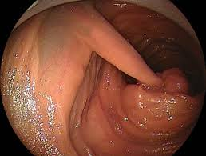

Slide 49
Cancers associated with PJS
Gastrointestinal cancers
Breast cancer
Ovarian cancer
Pancreas cancer
Gallbladder cancer
The risk of developing any cancer by age 65 years: 37 %

Slide 50
Management of PJS
Upper endoscopy and colonoscopy every 2 -3 years stated at 20 years
Biannual breast MRI and mammography started at age 25 years

Slide 51
Serrated Polyposis Syndrome (SPS)
Multiple hyperplastic or serrated polyps are identified in the large bowel
1 in 3000 people may have this condition
Increased risk of developing bowel cancer
May be associated with pancreatic cancer at older ages.
Genetic testing is not available.

Slide 52
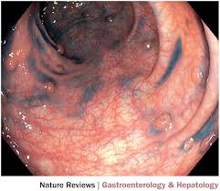
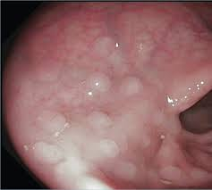

Slide 53
Serrated Polyposis Syndrome (SPS)
Screening by annual colonoscopy ( with removal of polyps) in the initial years after a diagnosis
After a few years the interval between procedures may lengthen.
Occasionally bowel surgery is required when polyps are multiple, large and show early signs of bowel cancer.

Slide 54
Juvenile polyposis syndrome JPS
multiple juvenile polyps in the GI tract
the term juvenile refers to the type of polyp, not to the age of the affected person
While the majority of the polyps found in Juvenile Polyposis Syndrome are non- neoplastic, hamartomatous, self-limiting and benign, there is an increased risk of adenocarcinoma

Slide 55
WHO criteria for diagnosis of juvenile polyposis syndrome are one of either
More than five juvenile polyps in the colon or rectum
or
2. Juvenile polyps throughout the GI tract
or
3. Any number of juvenile polyps in a person with a family history of juvenile polyposis

Slide 56
JPS Presentation
Age of onset is variable
Rectal bleeding, abdominal pain, diarrhea or anemia
Colonoscopy orsigmoidoscopy reveals polyps that vary in shape or size
Polyps can be sessile or pedunculated hamartomatous polyps

Slide 57
JPS Presentation
Autosomal dominant inheritance
2 genes associated with JPS BMPR1A and SMAD4]
The cumulative lifetime risk of colorectal cancer is 39% in patients with juvenile polyposis syndrome.^{[3]}

Slide 58
JPS Presentation
Annual upper and lower endoscopy with polyp excision
Their siblings may also need to be screened regularly

Slide 59
To reduce the risk of CRC
    Follow testing guidelines
    Know your family history
    Get regular exercise
    Do not smoke or use other tobacco products
    Avoid excessive alcohol consumption

Slide 60
To reduce the risk of CRC
    Eat 5 or more servings of fruits & vegetables a day
    Choose whole grain foods
    Limit your intake of red meat
    Maintain a healthy weight

Slide 63
Conclusion
CRC is a common cancer
Preventable
Screening to detect and remove polyps
Colonoscopy every 10 years ++++ for average risk population
To prevent hereditary CRC patients should be managed by expert physicians
Aspirin ++++

Slide 64
شكرا لإصغائكم

