Slide 1

Sickle cell anemia

Slide 2
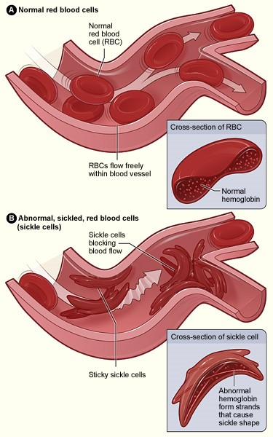
Musculoskeletal Manifestations of Sickle Cell Disease
الدكتور
مؤنس أبو منصور
أخصائي أمراض دم وأورام
رئيس مركز الأمراض الوراثيةبالسويداء

Slide 3
Sickle cell anemia
Sickle cell anemia is an inherited form of anemia — a condition in which there aren't enough healthy red blood cells to carry adequate oxygen throughout your body.

Slide 4
. In sickle cell anemia, the red blood cells become rigid and sticky and are shaped like sickles or crescent moons. These irregularly shaped cells can get stuck in small blood vessels, which can slow or block blood flow and oxygen to parts of the body.

Slide 5
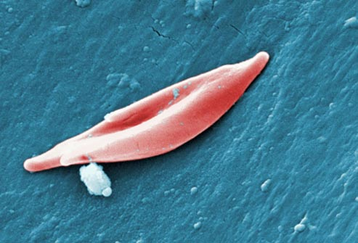

Slide 6
There's no cure for most people with sickle cell anemia. However, treatments can relieve pain and help prevent further problems associated with sickle cell anemia.

Slide 7

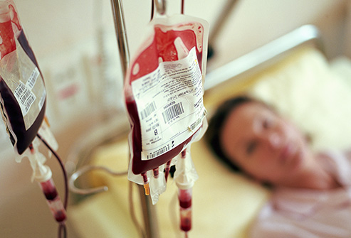

Slide 8
History
In 1910, a Chicago cardiologist, Professor James Herrick, described the sickle cell in the blood film of a dental student, Walter
Clement Noel .
The role of deoxygenation was discovered in the 1920’s by Hahn and Gillespie.
In 1922, a medical student, Verne Mason, at John Hopkins University coined the term sickle cell anemia.

Slide 9
Some 50 years earlier, the African medical literature was quoted to have reported the condition. Long before this time, this condition was known amongst the lgbos in Southeast Nigeria and Binis in the South Nigeria as Ogbanje and Igbakhwan, respectively.

Slide 10
There was recognition that the children involved died early, and it was assumed that they came to bring ill luck and pain to their families. Curiously, more than one child in the family usually had it, with series of ill health and subsequent death.

Slide 11
In 1949, Linus Pauling, et al. were the first to demonstrate that SCD occurs as a result of an abnormality in the haemoglobin molecule. They were the first to link it as a genetic disease due to a mutation of a specific protein .

Slide 12
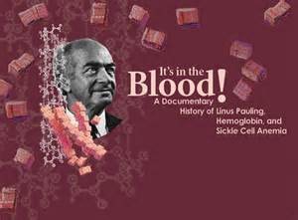

Slide 13
In 1956, Ingram revealed that it was the substitution of valine for the glutamic acid in the sixth position of the beta globulin molecule that was responsible for the abnormal function of the molecule after deoxygenation .

Slide 14
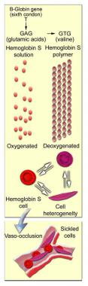
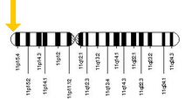

Slide 15
Epidemiology
Almost 300,000 children are born with a form
sickle-cell disease every year
mostly in sub-Saharan Africa, but also in other countries such as the West Indies and in people of African origin elsewhere in the world.

Slide 16
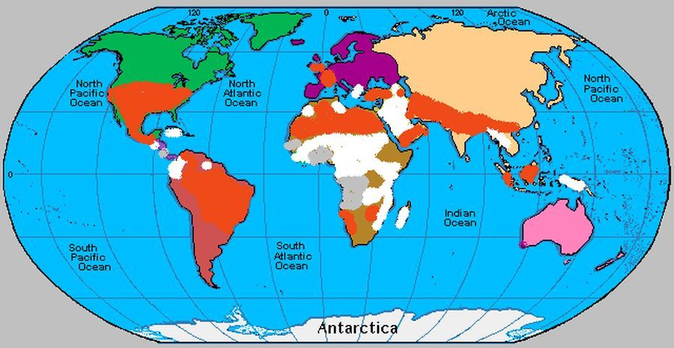
Global prevalence of sickle cell disease.[Orange: 0.1-0.99, White: 1- 9.9, Grey: 10- > 19 Births pathological Hb disorder per 1000 live

Slide 17
Epidemiology
The highest frequency of sickle cell disease is found in tropical regions, particularly sub-Saharan Africa, tribal regions of India and the Middle-East.
Africa:
Three quarters of sickle-cell cases occur in Africa
around 2% of newborns in Nigeria were affected by sickle cell anaemia.

Slide 18
150,000 affected children born every year in Nigeria alone.
The carrier frequency ranges between 10% and 40% across equatorial Africa.
United States:
The prevalence of the disease in the United States is approximately 1 in 5,000, mostly affecting Americans of Sub-Saharan African descent,

Slide 19
In the United States, about 1 out of 500 African-American children and 1 in every 36,000 Hispanic-American children born will have sickle-cell anaemia.
Sickle cell trait occurs among about 1:12 African-Americans and 1:100 Hispanic-Americans.
It is estimated that 2.5 million Americans are heterozygous carriers for the sickle-cell trait

Slide 20
Middle East:
In Saudi Arabia about 4.2% of the population carry the sickle-cell trait and 0.26% have sickle-cell disease. The highest prevalence is in the Eastern province where approximately 17% of the population carry the gene and 1.2% have sickle-cell disease.

Slide 21
India:
Sickle-cell disease is common in the tribal people of central India who share a genetic linkage with the african race, where the prevalence has ranged from 9.4 to 22.2% in endemic areas of madhya .pradesh, rajasthan and chhattisgarh.

Slide 22
In 2013 it resulted in 176,000 deaths up from 113,000 deaths in 1990.

Slide 23
Orthopaedic complications
Avascular necrosis of hip
Osteomyelitis
Septic arthritis
Leg ulcer
Growth retardation and skeletal immaturity
Dactylitis
Osteoporosis and vertebral collapse
Pathological fracture
Arthritis
Vaishya R, Agarwal A, Edomwonyi E O, et al. (October 20, 2015) Musculoskeletal Manifestations of Sickle Cell Disease: A Review. Cureus 7(10): e358. doi:10. .7759/cureus.358

Slide 24
Avascular Necrosis and Medullary Infarct
Avascular necrosis (AVN) of the bone is a relatively common problem among patients with SCD. The femoral head is the most common area of bone destruction in those patients.
Vaishya R, Agarwal A, Edomwonyi E O, et al. (October 20, 2015) Musculoskeletal Manifestations of Sickle Cell Disease: A Review. Cureus 7(10): e358. doi:10. .7759/cureus.358

Slide 25
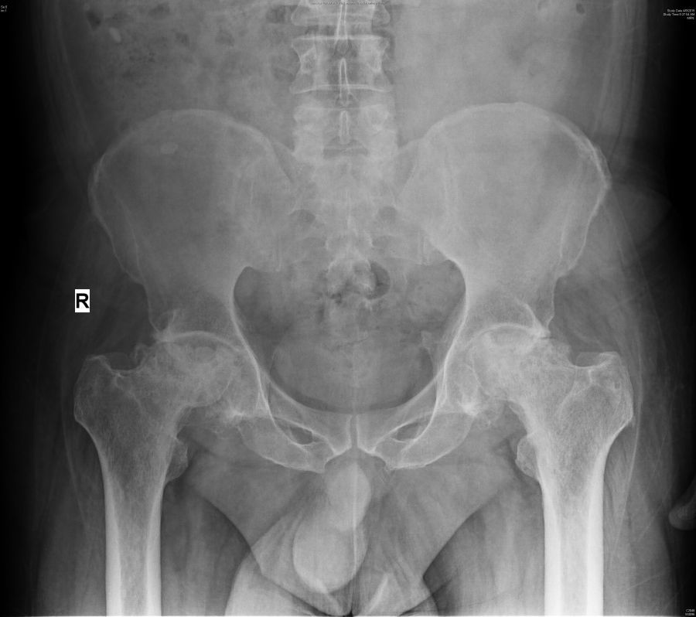
: X-ray pelvis anteroposterior view showing avascular necrosis of the head of the femur

Slide 26
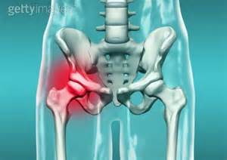

Slide 27
Other sites affected are the shoulder, knee, and talus

Slide 28
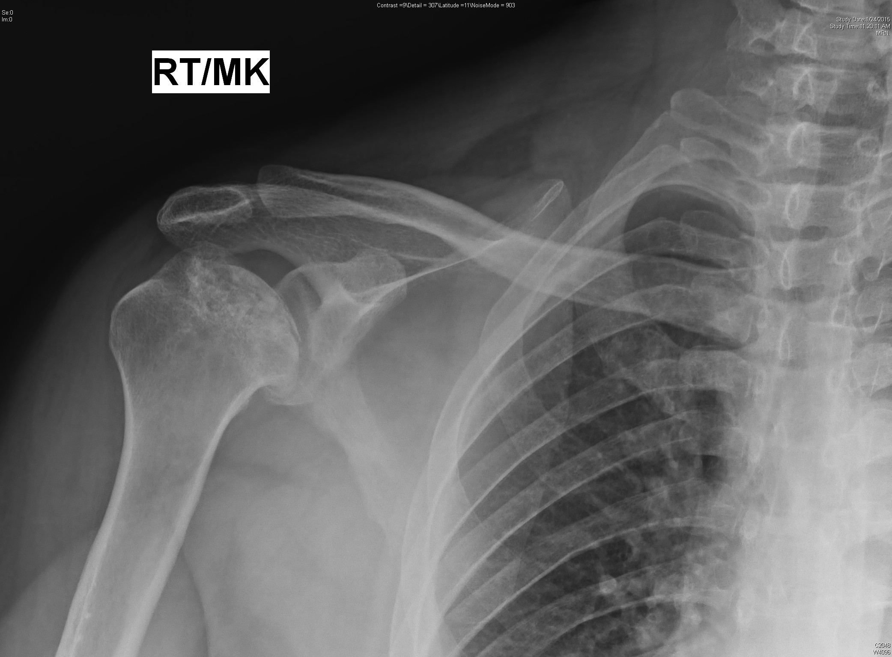
X-ray right shoulder anteroposterior view showing avascular necrosis of the head of the humerus

Slide 29
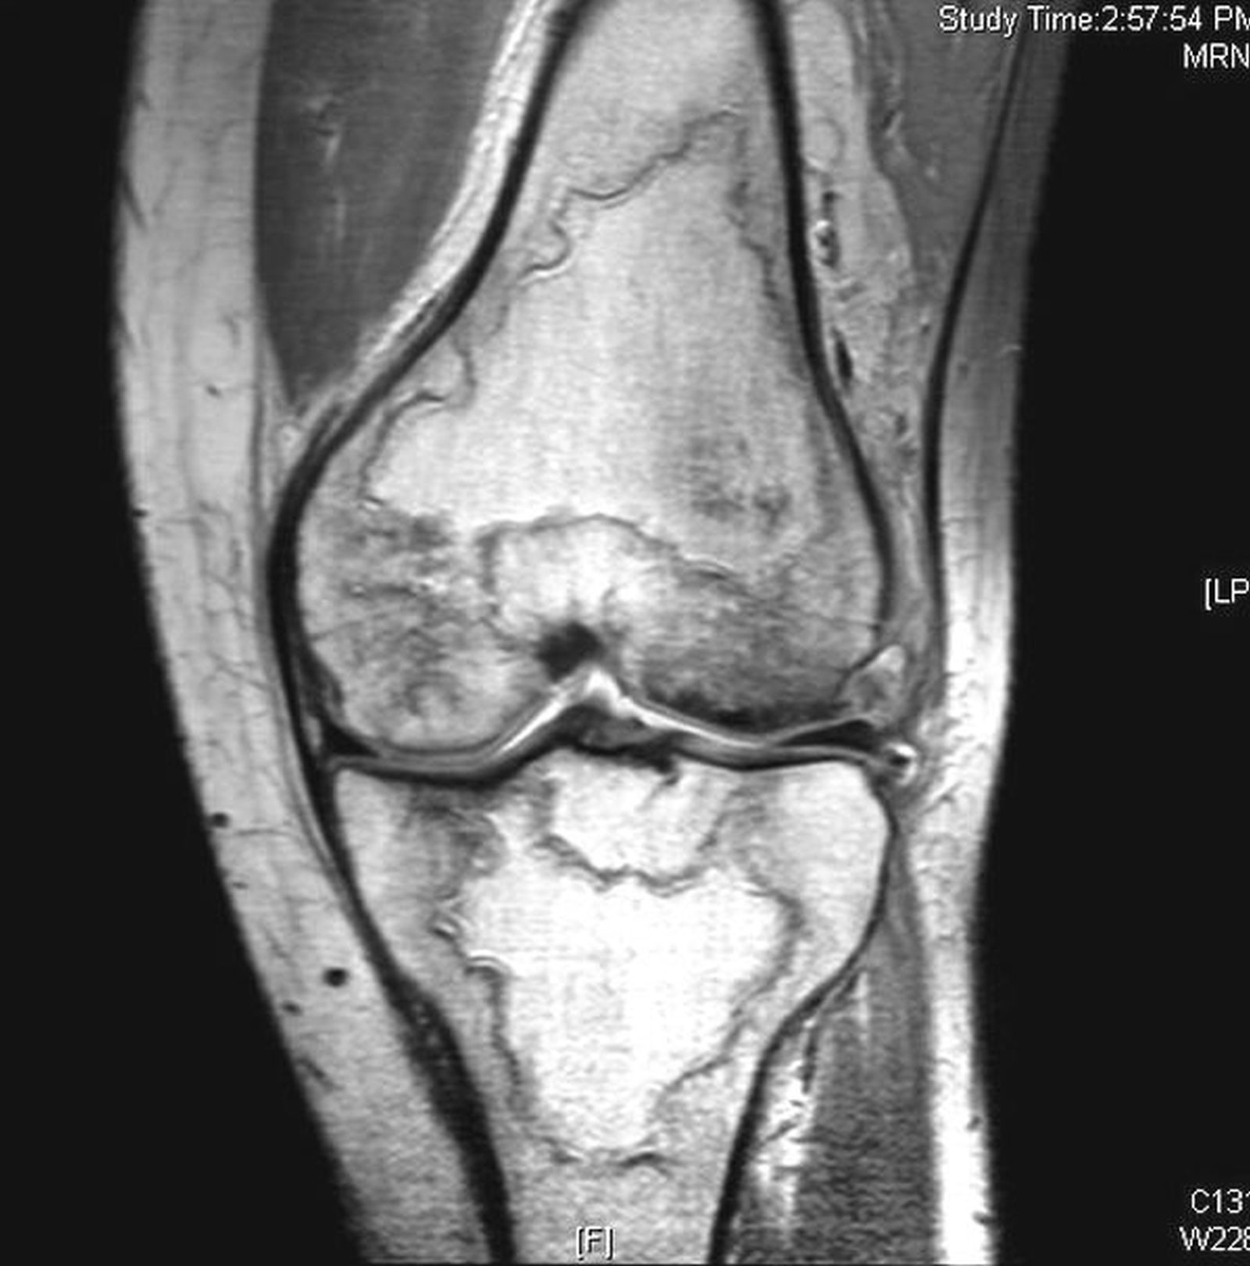
MRI of the knee showing multiple infarcts

Slide 30
AVN in SCD is different from AVN due to other causes. In SCD:
1- the entire epiphysis of the long bone is uniformly affected while, in other conditions, the weight-bearing areas are commonly involved.
2-The initial infarcts often occur in the subchondral regions where the collateral circulation is minimal

Slide 31
3-The overlying articular cartilage often remains viable in the early stages of the disease because it receives nutrition fromthe synovial fluid,
4- then micro-fractures develop that eventually lead to the collapse of necrotic cancellous bone and ultimately to joint destruction

Slide 32
5-This almost always includes the anterior superior portion of the proximal femur, where the weight-bearing forces are the greatest .
6-Early reports have found a higher rate of AVN in homozygous SCD compared with other sickle mutations.

Slide 33
The pathogenesis of AVN is still not clear. Several possible factors have been implicated:
1- intravascular coagulation
2- microvascular occlusion (following marrow hyperplasia with tissue crowding)
3- fat embolism
4- intraosseous stress
5- immunologic factors

Slide 34
The treatment of early disease may require:
-prolonged bed rest
-with the traction of the affected limb to relieve the weight,
-physical therapy, and subsequently graduated weight-bearing.
-Untreated asymptomatic AVN of the femoral head in patients with SCD has a high likelihood of progression and collapse

Slide 35
Therefore, early surgical intervention to retard the progression of the disease is helpful .
Many surgical procedures have been proposed to treat AVN, but none is entirely satisfactory.
Core decompression with the removal of necrotic zones and concomitant bone grafting or muscle pedicle grafting is a vital option for early cases

Slide 36
The purpose of core decompression is to promote osteogenesis and improve bone repair.

Slide 37
-Electrical stimulation may be transiently effective in some cases.
-Autologous bone marrow graft or acrylic cement may be helpful to support the subchondral bone at risk of collapse

Slide 38
The procedure of the core decompression with a vascularized fibular transplant is a promising treatment for AVN.
Arthroscopic and surgical debridement are other options available

Slide 39
-Upper femoral osteotomy redirects the load on the femoral head and prevents further
collapse of the femoral head.
-Total hip arthroplasty (THA) is the only option left with advanced stage disease .
-Overall, patients with SCD requiring THA are younger than the general population

Slide 40
Osteomyelitis
-Nearly 90% of SS sicklers suffer from osteomyelitis of one or more bones before
they are ten years of age.
- No bone is exempted from osteomyelitis, and several bones could be affected at a time

Slide 41
few factors that predispose Osteomyelitis
- Hyposplenism
- impaired complement activity
- presence of infarcted and necrotic bone

Slide 42
The common infective agents i
- Staphylococcus pyogenes
- coliforms.
- Salmonella typhi
is more common in SCD patients than in the
general population .
It could be multifocal in some cases

Slide 43
.
Osteomyelitis commonly affects the diaphysis of the femur, tibia, or humerus.

Slide 44
The acute attack of bone infarction could present as
- persistent fever.
- swelling.
- bone tenderness.
- leucocytosis.
- septicaemia.

Slide 45
Like acute osteomyelitis, significant x-ray finding is usually not seen in the early stages of bone infarction.
Infarction can be 50 times more common than bacterial osteomyelitis in those who have sickle cell disease .

Slide 46
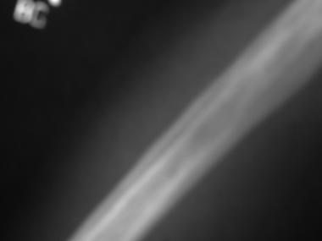

Slide 47
It is admissible, however, that a persistent leukocytosis with fever, overabundant involucrum suggests osteomyelitis.

Slide 48
Radionuclide scanning can be useful. It has been shown that a combination of the 99mTc-sulphur colloid and 99mTc-diphosphonate or 99mTc with gallium leads to improved accuracy .
The marrow uptake is normal in osteomyelitis but increased in infarction

Slide 49
MRI shows considerable overlap between infection and infarction. However, specificity is increased by contrast enhancement.
It is more useful in the localization of the lesion and monitoring of response to treatment

Slide 50
Treatment of acute osteomyelitis
Treatment of acute osteomyelitis is mostly conservative and may require immobilization in plaster or traction, analgesics, and broad-spectrum antibiotics for six weeks

Slide 51
Chronic osteomyelitis
Chronic osteomyelitis may manifest as a discharging sinus. The infection is mostly contained locally, and systemic signs are common. An x-ray may reveal sequestrum, abundant involucrum, and cloaca. Wound swab culture and biopsy are advised

Slide 52
Treatment involves adequate surgical debridement, management of the resultant dead space, and antibiotic coverage based on a sensitivity pattern.

Slide 53
Septic Arthritis
Septic arthritis (SA) results from vaso-occlusion involving articular surfaces with subsequent infection .
It is usually by haematogenous spread. The profile of the organisms is similar to that of osteomyelitis

Slide 54
Diagnosis can be confirmed by a culture of joint aspirate. Early diagnosis and treatment are essential to prevent irreparable joint damage. The treatment entails bed rest, drainage, and splinting of the joint, graduated mobilization, analgesics, and antibiotics.
Arthroscopic debridement and irrigation are rewarding

Slide 55
Leg Ulcers
SCD patients commonly present with leg ulcers with up to 90% occurring in the lower third of the leg above the medial malleolus.
It is bilateral in 30% of the cases, and it is usually superficial.

Slide 56
The cause is multifactorial and has been associated with trauma, infection, anaemia, and circulatory defects in the ankle due to stasis and thrombosis

Slide 57
Treatment includes: bed rest, limb elevation, dressings, compression bandaging, and use of zinc tablets and zinc cream.
Ulcer excision and subsequent skin cover with skin graft provide a good result.
A human epidermal autograft is being advanced

Slide 58
Growth Retardation and Skeletal Immaturity
Abnormalities of growth are one of the primary orthopaedic complications of SCD in children.
The pathological basis for these is numerous. Marrow hyperplasia leading to ischaemia accounts for the H-shaped and ‘tower’ vertebrae of the spine.

Slide 59
Local anoxic events may result in the premature closure of the epiphysis and impaired or even asymmetrical growth of the long bones of the limbs.
Skeletal immaturity and subsequent retardation in growth and angular deformities are usually seen .
The ongoing hematopoietic activity involving the skull bones leads to expansion and subsequent frontal bossing observed in some of these patients.

Slide 60
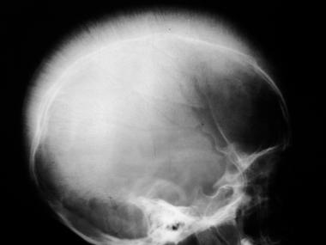

Slide 61
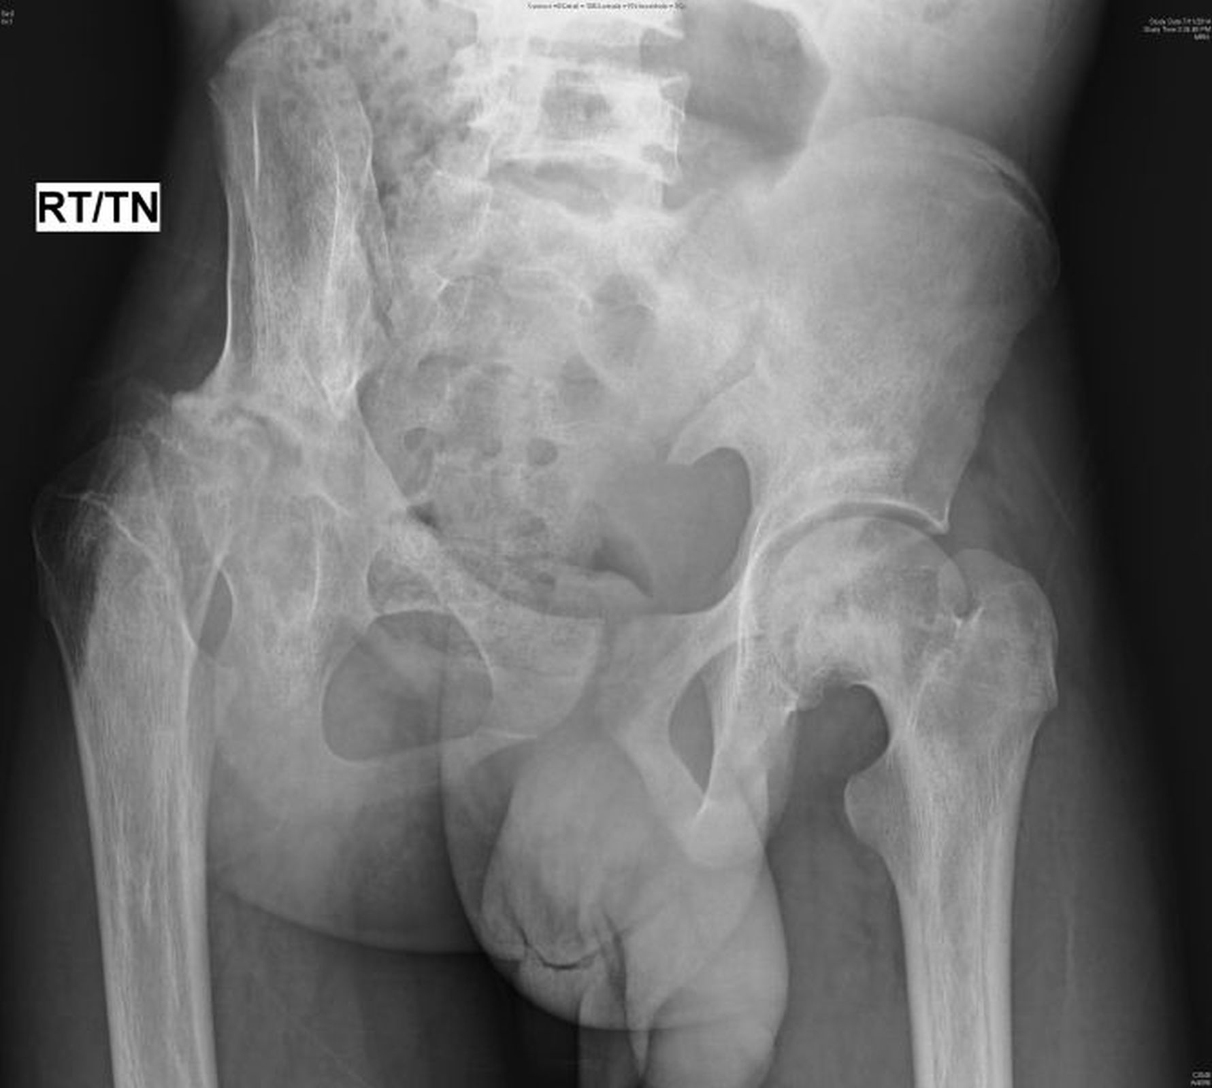
Figure 6: X-ray pelvis anteroposterior (AP) view showing retardation in growth of the proximal femur

Slide 62
Dactylitis
Hand and foot syndrome is common at six months to seven years of age.
These are symptomatic microinfarcts in the phalanges and metatarsal bones,

Slide 63
Symptoms of dactylitis consist of:
1- unilateral or bilateral painful swelling of the distal extremities.
2- This painful swelling of the hands and feet is often associated with leukocytosis and fever. 3-The symptoms mimic osteomyelitis or cellulitis.
4- the symptoms of dactylitis are self-limiting and usually resolve within a month

Slide 64
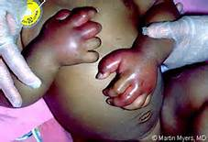
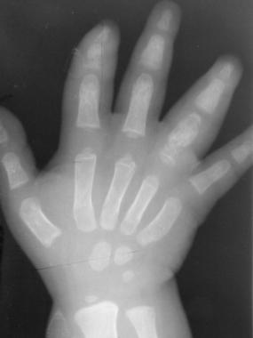

Slide 65
Conservative treatment is advised since symptoms usually resolve within weeks. Treatment includes:
1- bed rest.
2- elevation, immobilization.
3- analgesics.
4-Mild heat is acceptable, but avoidance of ice or cold is necessary to avoid a vaso-occlusive crisis .

Slide 66
Osteoporosis and Vertebral Collapse
Patients with SCD have been shown to have a lower bone density at all sites compared with age match in the general population . This is attributed to erythroid hyperplasia due to increased haemopoietic activity in the bone resorption. This leads to generalised osteoporosis and thinning of the cortex, especially in the vertebrae

Slide 67
. Radiologically, the vertebral body appears as biconcave or ‘fish-mouth’ due to the effect of the intervening disc on the adjoining vertebral end plate.
Vertebral collapse can thus readily occur following weakening from thrombosis or infarction.
This is common sequelae to osteoporosis involving the vertebrae

Slide 68
Rest or physical therapy is often only minimally helpful.
proper thoracic or lumbar orthosis can be beneficial and diminish the need for medications.
Surgical intervention may be required in advanced collapse

Slide 69
Pathologic Fracture
Osteoporotic bone is prone to pathologic fracture as it cannot withstand normal physiological stresses. Repeated infarcts give rise to areas of necrosis and weakening that are prone to pathologic fractures.
These weakened bones can be protected by external casts and fractures fixed internally or externally as the case may require.

Slide 70
Arthritis
Several forms of arthritis, both inflammatory and non-inflammatory, are described in association with SCD, including:
1- bone infarcts.
2- hyperuricemia.
3- gout.
4-osteomyelitis

Slide 71
Arthritis associated with SCD is usually
1-polyarticular (more than 80% of cases) and symmetric (over 60% of cases),
2- with a predilection for large joints and lower extremities and generally lasting less than a week .
3-X-rays can identify periarticular osteopenia, bone erosion, synovitis, and joint space narrowing.

Slide 72



Slide 73
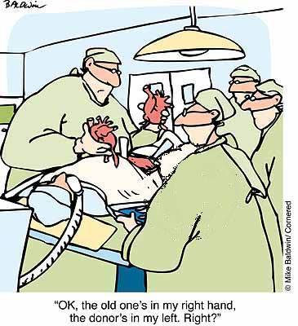
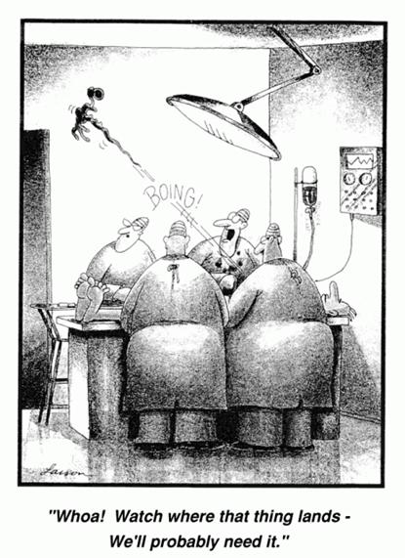

Slide 74
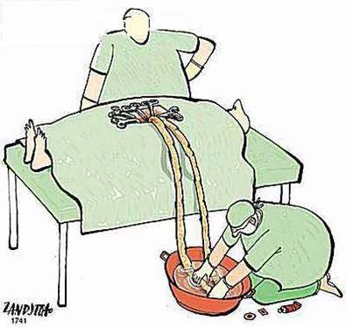

Slide 75
الرجل الذي نقل الجبل
من مكانه هو من بدأ
بنقل الأحجار الصغيرة

Slide 76
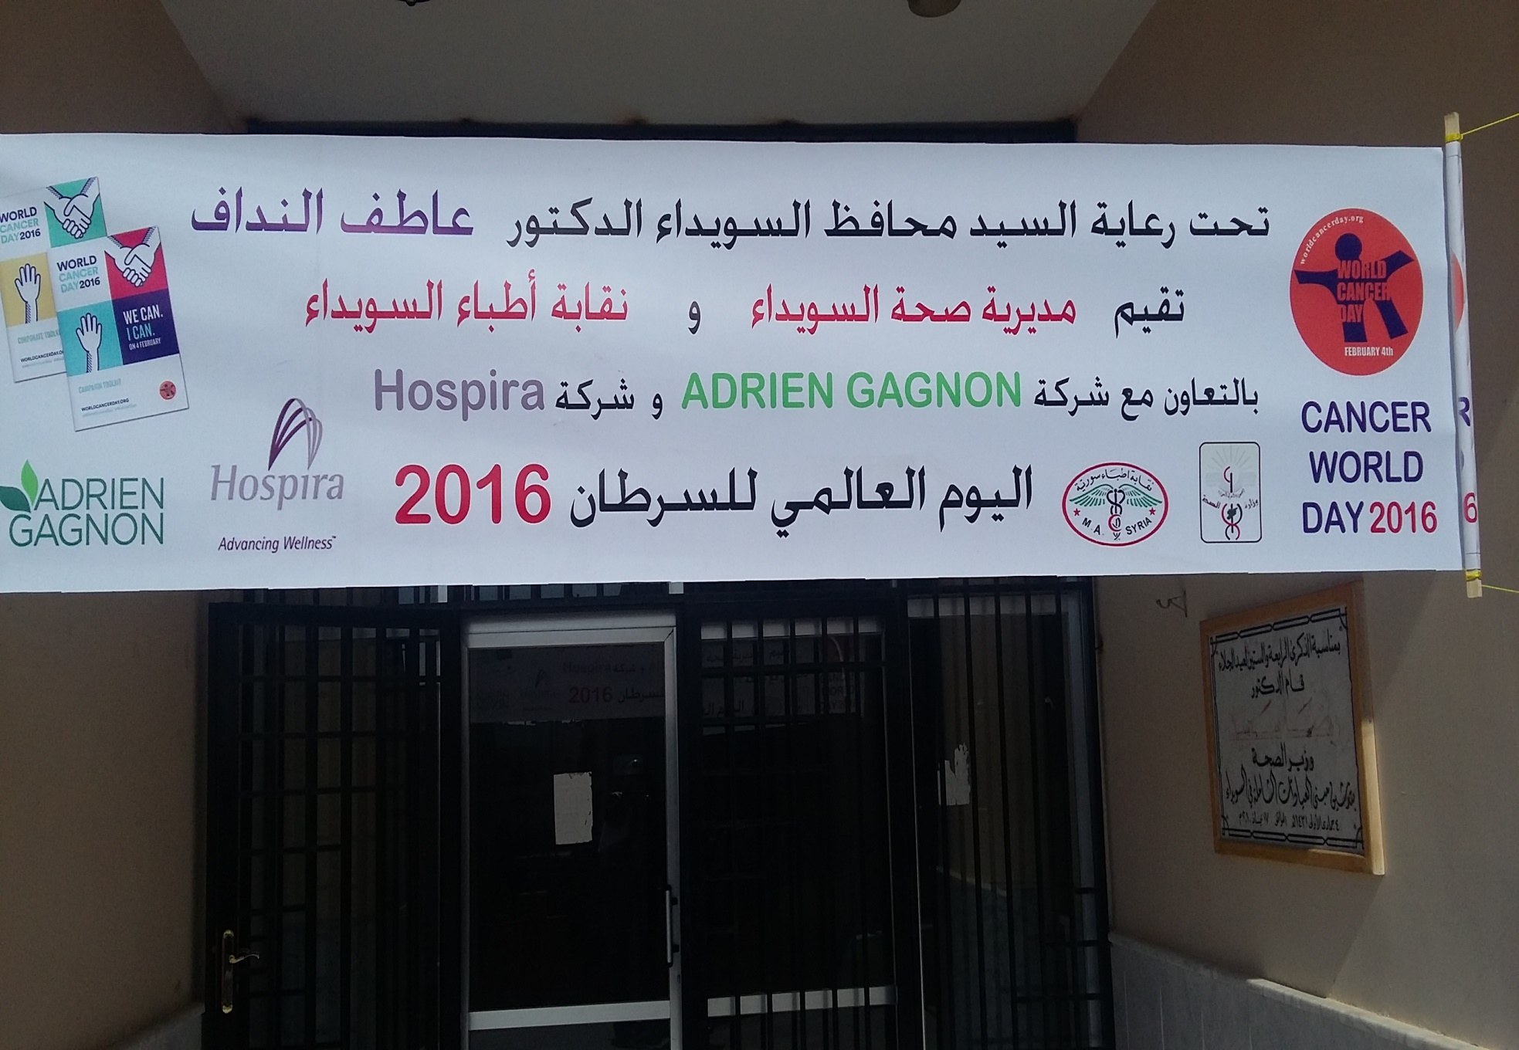

Slide 77

Thank you

