Slide 1
Therapy Targeted
مؤتمر نقابة أطباء سورية العلمي الأول
د.نورس نبيل جعفر
أخصائية في علم الأورام
طبيبة مشرفة بمشفى ابن النفيس

Slide 2
Cancer is one of the most common causes of death, taking nearly 7 million lives each year worldwide.
Therefore, current efforts to cure cancer have been focusing on drugs, biological molecules and immune mediated therapies.

Slide 3
Here we will explain:
What is targeted therapy?
The different ways that targeted therapy can work
Some of the types of targeted therapy
What you can expect if you are being treated with targeted therapy (including some common side effects)

Slide 4
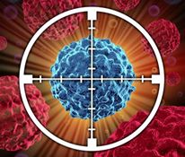
What is targeted therapy?
Targeted cancer therapies are drugs or other substances that block the growth and spread of cancer by interfering with specific molecules ("molecular targets") that are involved in the growth, progression, and spread of cancer.

Slide 5
What is the goal of targeted therapies?
Cure cancer
Kill cancer cells
Slow tumor growth
Relieve symptoms from cancers

Slide 6
The difference between the target and chemotherapy treatment
chemotherapy | Targeted therapy
act on all rapidly dividing normal and cancerous cells. | act on specific molecular targets that are associated with cancer
cytotoxic | cytostatic
More side effects | Few side effects

Slide 7
Types of targeted therapy used today
There are two main types of targeted therapy drugs:
Monoclonal antibody drugs :are man-made versions of large immune system proteins (called antibodies) that are designed to attack a very specific target on cancer cells.
Small-molecule drugs :target molecules that are inside cancer cells themselves. Because of their small size, they can easily enter the cells and interfere with the molecules inside.

Slide 8
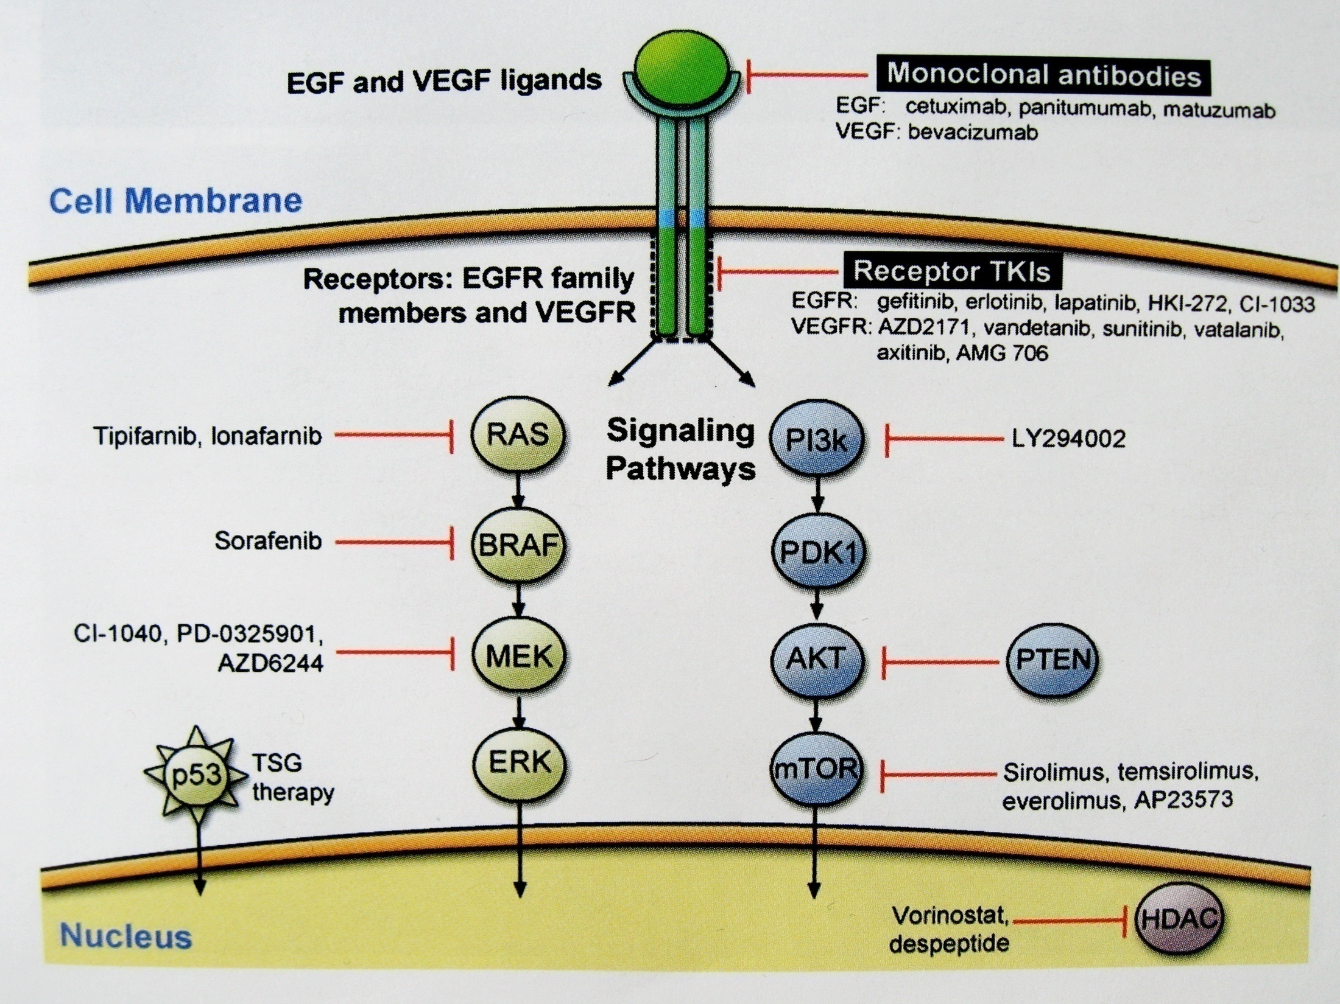

Slide 9
Inhibitors of Epidermal growth factor receptor (EGFR)
tyrosine kinase inhibitors (TKI's):
erlotinib
gefitinib
monoclonal antibody against EGFR:
cetuximab
panitumab
Inhibitors of vascular endothelial growth factor (VEGF)
tyrosine kinase inhibitors (TKI's):
Sorafinib
Pazobanib
Sunitinib
monoclonal antibody against VEGFR :
bevacizumab
Inhibitor of tyrosine kinase (TKI's):(BCR-Abl)
Imatinib
Nilotinib
Dasatinib

Slide 10
Estrogen modulators and aromatase inhibitors ( AIs ) Tamoxifen , Letrozole , Anastrozole and Exemestane
Anti-CD 20 : Rituximab
Anti-HER2 ( Erb-2 ) : a) Monoclonal antibodies : Trastuzumab b) TKI : Lapatinib
Anticytoxic T-lymhocyte antigen-4 inhibitors ( CTLA-4 ) : Ipilimumab
Anaplastic lymphoma Kinase inhibitors ( ALK ) : Crizotenib ( in NSCLC and anaplastic large cell lymphoma )
Anti-CD 40 : Dacetuzumab ( refractory NHL )
Vascular disrupting agents : a) Fluvanoids ( Vadimezan ) b) Tubulin binding compounds.
Mutagen-activated protein kinase inhibitors: Under investigations in NSCLC , melanoma , CRC and breast

Slide 11
Some targeted therapy drugs

Slide 12
1-IMATINIB
the first selective oral tyrosine kinase inhibitor to be approved for the treatment of cancer in 2001.
Inhibitor of tyrosine kinase (TKI's):(BCR-Abl)
can be used to treat:
CML, gastrointestinal stromal cell tumors(GIST),ALL(Ph+), and Melanoma advanced or metastatic with C-KIT mutation

Slide 13
IMATINIB

Slide 14
2-GEFITINIB
a selective oral epidermal growth factor receptor tyrosine kinase inhibitor.
Gefitinib is FDA-approved 2003 for treatment of patients with locally advanced or metastatic NSCLC with activating mutation of EGFR-TK.

Slide 15
GEFITINIB

Slide 16
3-Erlotinib
Erlotinib is an EGFR tyrosine kinase inhibitor, Oral agent One 150 mg tablet daily.
can be used to treat:
NSCLC first-line therapy in patients with EGFR mutations ,Pancreatic cancer progression.

Slide 17
4-Cetuximab
Cetuximab is a Mob to the epidermal growth factor receptor (EGFR)
can be used to treat:
Metastatic colorectal cancer KRAS (wild type),Advanced NSCLC(Non small cell lung cancer) EGFR-expressing ,Unresectable Squamous cell skin cancer ,Head and neck cancer(Squamous cell)

Slide 18
5- Bevacizumab
Bevacizumab is a Mob to the vascular endothelial growth factor receptor (VEGFR)
can be used to treat:
Metastatic colorectal cancer ,first-line treatment of metastatic non-squamous NSCLC, Glioblastoma, Metastatic Renal cell cancer,Advanced Ovarian cancer, Metastatic breast cancer, Soft tissue sarcoma.

Slide 19
6- TRASTUZUMAB
Trastuzumab is a recombinant humanized monoclonal antibody that binds with high affinity to the extracellular juxtamembrane domain of HER2 and inhibits the proliferation of human tumor cells that overexpress HER2.
can be used to treat:
Breast cancer adjuvant or metastatic treatment(HER-2+), Gastric cancer metastatic(HER-2+)

Slide 20
TRASTUZUMAB

Slide 21
7-Rituximab
Anti-CD20 Monoclonal Antibody.
can be used to treat:
Non-Hodgkin's lymphoma(NHL; Relapsed-Refractory-low grade or follicular CD20-Positive,B-cell), CLL.

Slide 22
RITUXIMAB

Slide 23
8-SORAFENIB
Oral(VEGF) Vascular endothelial growth factor receptor tyrosine kinase inhibitor.
can be used to treat:
Advanced renal cell carcinoma,Hepatocellular cancer,GIST,Thyroid cancer,Angiosarcoma.

Slide 24
Will targeted therapy drugs be my only treatment for cancer?
Sometimes treatment with a targeted therapy drug will be the only treatment you need.
But in most cases, targeted therapy is used along with other treatments such as chemo, surgery, and/or radiation therapy.

Slide 25
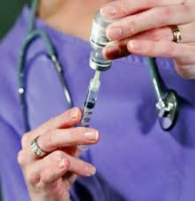
How are targeted therapy drugs given?
The most common way to give these drugs is as a pill (by mouth) or into a vein(intravenous).

Slide 26
What causes side effects?
Side effects from these drugs depend largely on what the drug targets.
Some drugs target substances that are more common on cancer cells, but are also found on healthy cells. So these drugs may affect healthy cells too ,causing some side effects.
When drugs attack more than one target, side effects are more likely.

Slide 27
Side effects of targeted therapy drugs
Skin problems:
Many of the targeted therapy drugs can cause a rash or other skin changes.
These problems usually develop slowly over days to weeks and are not signs of a drug allergy.

Slide 28
What kind of skin changes can targeted therapies cause?
Changes in how your skin feels:
Your skin may start off feeling like it’s sunburned, before any redness or rash shows up. Even though it doesn’t look different, the sensation can be disturbing.
You may notice this change on your face as early as the first week of treatment.

Slide 29
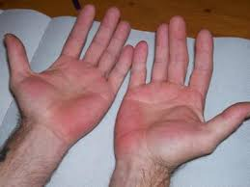
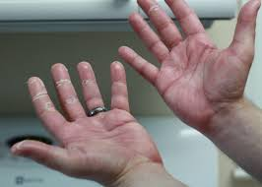
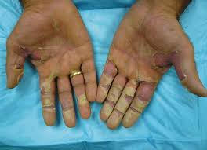
Rash: The most common skin change is a rash
The rash is mild for most people.
It often looks like acne (but with no blackheads) and shows up on the scalp, face, neck, chest, and upper back.
starts as skin redness and swelling and is often worst within the first few weeks of treatment.
By about the 4th week of treatment, the skin usually crusts and gets very dry and red but it should completely go away about a month after treatment is stopped.

Slide 30
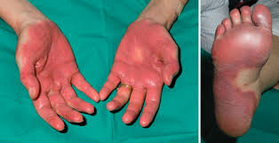
Dry skin, Itching, Red, sore cuticles (the areas around the nails), Hand-foot syndrome: The cause of this syndrome is not known for sure. It may have to do with damage to the tiny blood vessels in the hands and feet, or with the drugs themselves leaking out of the blood vessels and causing Tissue damage.

Slide 31
Changes in hair growth and it’s color.
Changes in and around the eyes:
The eye itself may burn, and become dry or red. In some, the eyelids get tender,swollen,or inflamed,
and crusts may be seen in the lashes.
High blood pressure, Problems with bleeding or clotting, Problems with wound healing.

Slide 32
Diarrhea
Nausea and vomiting
Constipation
Mouth sores
Shortness of breath or trouble breathing
Cough
Feeling tired all the time (fatigue)
Headache
Swelling in your hands and feet
Low blood cell counts

Slide 33
what’s next?

Slide 34
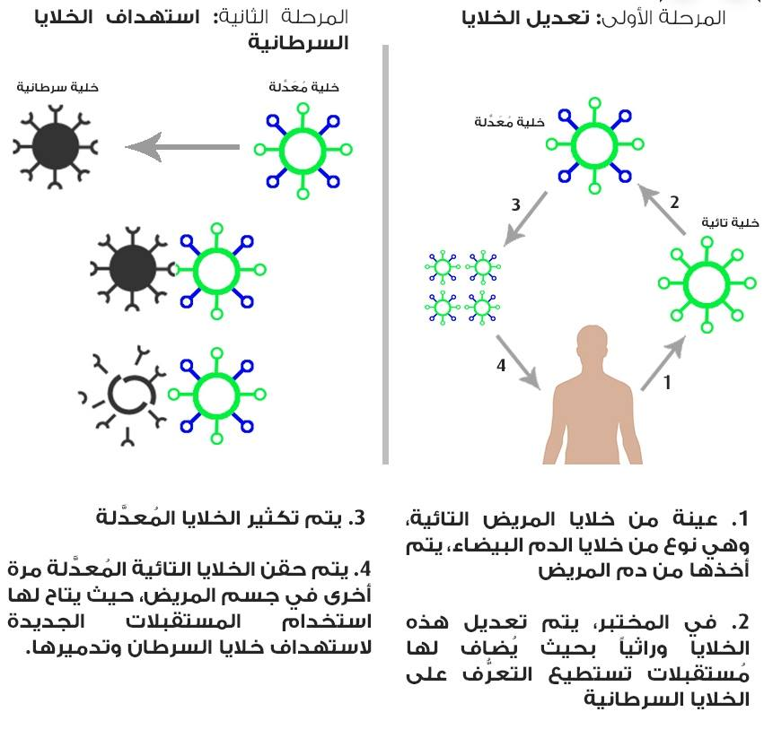
Immunotherapy of Cancer

Slide 35
Cancer treatment

Slide 37
LOVE SYRIA
THANK YOU

