Slide 1
Endocrine Complications in Patients with Thalassemia Major
Dr . Mouna Dakar

Slide 2
Epidemiology
Approximately 7% of the world’s population is a carrier of haemoglobin disorders¹
Between 300,000 and 500,000 infants are born every year with severe homozygous forms of the disease¹
An overview of the global distribution of thalassaemias shows that in addition to the Mediterranean countries in which they were first recognized, thalassaemias are frequently found in Asia and the Far East²
Population migration has led to spread of this condition with its morbidity and mortality²
1. Weatherall D, et al. Disease Control Priorities in Developing Countries, 2006.
2. Cappellini N, et al, eds. Thalassaemia International Federation; 2000.

Slide 3
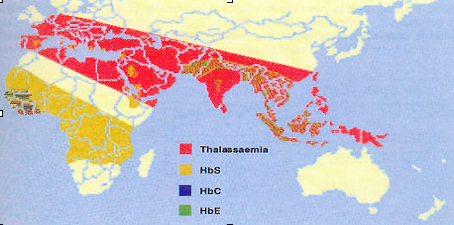
Thalassaemia—Global Distribution
Due to the continual migration of populations from one area to another, there is virtually no country of the world now in which thalassaemia does not affect some percentage of the inhabitants
Cappellini N, et al, eds. Thalassaemia International Federation 2000, with permission.

Slide 4
Iron Distribution & Turnover In Humans
Erythron
2g
20-30mg/day
20-30 mg/day
Parenchyma
0.3g
Liver
1g
Macrophages
0.6g
Transferrin
3mg
2-3mg/day
20-30 mg/day
1-2 mg day
Gut
Adapted with permission from Porter JB; Hematol/Oncol Clinics 2005; 19, 1-6.
Andrews NC. N Engl J Med. 1999; 341:1986-1995.
Notes:
3
8

Slide 5
Iron Loading From Blood Transfusions
1 unit of blood contains approximately
200 mg of ironª
  Normally, total body iron is approximately
  3 to 4 g
  Chronic transfusion-dependent patients have an iron excess of 0.3 to 0.7 mg/kg/day, equivalent to 4 to 10 g of iron per year^{b}
Iron accumulates with repeated blood transfusion
ª Porter JB. Br J Haematol. 2001;115:239-252.
^{b} Andrews NC. N Engl J Med. 1999;341:1986-1995.

Slide 6
Iron Overload
1 unit of blood contains approximately
200–250 mg of iron¹
  Chronic transfusion-dependent patients have an iron excess of ~ 0.32–0.64 mg/kg/d²
With repeated infusions, iron accumulates
  Signs of iron overload can be seen after anywhere from 10 to 20 transfusions, such as in thalassaemia major patients²
Iron overload can lead to early mortality²
1. Andrews NC. N Engl J Med. 1999;341:1986.
2. Porter JB. B J Haematol. 2001;115:239.

Slide 7
Plasma Ferritin as a
Monitor of Iron Loading
Relatively non-invasive
Inexpensive
Obtained as
routine laboratory assay
Values confounded by
  Inflammation
  Liver function
24,000
Sickle cell anemia (n = 37)
Thalassemia major (n = 74)
12,000
Plasma ferritin, µg/L
8000
4000
0
0
4000
8000
12000
Hepatic iron, µg Fe/g liver *
Brittenham et al. Am J Hematol. 1993;42:81.
Notes:
Brittenham GM, Cohen AR, McLaren CE, et al. Hepatic iron stores and plasma ferritin concentration in patients with sickle cell anemia and thalassemia major. Am J Hematol. 1993;42:81-85.

Slide 8
Organ Systems Affected by
Iron Overload
Pituitary gland
Heart
Liver
Pancreas
Gonadal
Iron overload results in non–transferrin-bound
iron in the plasma
Increased iron uptake into selective organs
Generation of free hydroxyl radicals
Tissue damage

Slide 9
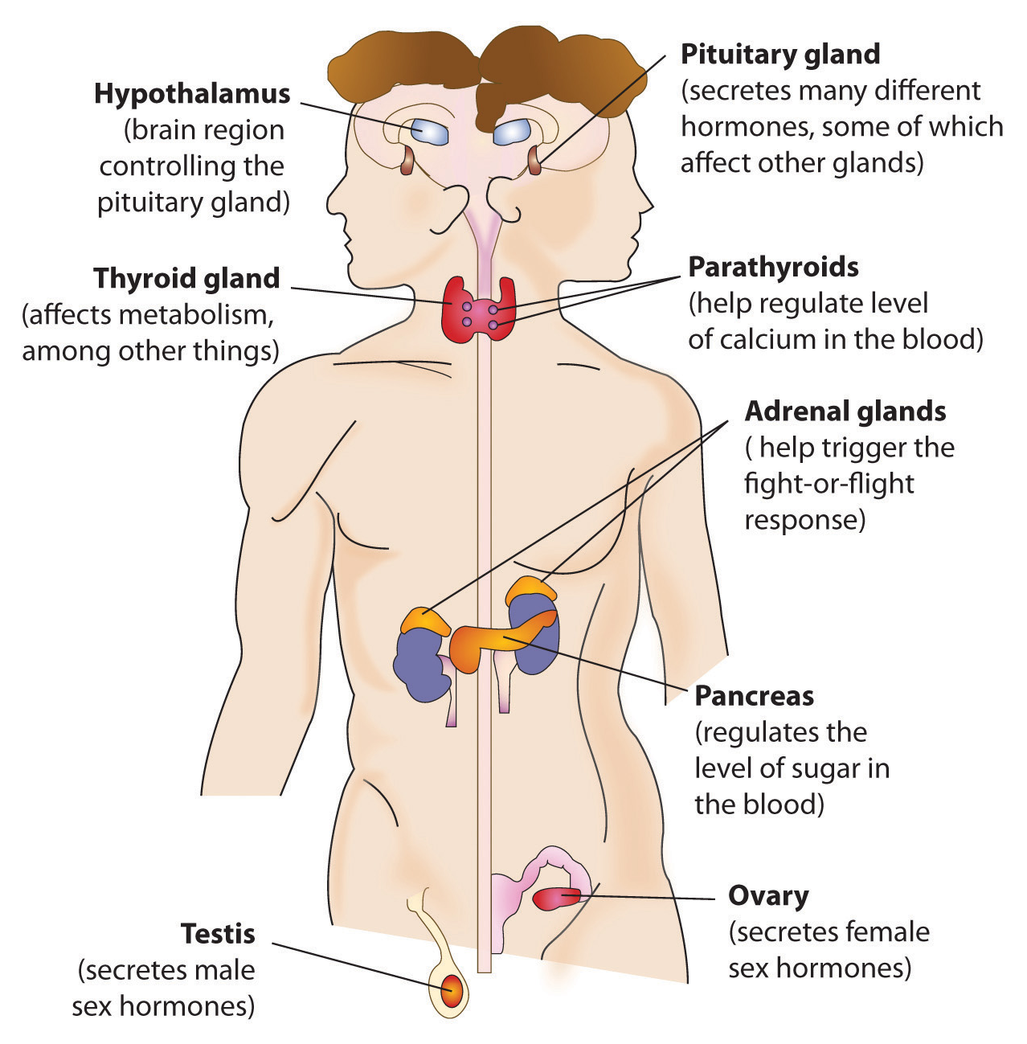
Where do hormones come from and what do they do?

Slide 10
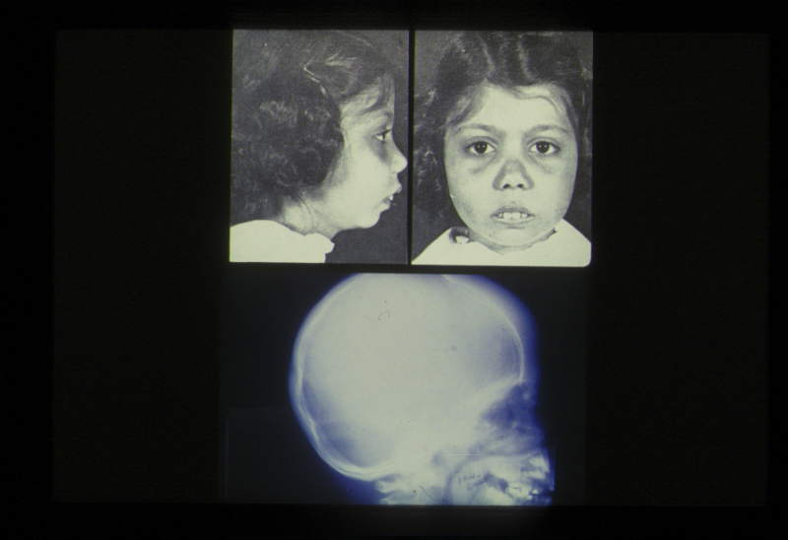
Clinical Manifestations
With permission from Dr. Cappellini.

Slide 11
Endocrine complications in patients with Thalassaemia Major.
Toumba M¹, Sergis A, Kanaris C, Skordis N
.
Abstract
Patients with multi-transfused thalassaemia major may develop severe endocrine complications due to iron overload. The anterior pituitary is particularly sensitive to iron overload which disrupts hormonal secretion resulting in hypogonadism, short stature , acquired hypothyroidism and hypoparathyroidism.

Slide 12
A multicenter study in Cyprus including 435 patients showed hypogonadotrophic hypogonadism in 32.5%, short stature in 35%, acquired hypothyroidism in 5.9%, hypoparathyroidism in 1.2% and diabetes mellitus in 9.4%.

Slide 13
pituitary iron overload was detected by magnetic resonance imaging during the first decade of life, while clinically significant pituitary volume loss was not observed until the second decade of life [34

Slide 14
In a study of 142 chronically transfused patients with hemoglobin E-beta thalassemia or BTM ≥12 years of age and an average serum ferritin ≥2000 microg/L, the following endocrine/metabolic abnormalities were noted [33]:
Hypogonadism — 40 percent
Growth failure — 33 percent
Diabetes — 13 percent
Hypothyroidism — 10 percent

Slide 15
Prevalence of Common Complications in TI vs TM in Italy and Lebanon
Thalassaemia Thalassaemia
Complication (% of TI, Lebanon TI, Italy Major, Lebanon Major, Italy
Patients Affected) (n = 37) (n = 63) (n = 40) (n = 60)
Splenectomy 90 67 95 83
Cholecystectomy 85 68 15 7
Gallstones 55 63 10 23
EMH 20 24 0 0
Leg ulcers 20 33 0 0
Thrombotic events 28 22 0 0
Cardiopathy* 3 5 10 25
PHT 50† 17 10 11
Abnormal liver enzymes 20 22 55 68
Hepatitis C virus infection 7 33 7 98
Hypogonadism 5 3 80 93
Diabetes mellitus 3 2 12.5 10
Hypothyroidism 3 2 15 11
*Fractional shortening <35%.
†PHT was defined as pulmonary artery systolic pressure >30 mmHg. A well enveloped tricuspid regurgitant
jet velocity could be detected in only 20 patients, so frequency was assessed in these patients only.
Taher A, et al. Blood Cells Mol Dis. 2006;37:12.

Slide 16
Short Stature

Slide 17
Growth retardation is frequently profound in these children. This reflects, in part, the diversion of caloric resources for erythropoiesis, along with the effects of anemia, since hypertransfusion frequently restores growth rates to normal. However, the adolescent growth spurt is often delayed, even in children who are hypertransfused, unless intensive iron chelation therapy is instituted early in life.

Slide 18
Growth problems
Anemia and ?DBA itself
Absent/ Abnormal puberty
Iron overload
Short stature
Low Growth hormone
Hypothyroidism
Glucocorticoids
Multiple causes of poor growth in DBA patients

Slide 19
Disproportionate short stature is frequent and becomes more evident at puberty because of the lack of growth spurt. Later on, partial height recovery may occur. Long-term treatment with recombinant human GH seems ineffective to improve final height

Slide 20
Delayed Puberty

Slide 21
Primary and secondary characteristics of sexual development are usually delayed for both boys and girls [20]. While there is increasing evidence that hypogonadism may be primarily due to iron overload, zinc deficiency may also play a role.

Slide 22
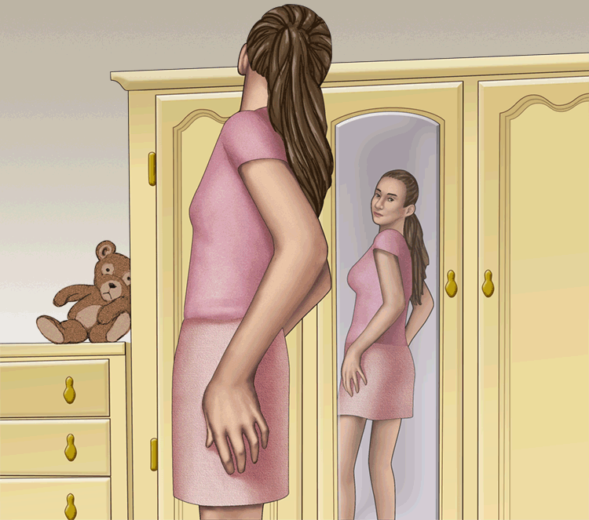
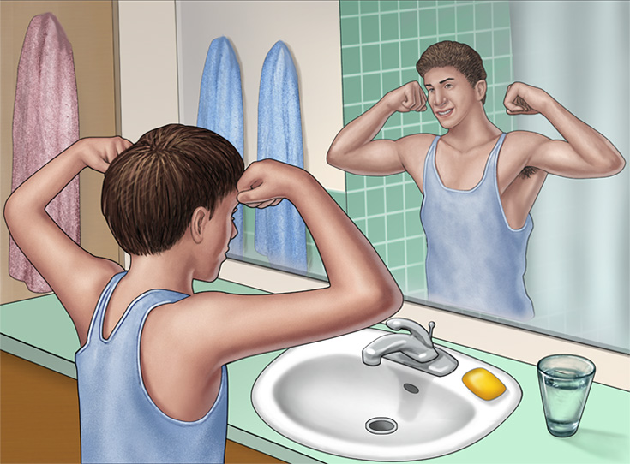
What's Happening to my Body?

Slide 23
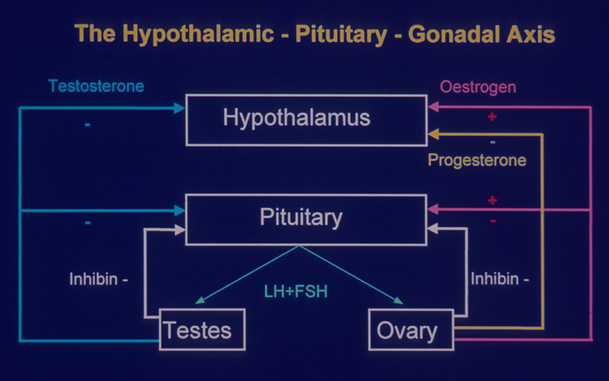

Slide 24
Puberty
Physiological transition from childhood to reproductive maturity
Associated with:
  Growth spurt
  Appearance of both primary and secondary sexual characteristics in children
  Occurs between 8 and 14yrs in girls
  Occurs between 9 and 14yrs in boys

Slide 25
Physical Changes
5 stages from childhood to full maturity
Marshall and Tanner (P1 – P5)
Reflect progression in changes of the external genitalia and of sexual hair
Secondary sexual characteristics
  Mean age 10.5yrs in girls
  Mean age 11.5 – 12yrs in boys

Slide 26
Puberty: Girls
Breast enlargement usually first sign.
Thelarche
Often unilateral
Menarche usually 2-3 yrs after breast development
Growth spurt peaks before menarche
Pubic and axillary hair growth: sign of adrenal androgen secretion
Starts at similar stage of apocrine gland sweat production and associated with adult body odour

Slide 27
Pubertal Stages (Tanner)
Female
P1 Prepubertal
P2 Early development of subareolar breast bud +/- small amounts of pubic and axillary hair
P3 Increase in size of palpable breast tissue and areolae, increased dark curled pubic/axillary hair
P4 Breast tissue and areolae protrude above breast level. Adult pubic hair but no spread to medial thighs.
P5 Mature adult breast. Pubic hair extends to upper thigh

Slide 28
Menarche
During puberty oestradiol levels fluctuate widely (reflecting successive waves of follicular development that fail to reach ovulatory stage)
Endometrium affected by oestradiol. Undergoes cycles of proliferation and regression until point where withdrawal of oestrogen results in the first menstrual bleed (menarche)
Increase of only 4% of final height after menarche

Slide 29
Puberty: Boys
First signs often go unnoticed
Testicular enlargement (12-13 yrs)
Prepubertal testis – 2mls diameter
Puberty begins when volume reaches 4mls
Penile and scrotal enlargement occur approx 1 yr after testicular enlargement. Pubic hair appears at same time

Slide 30
Pubertal Growth Spurt: Boys
Occurs later than in females
Testosterone less of a stimulus to GH responsiveness than oestradiol
Testosterone required in larger concentrations to produce same anabolic effect
Greater and later growth spurt in boys

Slide 31
Pubertal Stages (Tanner)
Male
P1 Prepubertal, testicular volume < 2mls
P2 Enlargement of scrotum and penis. Scrotum slightly pigmented. Few long dark pubic hairs
P3 Lenghtening of penis. Further growth of testes and scrotum. Pubic hair darker, coarser and more curled
P4 Penis increases in length and thickness. Increased pigmentation of scrotum. Adult pubic but no spread to medial thighs
P5 Genitalia adult in size and shape. Pubic hair spread to thighs

Slide 32
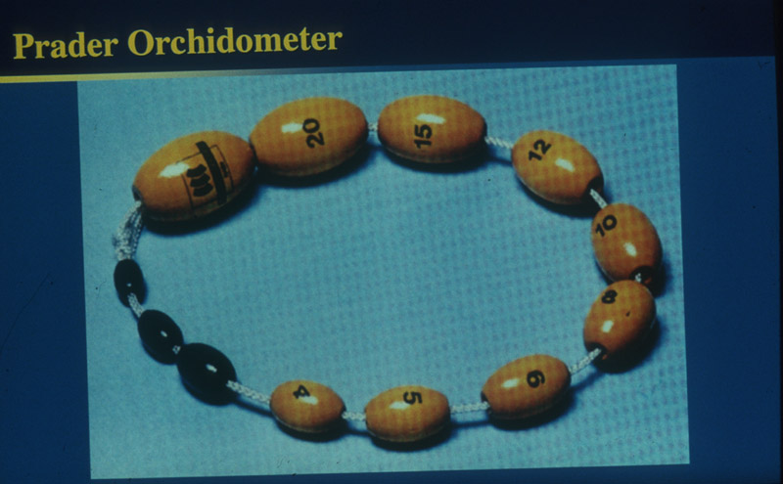
Secondary sexual development
First signs of puberty
  Testicular volume of 4mls
  Slight progressive increase in scrotal folds
  Slight increase in scrotal pigmentation

Slide 33
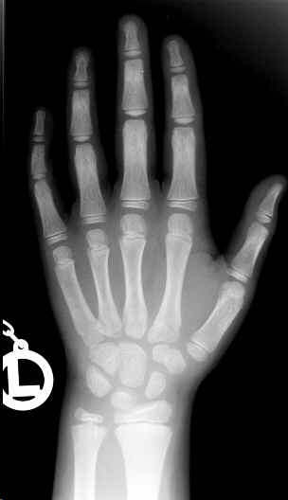
Final height
Puberty usually completed within 3 - 4 yrs of onset
Left wrist x-ray to assess bone age
Final adult height results from complete fusion of epiphyses
  Occurs approx 2yrs after menarche

Slide 34
What is abnormal?
Delayed Puberty
Early or Precocious Puberty
  More common in females
  Uncommon in males (usually pathological)
  < 8yrs in females
  < 9yrs in males
  May be associated with a growth spurt

Slide 35
Hypogonadism
What is Delayed Puberty?
In girls, no breast development by 13 years, or no periods by 15 years or by 2 years after breast development.
In boys, no testicular enlargement by 14 years

Slide 36
Menarche is frequently delayed, breast development is often poor, and patients are frequently oligomenorrheic or amenorrheic, even if menarche occurs.

Slide 37
Boys frequently develop no or sparse facial and body hair and tend to have decreased libido, even if sperm production does occur.

Slide 38
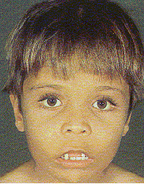

Slide 39
Diabetes Mellitus

Slide 40
^{Diabetes: A global emergency}

Slide 41
^{Diabetes around the world}

Slide 42
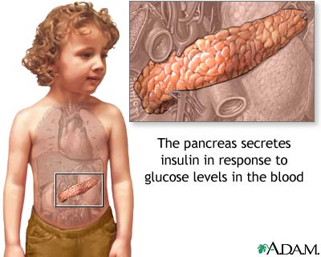
Diabetes mellitus
What is it?
Not enough insulin hormone

Slide 43

Diagnosis of Diabetes
Category | Plasma Glucose (mmol/l)
 | Fasting | 2h Post-Glucose Load
Diabetes mellitus | ≥ 7.0 | ≥ 11.1
Impaired glucose tolerance (IGT) | < 7.0 | 7.8 – 11.0
Impaired fasting glycaemia (IFG) | 6.1 – 6.9 (WHO) 5.6 – 6.9 (ADA) | < 7.8 < 7.8
Not diabetic or glucose intolerant | ≤ 6.0 (WHO) ≤ 5.6 (ADA) | < 7.8
Category | Plasma Glucose (mg/dl)
 | Fasting | 2h Post-Glucose Load
Diabetes mellitus | ≥ 126 | ≥ 200
Impaired glucose tolerance (IGT) | < 126 | 140 – 199
Impaired fasting glycaemia (IFG) | 110 – 125 (WHO) 100 – 125 (ADA) | < 140 < 140
Not diabetic or glucose intolerant | < 110 (WHO) < 100 (ADA) | < 140
Notes:
43

Slide 44
Glucose intolerance and diabetes mellitus are also common in thalassaemic patients. The severity of the clinical manifestation and laboratory findings in thalassaemia largely depends on the genotype; thus homozygotes or compound heterozygotes for the mutations beta0 or beta+ depend for life on frequent transfusions.

Slide 45
Glucose intolerance usually develops during the second decade of life, even though baseline blood sugar levels are frequently normal. Interestingly, the early lesion appears to be related more to insulin resistance than to defective insulin production. More effective iron chelation appears to improve glucose intolerance [36].

Slide 46
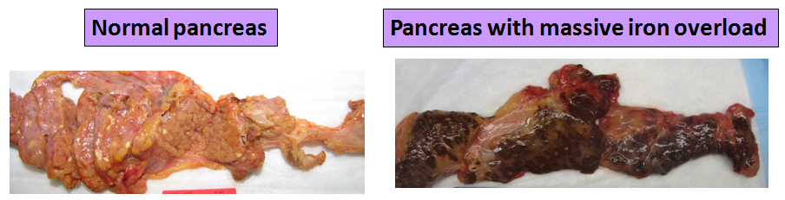
Diabetes mellitus
Both iron overload and glucocorticoids lead to:
↓in insulin secretion; and
↓ in insulin sensitivity

Slide 47


Diabetes and Thalassaemia
3rd Pan-European Conference on Haemoglobinopathies & Rare Anaemias
Limassol, 24 – 26 October 2012
Dr Maria Barnard & Dr Ploutarchos Tzoulis
Romilla Jones, Emma Prescott, Dr Farrukh Shah
The Whittington Hospital NHS Trust, London

Slide 48

The Diabetes Epidemic
Diabetes affects 366 million people worldwide
Predicted to affect 552 million people by 2030
Diabetes caused 4.6 million deaths in 2011
Every 10 seconds a person dies from diabetes-related causes
Every 10 seconds two people develop diabetes
Greatest number of people with diabetes are between 40 to 59 years of age
78,000 children develop type 1 diabetes each year
International Diabetes Federation. IDF Atlas, 5th edn. Brussels, Belgium: IDF, 2011. http://www.idf.org/diabetesatlas
Notes:
48

Slide 49
Diabetes in β-Thalassaemia Major
Diabetes prevalence ~20% (age, chelation therapy)
Aetiology and risk factors:
  Transfusional iron overload
  Poor chelation therapy, poor compliance, advanced age of onset
  Altered β-cell insulin secretion
  Autoimmunity
  Insulin resistance secondary to liver disease
  HCV infection
  Global epidemic – type 1/type 2 diabetes
Notes:
49

Slide 50
Early Diagnosis of Diabetes
Annual oral glucose tolerance tests (OGTT) from puberty or from age 10 years if there is a positive family history
  Prompt treatment of hyperglycaemia
  Intensification of iron chelation therapy
Thalassaemia International Federation. Guidelines for the Clinical Management of Thalassaemia. 2nd Revised Edition 2008. Available at: http://www.thalassaemia.org.cy/publications.html
United Kingdom Thalassaemia Society. Standards for the Clinical Care of Children and Adults with Thalassaemia in the UK. 2nd Edition 2008. Available at: http://www.ukts.org/pdf.html
Notes:
50

Slide 51
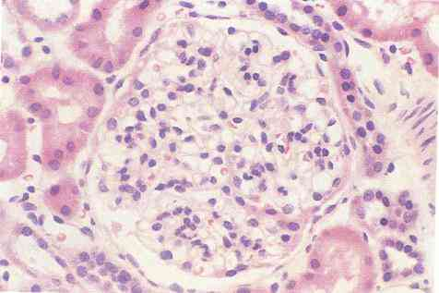
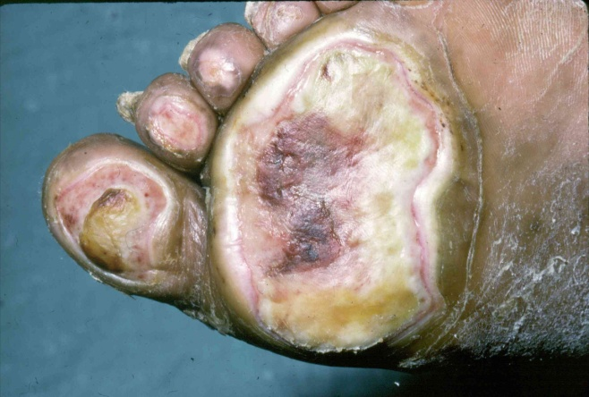
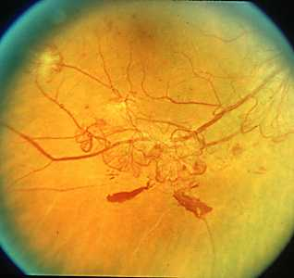
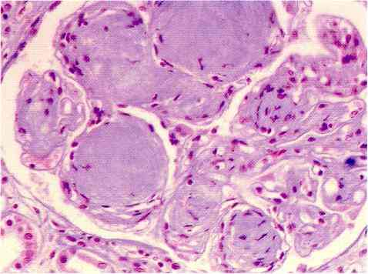
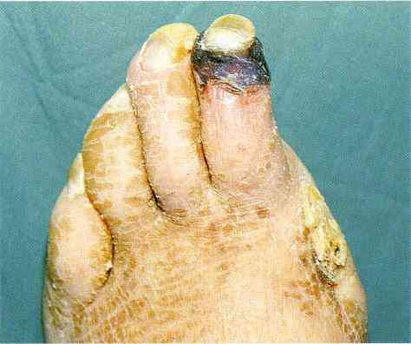
Aim of Treatment
Prevention, detection and management of complications
Microvascular & Macrovascular
Background retinopathy
Kidney glomerulus
Neuropathic foot ulcer
Proliferative retinopathy
Glomerular sclerosis
Ischaemia
Notes:
51

Slide 52
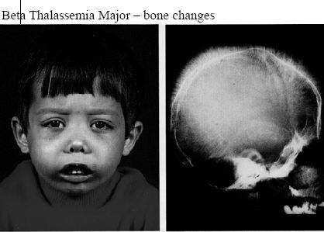

Slide 53
Hypothyroidism

Slide 54
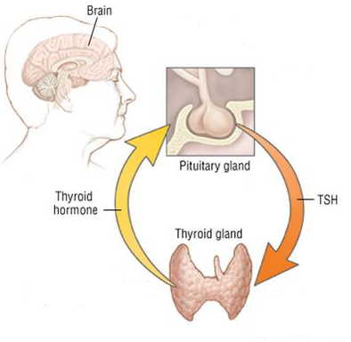
Hypothyroidism
What is it?
Insufficient thyroid hormone

Slide 55
Primary hypothyroidism and hypoparathyroidsm usually appear in the second decade of life; are related to iron overload and may be reversible at an early stage by intensive chelation.

Slide 56
قصور الدرق البدئي
* سريريا:
أولا:الولدان(الفدامة):
-تحدث عند الولدان في المناطق ذات الوارد اليودي القليل.
-تترافق مع تأخر عقلي-قصر قامة-انتفاخ الوجه و اليدين- صمم-بكم-فتق سري-امساك- ضعف رضاعة-خشونة جلد-يرقان .
ثانيا:الأطفال:
-تأخر نمو-تأخر عقلي-و قد يحدث بلوغ باكر-كبر حجم السرج التركي مع قصر قامة.
ثالثا:البالغين:
-سرعة تعب-شعور بالبرد-كسب وزن-امساك-اضطراب بالطمث- انتفاخ بالوجه و اليدين-بحة صوت-بطء منعكسات-جفاف و خشونة الجلد-بطء قلب-فرط ضغط الدم.

Slide 57
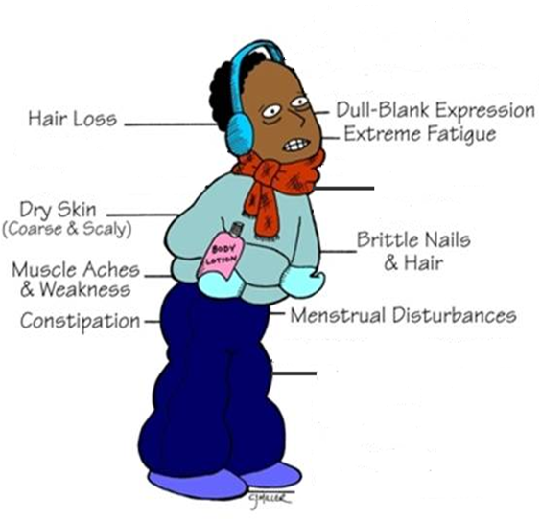
Hypothyroidism
Feeling cold
out of ordinary
Not growing well
Or, no symptoms at all!!! ( especially in early stages)
Notes:
How you may feel?

Slide 58
قصور الدرق البدئي
* التشخيص:
ارتفاع TSHمع انخفاض FT4
ايجابية أضداد الدرق يشير الى التهاب درق هاشيموتو.

Slide 59
قصور الدرق البدئي
* العلاج :
- يعالج بالليفوتيروكسين .
- الجرعة:0.05 -0.2 مغ / اليوم و بشكل وسطي 0.125 مغ / اليوم .
- من الأفضل تناول العلاج صباحا على الريق .
- تختلف الجرعة حسب عمر المريض و وزنه .

Slide 60
Osteoporosis

Slide 61
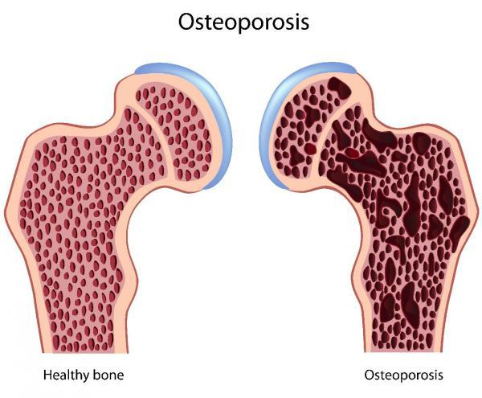
Bone disorders
How?

Slide 62
Osteopenia and osteoporosis due to a complicated pathogenesis represent prominent causes of morbidity in young adults of both genders with thalassaemia.

Slide 63
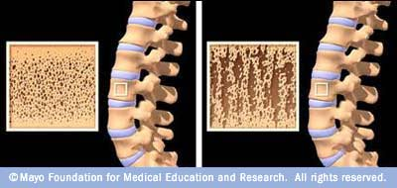
Etiology
Nutritional and gastrointestinal disorders
  malnutrition,
  parenteral nutrition,
  malabsorption syndromes,
  gastrectomy,
  severe liver disease (especially biliary cirrhosis),
  pernicious anemia.
Endocrine disorders
  Cushing's syndrome,
  hyperparathyroidism
  thyrotoxicosis,
  insulin-dependent diabetes mellitus,
  acromegaly,
  adrenal insufficiency
Hypogonadal states
  Turner syndrome,
  Klinefelter syndrome,
  Kallmann Syndrome,
  anorexia nervosa,
  hypothalamic amenorrhea,
  hyperprolactinemia.
Hematologic disorders/malignancy
  multiple myeloma,
  lymphoma and leukemia,
  mastocytosis,
  hemophilia,
  thalassemia.

Slide 64
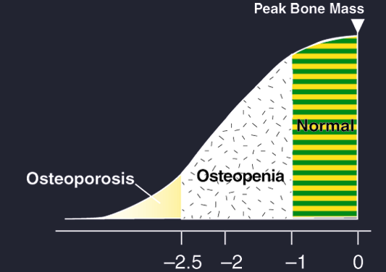
World Health Organization (WHO) Osteoporosis Guidelines
Bone Mineral Density Values
Mean Lumbar Spine BMD:
Decades 3 to 9 of a Woman’s Life
1.4
Mean
–2 SD
Consider preventive intervention
Consider therapeutic intervention
1.3
1.2
1.1
BMD
1.0
0.9
0.8
0.7
0.6
0.5
0.4
0.3
20
30
40
50
60
70
80
T-Score
Age
WHO, Guidelines for Preclinical Evaluation and Clinical Trials in Osteoporosis, 1998.
Adapted from AACE Guidelines. Endocr Pract. 2001;7:293-312.

Slide 65
Bone disorders
Hypogonadism
Low Vitamin D & parathyroid gland failure
Iron overload
Weak bones
? Low Growth hormone
Diabetes mellitus
Glucocorticoids
Multiple causes of poor bone density in DBA patients

Slide 66
Hypoparathyroidism

Slide 67
Patients with beta thalassemia major had higher rates of multiple endocrinopathies, worse hyperglycemia, subclinical hypoparathyroidism, and hypercalciuria. All were found to correlate with higher ferritin concentrations.

Slide 68
قصور جارات الدرق
تتراوح نسبة حدوث قصور جارات الدرق عند مرضى التلاسيميا بين 4,5 - 20 % .
يتراوح العمر عند التشخيص بين 11- 24 سنة .
لا يعاني معظم مرضى التلاسيميا المصابين بقصور جارات الدرق من أعراض سريرية لنقص كالسيوم الدم و لذلك ينصح بالمسح السنوي اعتبارا من عمر العاشرة .

Slide 69
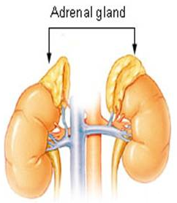
Adrenal insufficiency
What is it?
Not enough adrenal hormones
Stress hormone (cortisol)
Salt retaining hormone (Aldosterone)
Male hormones

Slide 70
قصور الكظر
يمكن أن يسبب عدم تشخيص قصور الكظر لدى المرضى الوفاة في حال الاصابة بحالات مرضية حادة .
تتنوع نسبة انتشار قصور الكظر بين 0 – 45 % بسبب اختلاف الفحوص التشخيصية المستخدمة .
متوسط عمر المرضى عند التشخيص 13,5 سنة .
لا بد من تقييم مستوى الكورتيزول عند مرضى التلاسيميا بعد عمر عشر سنوات .

Slide 71
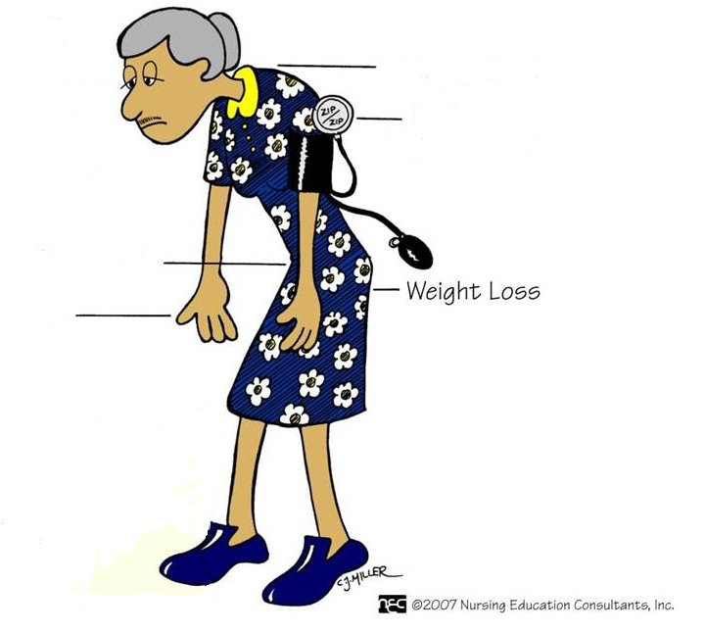
Adrenal insufficiency
Dark color of non-sun- exposed areas
Low BP and dizziness
Extreme tiredness
Nausea, vomiting, abdominal pain, diarrhea, constipation
Muscle weakness
Symptoms may be missed or attributed to anemia or missed!
Notes:
Although the picture I have used is of an old lady, not everybody who develops this is old

Slide 72
Early recognition and prevention of the endocrine complications, by early and regular chelation therapy, is mandatory for the improvement of the quality of life and psychological outcome of these patients.

Slide 73
التوصيات
يجب معالجة مرضى التلاسيميا الذين يعانون من تأخر البلوغ بالاستراديول أو أحد مشتقات الاستروجين عند الاناث و حقن التستستيرون عند الذكور من أجل تحريض عملية البلوغ .
يجب مراقبة قصور الغدة الدرقية سنويا عند مرضى التلاسيميا الذين تجاوزوا عمر عشر سنوات ،و يعالج قصور الدرق بالتيروكسين .

Slide 74
التوصيات
يجب أن يجرى فحص تحمل الغلوكوز الفموي سنويا عند مرضى التلاسيميا اعتبارا من عمر عشر سنوات فما فوق .
يجب أن يعالج مرضى التلاسيميا المصابين بعدم تحمل الغلوكوز بواسطة الحمية و تخفيف الوزن في حال زيادته و المعالجة المكثفة في خلب الحديد .
يجب أن يعالج مرضى التلاسيميا المصابين بالسكري بواسطة الانسولين .

Slide 75
التوصيات
يجب ضمان تناول الكمية الكافية من الكالسيوم و فيتامين D لجميع مرضى التلاسيميا و تشجيعهم على الرياضة و الامتناع عن التدخين .
يجب تقييم مستويات الكالسيوم و فيتامين D و الزنك عند مرضى التلاسيميا سنويا ابتداء من سن العاشرة .
يجب دراسة كثافة العظم مرة سنويا اعتبارا من عمر العاشرة.

Slide 76
التوصيات
يجب استقصاء قصور جارات الدرق فوق سن العاشرة .
يعالج قصور جارات الدرق بدواء الكالستيريول مع أو بدون الكالسيوم .
يجب مراقبة قصور الكظر سنويا عند مرضى التلاسيميا فوق عمر عشر سنوات و خاصة المرضى الذين يعانون من الهزال .

Slide 77
Thank you

