Slide 1
The Role of SGLT-2 Inhibitors in the Management of Patients with Type 2 Diabetes

Slide 2
(T2DM) accounts for >90% of all cases of diabetes in the United States.
More than 200,000 people die each year ,making it the sixth leading cause of death.
All evidence suggests that the prevalence of type2 diabetes will continue to increase both in the US and in the rest of the world

Slide 3
The development of diabetes is projected to reach pandemic proportions over the next10-20 years.
International Diabetes Federation (IDF) data indicate that by the year 2025, the number of people affected will reach 333 million –90% of these people will have Type 2 diabetes.

Slide 5
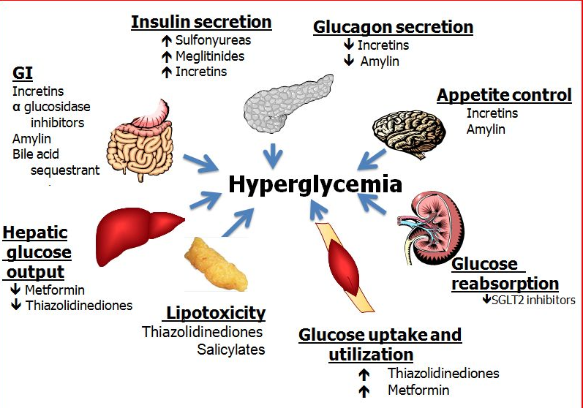

Slide 9
Challenges in Type 2 Diabetes
Large number of patients
Diabetes affects 25.8 million people (8.3 % of the US population)
DIAGNOSED- 18.8 million people
UNDIAGNOSED- 7.0 million people
PREDIABETES – 79 million people
Progressive worsening of insulin secretory deficit requiring increased number of antihyperglycemic medications over time
Risk for hypoglycemia with some therapies
Risk for weight gain with some therapies
Difficulty controlling postprandial glucose and glucose fluctuations
Preventing and managing complications and co-morbidities
Difficulty attaining and sustaining optimal long-term glycemic control

Slide 10
Limitations Conventional Antihyperglycemic Therapies
Many therapies are associated with weight gain
Insulin and non incretin oral insulin secretagogue therapies are associated with significant risk for hypoglycemia
Other AEs with some therapies include GI side effects and edema
Many therapies fail to adequately control postprandial hyperglycemia
Therapies often fail to maintain long-term glycemic control

Slide 11
Features Of The Ideal Antidiabetes Medication
Effective long-term control of hyperglycemia
No risk for hypoglycemia
Causes weight loss
Improves CV outcomes
Safe
Tolerable
affordable

Slide 14
Sodium- Glucose Cotransporters

Slide 16
Altered Renal Glucose Control in Diabetes
Gluconeogenesis is increased in postprandial and postabsorptive states in patients with Type 2 DM
Renal contribution to hyperglycemia
3-fold increase relative to patients without diabetes
Glucose reabsorption
Increased SGLT-2 expression and activity in renal epithelial cells from patients with diabetes vs. normoglycemic individuals

Slide 17
(SGLT2) Inhibitors are a novel class of agents that lower plasma glucose by blocking renal glucose reabsorption,
As well as increase the renal threshold for glucose excretion.
Inducing glucosuria (glucose in the urine)

Slide 26
SGLT2 Inhibition :Potential Clinical Benefits In T2DM
Insulin-independent mechanism
Glucose lowering with a low risk for hypoglycemia
Osmotic diuresis resulting in initial weight loss
Loss of excess glucose in the urine leading to sustained weight loss

Slide 27
SGLT2 Inhibitors :Efficacy
Reduce HBA1c by ˷0,4%- o.9%
Reduce weight by ˷3-4 kg
Reduce SBP by ˷5-6 mm hg

Slide 35
Safety: Malignancies
Bladder cancer incidence rate:
0.16% patients (n=5,478) treated with dapagliflozin vs 0.03% patients (n-3,156) in placebo group (p = 0.15)
Breast cancer incidence rate:
0.4% patients (n=2,223) treated with dapagliflozin vs 0.09% patients (n=1,053) in placebo group (p = 0.27)

Slide 38
summary
SgLT2 inhibitors are generally well tolerated
SGLT2 inhibitors are associated with an increase in GMIs,but these are generally mild to moderate and respond well to treatment
SGLT2 inhibitors do not increase the risk for fractures
Ongoing outcomes studies are evaluating the long-term effect of SGLT2 inhibitors on CV events

Slide 39
Patient Selection Criteria For Therapy With An SGLT2 Inhibitor
Patient not at target HBA1c
Overweight or obese
Difficulty controlling blood pressure
Adequate renal function

Slide 40
Ideal T2DM Patients For SGLT2 Inhibitors
Those who do not tolerate metformin
Patients unable to sustain glucose lowering effect on metformin
These not at goal on insulin therapy
In individuals where you would like to see weight loss
Those with good renal function
Concern in the elderly and those at risk for hypotension

Slide 43
Changes from Baseline in A1C in Dapagliflozin Studies

Slide 44
Changes from Baseline in Fasting Plasma Glucose in Dapagliflozin Studies

Slide 45
Changes from Baseline in Body Weight in Dapagliflozin Studies

Slide 46
Dapagliflozin as Add-on Therapy: Summary and Conclusions
Add-on to metformin in patients inadequately controlled with metformin alone
Favorable safety parameters and tolerability
Improved glycemic control
Lowers weight
Not associated with risk for hypoglycemia
Adverse events occurred in similar proportions
Events suggestive of urinary tract infection were 8%, 4%, 7%, and 8% for placebo, DAPA 2.5mg, 5mg, and 10mg groups, respectively
Events suggestive of genital infection were 5%, 8%, 13%, and 9% for placebo, DAPA 2.5mg, 5mg, and 10 mg groups respectively
Hypoglycemic events occurred in 3%, 2%, 4%, and 4% of patients in placebo, DAPA 2.5mg, 5mg, and 10 mg groups respectively

Slide 47
Dapagliflozin as Add-on Therapy: Summary and Conclusions
Add-on to glimepiride in patients poorly controlled sulfonylurea therapy
Significantly improved mean A1C
Reduced weight
Well-tolerated
Adverse events were similar across all treatment groups
Events suggestive of urinary tract infection were 6.2%, 3.9%, 6.9%, and 5.3% for placebo, DAPA 2.5mg, 5mg, and 10mg groups, respectively
Events suggestive of genital infection were 0.7%, 3.9%, 6.2%, and 6.6% for placebo, DAPA 2.5mg, 5mg, and 10 mg groups respectively
Hypoglycemic events occurred in 4.8%, 7.1%, 6.9%, and 7.9% in patients for placebo, DAPA 2.5mg, 5mg, and 10 mg groups respectively

Slide 48
Dapagliflozin as Add-on Therapy: Summary and Conclusions
Add-on to insulin in patients poorly controlled with insulin
Sustained effectiveness and stable tolerability
Less likely to D.C or require insulin up-titration due to poor glycemic control versus placebo
Increased frequency of weight loss and reduced frequency of peripheral edema over time
Adverse events and discontinuations were balanced across groups
Actively solicited signs and symptoms suggestive of urinary tract (UTI) and genital infections (GI) were higher with dapagliflozin vs. placebo
Events suggestive of urinary tract infection occurred in 8.4% DAPA vs 4.1% placebo
Events suggestive of genital infection occurred in 7.2% DAPA vs 2.0% placebo

Slide 49
Dapagliflozin* vs. Glipizide as Add-on Therapy to Metformin: 2 Years
Urinary tract infection: 13.5% for dapagliflozin; 9.1% for glipizide
Genital infection: 14.8% for dapagliflozin ; 2.9% for glipizide

