Slide 1
Alkylating Agents
Dr.Muhammad Albaghdadi
Oncologist

Slide 2
HISTORY
Mechlorethamine- first alkylating agent-1942
Analogue of Sulphur mustard gas
Weapon in first world war-1917

Slide 3
Cont
Alkylating agents were the first anticancer molecules developed, and
they are still used today.
After more than 50 years of use, the basic
chemistry and pharmacology of this drug family is well understood
and has not changed substantially.

Slide 4
Alkylating Agents
Nitrogen Mustards
Aziridines
Alkyl Sulfonates
Nitrosoureas
Triazenes
Cyclophosphamide
Ifosfamide
Melphalan
Chlorambucil
Mechlorethamine
Thio TEPA
Busulfan
Carmustine
Lomustine
Streptozotocin
Dacarbazine
Temozolomide

Slide 5
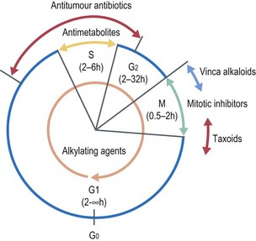
alkylating agents react with cells in all phases of the cell cycle

Slide 6
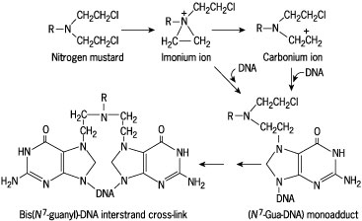
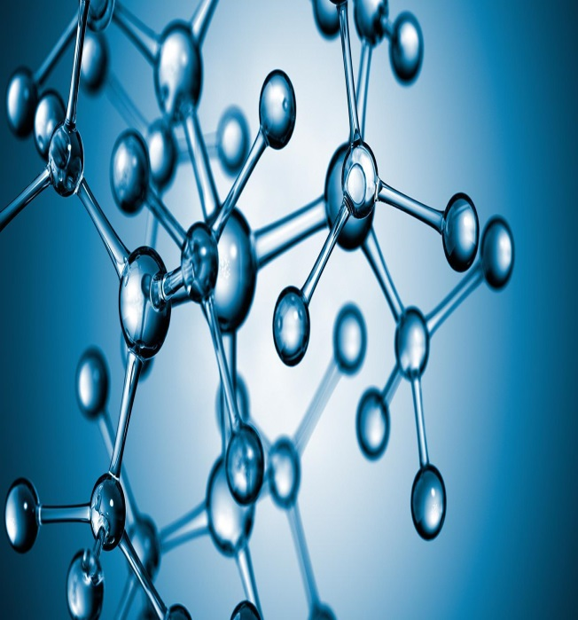
Mechanism of DNA alkylation by a reactive nitrogen mustard molecule and formation of interstrand cross-link

Slide 7
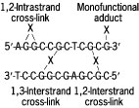
Monofunctional adducts and 1,2- and 1,3-interstrand and intrastrand cross-links induced by DNA interactive agents. X = antitumour agent.
MOA

Slide 8
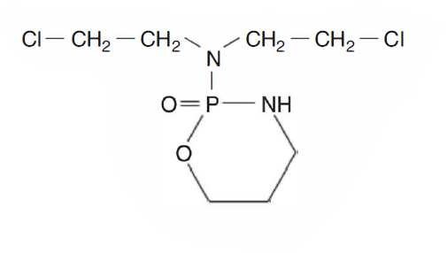
CYCLOPHOSPHAMIDE

Slide 9
Mechanism of Action
MOA
Inactive in parent form
Activated by liver cyt- p450 to cytotoxic metabolites PM & acrolein
DNA adduct

Slide 10
PHARMACOKINETICS
ROA- iv in Dextrose 5% or NaCl 0.9 %, Oral
Absorption bioavailability 90%
Vol of Dist-0.6L/Kg
Distribution-including brain & csf,also in milk & saliva
Protein binding- <20%
Cyclophosphamide & Ifosfamide

Slide 11
PHARMACOKINETICS
Metabolism- Prodrug activation by Cyt-p450 active forms are 4 hydroxycyclophosphamide phosphoramide mustard & acrolein
Elimination-t1/2- 4-6 hours parent drug & metabolites exclusively in urine
Cyclophosphamide & Ifosfamide

Slide 12
Indications
Breast Cancer
Ovarian Cancer
Sarcoma
NHL
High dose regimen-in bone marrow transplantation and for other autoimmune disorders

Slide 13
Dosage range
Breast cancer 100mg/m2 po days 1-14 every 28 days,iv 600mg/m2 every 21 days AC or CMF
NHL 400-600 mg/m2 iv every 21 days CVP,750mg/m2 every 21 days CHOP
High dose BMT 60mg/kg iv for 2 days

Slide 14
Special consideration
Caution in patients with abnl renal fuction
Encourage fluid intake 2-3l/day
Empty bladder several times daily

Slide 15
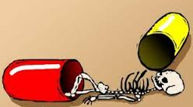
Toxicity
Myelosuppression- dose limiting mainly leukopenia 7-14 days
Nausea & vomiting 2-4 hrs
Alopecia 2-3 wks
Amenorrhoea with ovarian failure
Cardiotoxicity
Sec malig AML & bladder cancer
SIADH

Slide 16
TOXICITY
Hemorrhagic cystitis- Excretion of Acrolein
Rx
Adequate hydration
Continuous irrigation of bladder with MESNA (2mercaptoethanesulfonate)
Frequent bladder emptying
MESNA
Free sulfhydryl
Divided doses every 4 hrs- 60% of alkylating agents

Slide 17
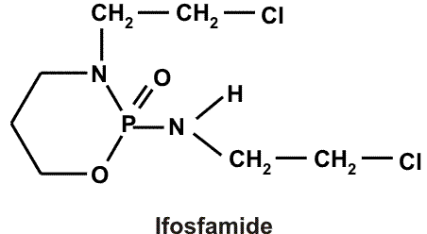
IFOSFAMIDE

Slide 18
PHARMACOKINETICS
ROA- oral or iv
Absorption- bioavailability 100%
Distribution- Widely distributed
Protein binding 20%
Metabolism in liver
Elimination- 50-70% excreted in urine
T1/2- 3 -10hrs

Slide 19
Indication
Osteogenic sarcoma
Ewing sarcoma
HL &NHL
Non small cell & small cell lung cancer
Bladder cancer
Recurrent germ cell tumors

Slide 20
Special consideration
Caution in patients with abnl renal function
Uroprotection with mesna & hydration
Monitor coagulation parameters

Slide 21
Toxicity
Myelosuppression
Bladder toxicity dose limiting
Alopecia >80 %
Amenorrhoea oligospermia

Slide 22
High dose ifosfamide
Neurotoxicity
Seizures, altered mental status,CN palsies, coma
Painful and acute exacerbation of peripheral sensory neuropathies and motor dysfunction of distal extremities
N-linked Chloroethyl
Chloro Acetaldehyde
TOXICITY
Recommendations
High risk - S.Cr>1.5mg or S.Albumin <3g/dl or both
Multiple day regimens reduce risk
Monitor-early signs(irritability,anxiety,hallucinations)
Terminate ifosfamide → Palliative therapy
N-Deethylation
Oxidation

Slide 23
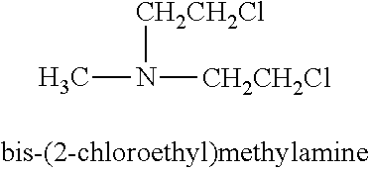
Mechlorethamine

Slide 24
Indication
HL
NHL
Cutaneous T cell lymphoma
Intrapleural intrapericardial intraperitoneal treatment of metastatic disease

Slide 25
Melphalan
Phenylalanine

Slide 26
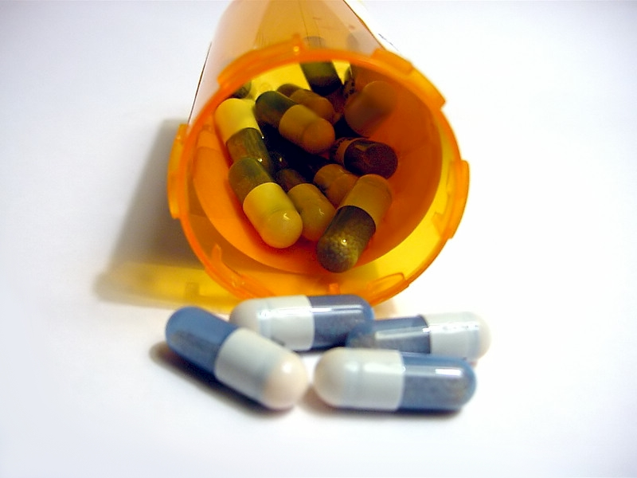
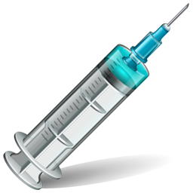
CLINICAL USE
Multiple Myeloma
Ovarian cancer
Myeloablative therapy
Bone marrow transplant
Melphalan

Slide 27
Chlorambucil
Aromatic Mustard

Slide 28
Indication
CLL
NHL
HL

Slide 29
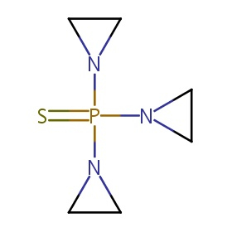
Thiotepa
Thiotepa

Slide 30
Indication
Breast cancer
Ovarian cancer
HL
NHL

Slide 31
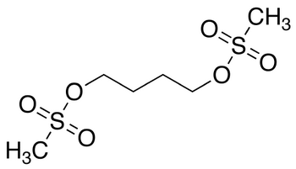
Busulphan
Busulphan

Slide 32
CLINICAL USE
CML
Myeloablative treatment- prior to BMT
Busulphan

Slide 33
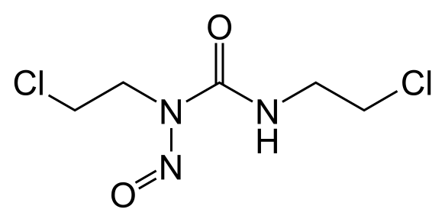
Carmustin (BiCNU)
Nitrosourea

Slide 34
CLINICAL USE
Brain tumour-GBM,glioma
Multiple Myeloma
Hodgkins Lymphoma,NHL
Nitrosourea

Slide 35
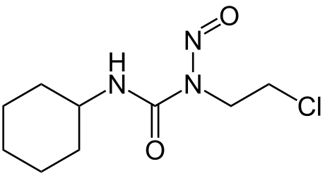
Lomustin
Nitrosourea

Slide 36
Indication
Brain tumor
HL
NHL

Slide 37
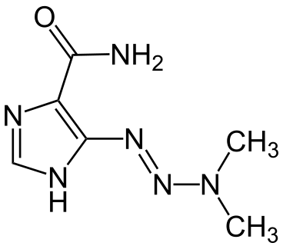
Dacarbazine
Nonclassic alkylating agent

Slide 38
Mechanism of Action
Methylates nucleic acids and inhibits DNA RNA & protein syn

Slide 39
PHARMACOKINETICS
ROA- iv
Absorption- slow & variable
Distribution- widely distributed
Protein binding- 20%
Metabolism- in liver
Elimination- 40 -60% unchanged in urine
t1/2- 5 hrs

Slide 40
Indication
Metastatic malignant melanoma
HL
Sarcoma
Neuroblastoma

Slide 41
Dosage range
HL 375mg/m2 iv D1 D15 every 28 days ABVD

Slide 42
Special consideration
Potent vesicant
Use of aggressive antiemetics
Avoid sunexposure

Slide 43
Toxicity
Flu like syndrome
CNS toxicity paresthesia neuropathies, ataxia,seizures
Photosensitivity
Teratogenic

Slide 44
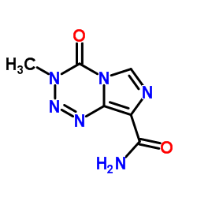
Temozolomide

Slide 45
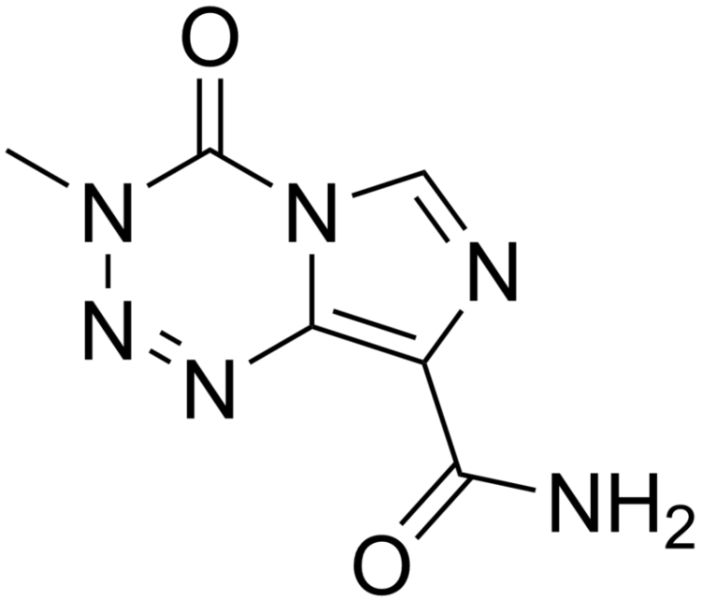
Temozolomide
Dacarbazine
Spontaneously releases the cytotoxic species 3-methyl-(triazen-1-yl) imidazole-4-carboxamide(MTIC)
Requires metabolic activation mediated by microsomal enzymes
CH3

Slide 46
Mechanism of Action
Imidazotetrazine analog
Methylates guanine residues(N7,O6) in DNA and inhibits DNA,RNA,protein syn
Cytotoxicity-formation of O6 methyl guanine adducts

Slide 47
PHARMACOKINETICS
ROA- Oral,iv
Absorption-
oral bioavailability 100%
Food reduces
Peak con- <1 h
Nitrosourea

Slide 48
PHARMACOKINETICS
CNS Penetration- High, CSF con 30-40% Selective distribution over tumour in brain
Metabolism- MTIC &AIC
Elimination-
Majority in urine 40-50%
t1/2- 1.8h
Nitrosourea

Slide 49
Dosage range
150mg/m2 po daily for 5 days -28 days
75mg/m2 po daily for 42 days with RT- GBM

Slide 50
CLINICAL USE
Glioma
Astrocytoma
Melanoma
Busulphan

Slide 51
Special consideration
Moderately emetogenic agent.
Avoid sun exposure after Rx
Caution in elderly patients

Slide 52
Toxicity
Myelosupression-Dose limiting toxicity
Photosensitivity
Teratogenic

Slide 55
Platinum Analogs
1-Cisplatin
2-Carboplatin
3-Oxaliplatin

Slide 56
History
1845 – Cisplatin first synthesized
1961 – Cisplatin’s cytotoxic effects discovered
by Dr. Barnett Rosenberg during a study on the
effect of electromagnetic radiation on E. Coli
growth
1978 – Cisplatin gains FDA approval for
testicular and ovarian cancers
1988 – Carboplatin gains FDA approval for
palliative treatment of recurrent ovarian
2002 – Oxaliplatin gains FDA approval for
metastatic colorectal 2nd line (2004 gains 1st lineapproval for advanced colorectal)

Slide 57
Cisplatin

Slide 58
INDICATIONS
FDA approved for
Metastatic testicular cancer in combination,
adjuvant
Metastatic ovarian cancer in combination,
adjuvant
Transitional cell bladder cancer

Slide 59
Cont
Brain tumor (peds)
Cervical cancer
Germ cell tumors
Head and Neck cancer
Lung cancer, small cell
and non-small cell
Neuroblastoma (peds)
Osteosarcoma (peds)
Esophageal cancer
Wilm’s (peds)

Slide 60
Cont
Adrenocortical cancer
Breast cancer
Endometrial cancer
Gastrointestinal cancer
Gynecological sarcoma
Hepatoblastoma
Malignant melanoma
Lymphoma
Thyroid cancer
Skin cancer

Slide 61
Side effect
Nephrotoxicity – Major dose limiting
toxicity
Severe and cumulative, noted in 28-36% of
patients following a single 50mg/m2 dose
Renal function MUST return to normal prior to
next dose
Requires aggressive hydration, ideally 1000ml
IV over 2 to 4 hours pre- and post- cisplatin
Preferably NS + KCl 20meq/L + Mag SO4 1 gm/L
Mannitol 12.5-25gm prior to cisplatin

Slide 62
Side effect
Ototoxicity
31% of patients following a single 50mg/m2 dose
Myelosuppresion
Occurs in 25-30% of patients
Nausea/vomiting
~ 100% incidence
Onset 1 to 4 hours post treatment, lasting up to 24 hours

Slide 63
Side effect
Electrolyte abnormalities
Magnesium, calcium, potassium, less often sodium, phosphate

Slide 64
Dosing
Testicular: Cisplatin 20mg/m2 IV daily x 5 days
every 3 weeks (BEP)
Ovarian: Cisplatin 75mg/m2 IV D1 every 3
weeks + paclitaxel
Single agent: Cisplatin 100mg/m2 IV D1 every 4
weeks
IP: Cisplatin 100mg/m2 IP D2 following paclitaxel IV
every 3 weeks, followed by IP paclitaxel D8
Bladder: 50-70mg/m2 IV every 3 to 4 weeks

Slide 65
Adminstrasion
Ensure aggressive hydration and
electrolyte replacement
Avoid aluminum containing needles or
administration sets
Must be diluted with a minimum ½ NS
solution, ideally to < 0.5mg/ml
Infuse over 30-60 minutes
Stable for 24 hours at room temperature

Slide 66
Carbopltin

Slide 67
Indications
FDA approved
Advanced ovarian cancer, in combination, 1st line and palliative
Other indications/ongoing trials
Locally advanced NSCLC, inoperable or recurrred
Neuroblastoma (peds)
Transitional cell cancer of the urothelium
Fallopian tube, 1o peritoneal cancer, endometrial cancer
SCLC
Breast cancer
Thyroid cancer
Colon cancer
Wilm’s tumor
Retinoblastoma

Slide 68
Sideeffect
Myelosuppression – dose limiting toxicity
Thrombocytopenia – 59% vs 35% cisplatin
Anemia – (<8 g/dL) 8% vs 24% cisplatin
Neutropenia – (<1000) 84% vs 78% cisplatin
Nadir 10 to 14 days
Nausea/vomiting
Moderate risk
Peripheral Neuropathy

Slide 69
Adminstration
No prehydration required
IV infusion over 30-60 minutes
Avoid aluminum containing needles or
administration sets
Compatible with NaCl 0.9% or D5W
Stable for 24 hours at room temperature

Slide 70
Oxaliplatin

Slide 71
INDICATIONS
FDA approved in Colorectal cancer; in
combination; first line in metastatic,
adjuvant in Stage III
Ongoing studies
Advanced nasopharyngeal cancer with concurrent
radiation
Gastrointestinal cancer
Pancreatic cancer
Cholangiocarcinoma
NHL
Germ Cell tumor
Ovarian cancer
Breast cancer
NSCLC

Slide 72
Sideeffect
Neuropathy
Frequency: 92%
Pulmonary toxicity
Rare (<1%), but potentially fatal pulmonary fibrosis
Hepatotoxicity
LFT’s and alk phos twice as likely in studies
Nausea/Vomiting
Pretreatment with 5-HT3 antagonist and dexamethasone
Myelosuppression

Slide 73
Adminstration
No prehydration required
Do not allow to come in contact with
aluminum
Compatible with D5W only – never dilute
with NaCl or other Cl containing solutions
Stable for 6 hours room temperature and
24 hours refrigerated

Slide 74
Nedaplatin and Lobaplatin
developed as a less
nephrotoxic second-generation platinum analog, has been shown
to be active in a range of tumors similar to that of cisplatin and carboplatin
It is licensed in China for
the breast cancer, small-cell lung cancer,
and chronic myelogenous leukemia.
It has not achieved approval
in the United States or Europe

